Slide 1
CREST
持続可能な水利用を実現する革新的な技術とシステム
安全で持続可能な水利用のための放射性物質移流拡散シミュレータの開発
あ
大気拡散シミュレーション分野
現状についての報告@2012/8/27
東京大学 大気海洋研究所
芳村圭

Slide 2
Updates
Dr. Eun-Chul Chang joined our team.
  Appointed for implementation of semi-lagrangian transport for tracers.
Realistic emission has been implemented.
Sensitivity of three parameters was examined.
  Wet deposition rate
  Dry deposition rate
  Horizontal diffusivity
Make the code transferable. (Eun-Chul and Saya have already started their calculations.)

Slide 3
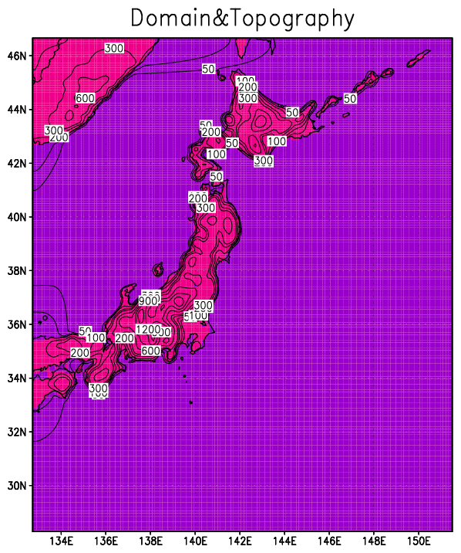
Radioactive Tracer Experiments with IsoRSM
Model:
  IsoRSM (Yoshimura et al., 2010)
Lateral Boundary Condition
  NCEP-R2 with Spectral Nudging
Domain/Resolution
  161x200/10km Mercator
  Lon: 132.7E to 151.5E
  Lat: 28.3N to 46.7N
Period
  2011/03/12 0Z – 3/28 0Z
Physical Processes
  RAS convective precipitation
  Non-Local K PBL
Tracer type / Emission
  ¹³¹I and ¹³⁷Cs
  Emitted at 140.9E/37.34N with Chino et al. (2011)
Deposition processes
  Next pages

Slide 4
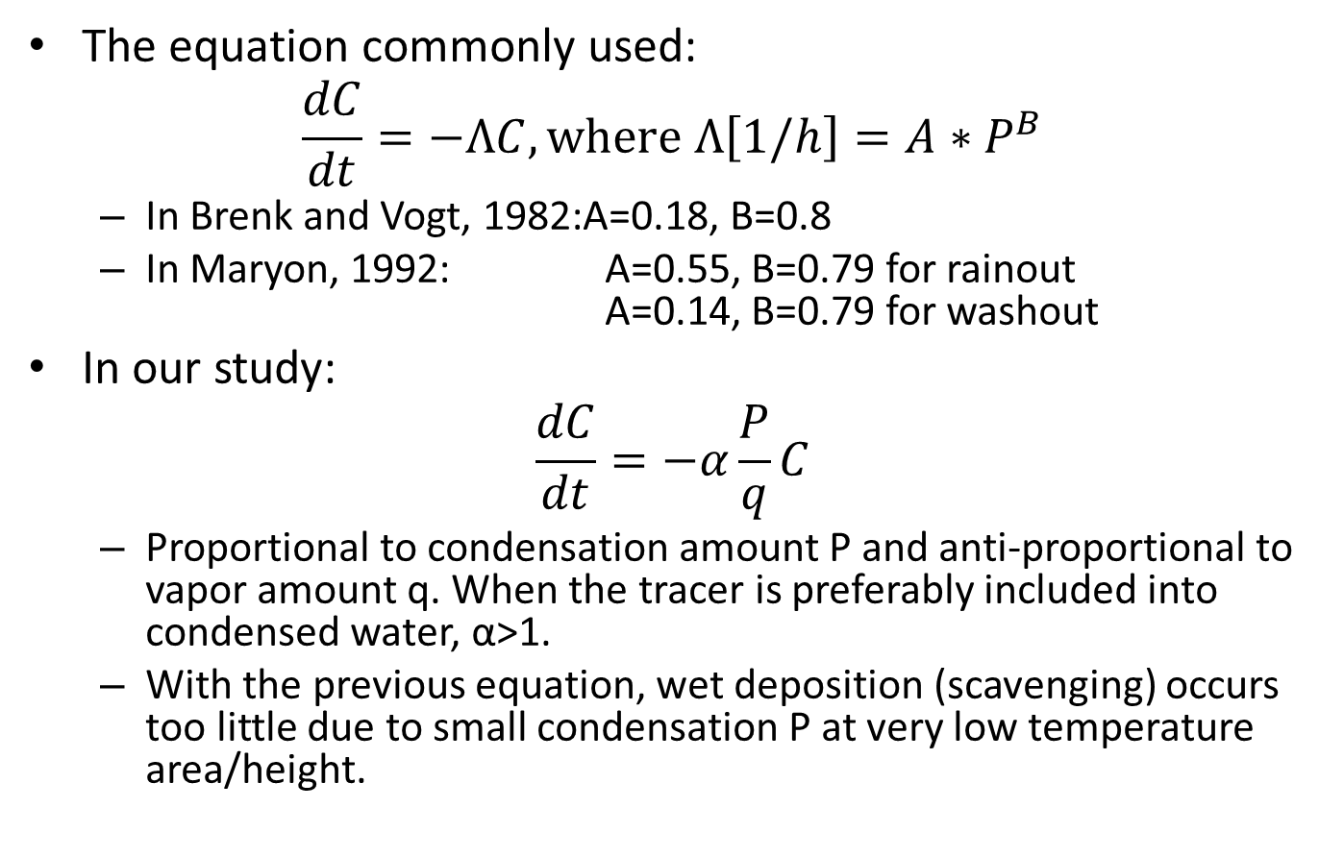
Wet Deposition
The equation commonly used:
$$\frac{dC}{dt}=−ΛC, where Λ\left[1/h\right]=A∗P^{B}$$
  In Brenk and Vogt, 1982:A=0.18, B=0.8
  In Maryon, 1992: A=0.55, B=0.79 for rainout
  A=0.14, B=0.79 for washout
In our study:
$$\frac{dC}{dt}=−α\frac{P}{q}C$$
  Proportional to condensation amount P and anti-proportional to vapor amount q. When the tracer is preferably included into condensed water, α>1.
  With the previous equation, wet deposition (scavenging) occurs too little due to small condensation P at very low temperature area/height.

Slide 5
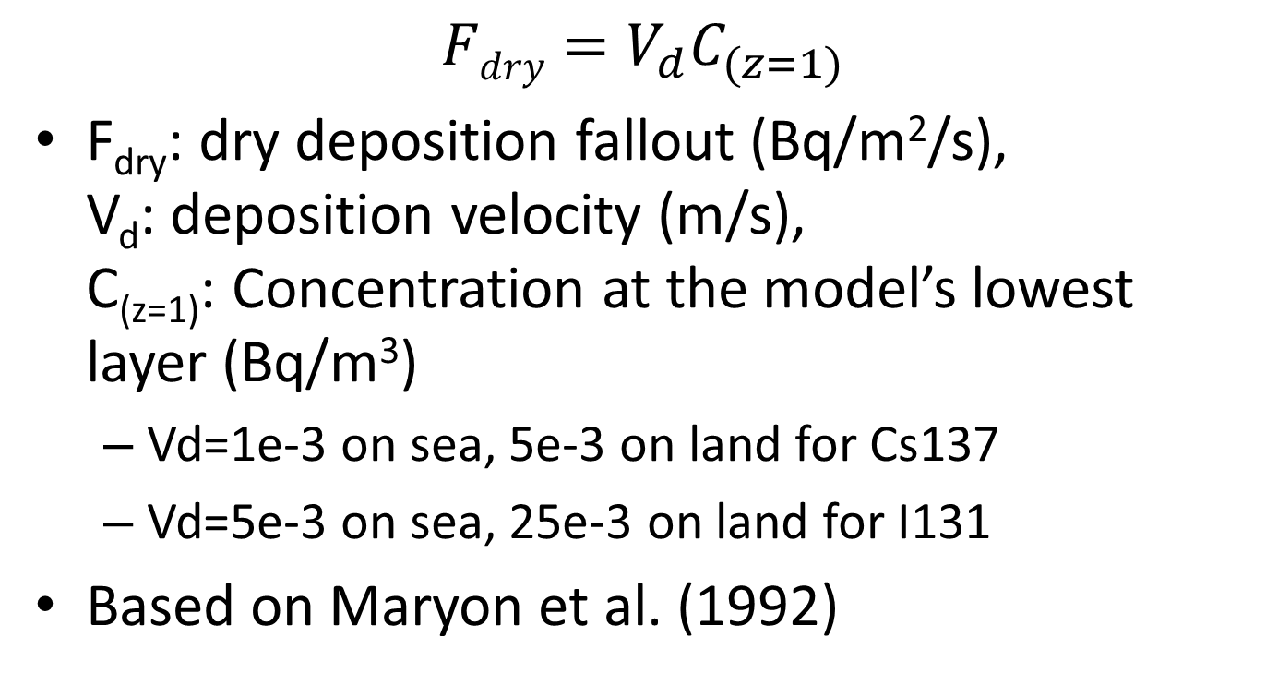
Dry Deposition
$$Fdry=V_{d}C_{(z=1)}$$
F_{dry}: dry deposition fallout (Bq/m²/s),
V_{d}: deposition velocity (m/s),
C_{(z=1)}: Concentration at the model’s lowest layer (Bq/m³)
  Vd=1e-3 on sea, 5e-3 on land for Cs137
  Vd=5e-3 on sea, 25e-3 on land for I131
Based on Maryon et al. (1992)

Slide 6
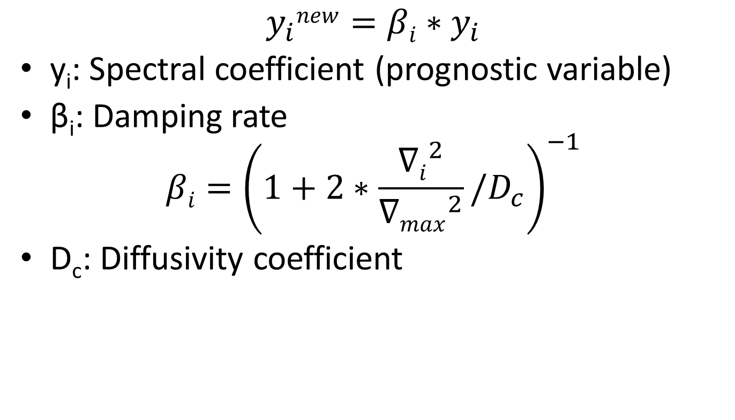
Horizontal Diffusion
$$y_{i}new=βi∗y_{i}$$
y_{i}: Spectral coefficient (prognostic variable)
β_{i}: Damping rate
$$βi={\left(1+2∗\frac{{∇i}^{2}}{{∇max}^{2}}/D_{c}\right)}^{−1}$$
D_{c}: Diffusivity coefficient
β

Slide 7
Parameters of Control Experiment
 |  | I131 | Cs137
α (ND) |  | 1 | 1
Vd (m/s) | Land | 25e-3 | 5e-3
 | Sea | 5e-3 | 1e-3
Dc (ND) |  | 0.2 | 0.2

Slide 8
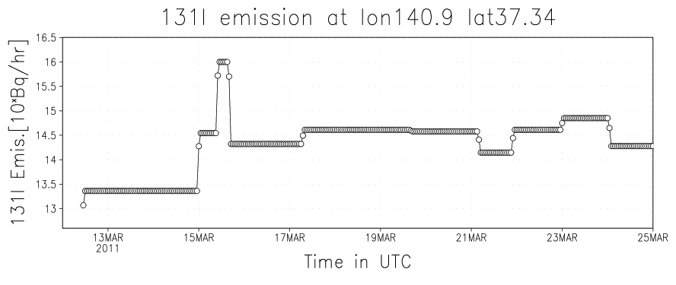
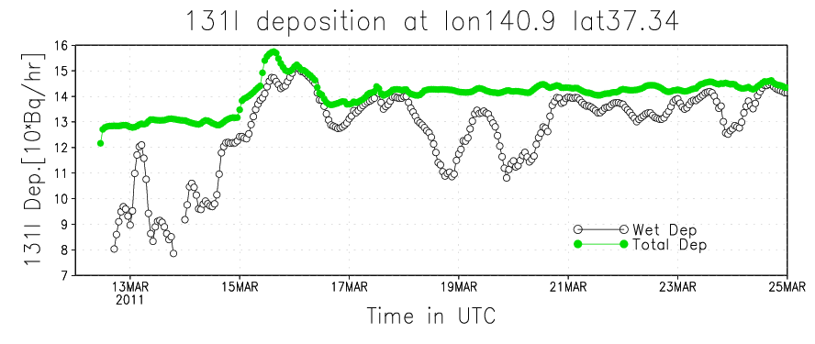
I131 Emission and Deposition
All Domain

Slide 9
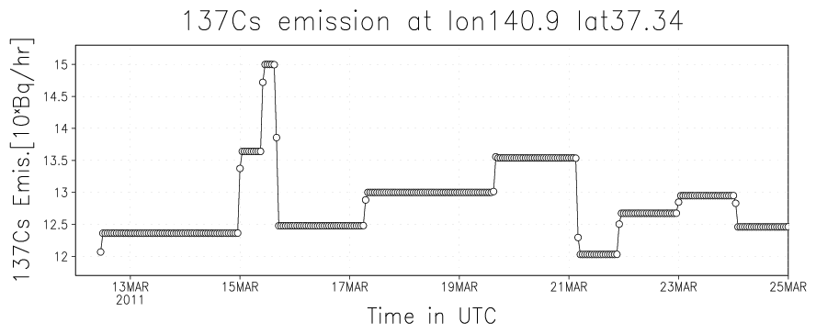
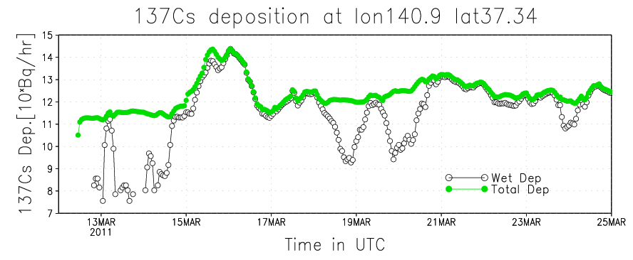
Cs137 Emission and Deposition

Slide 10
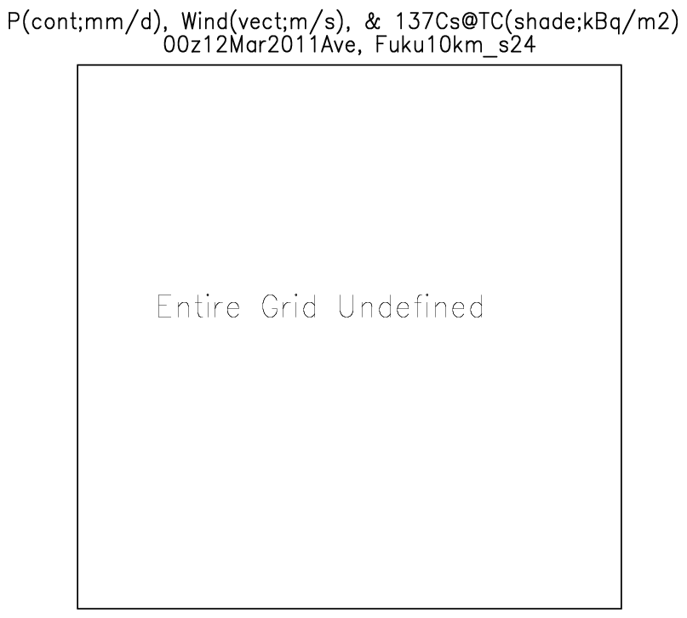

Slide 11
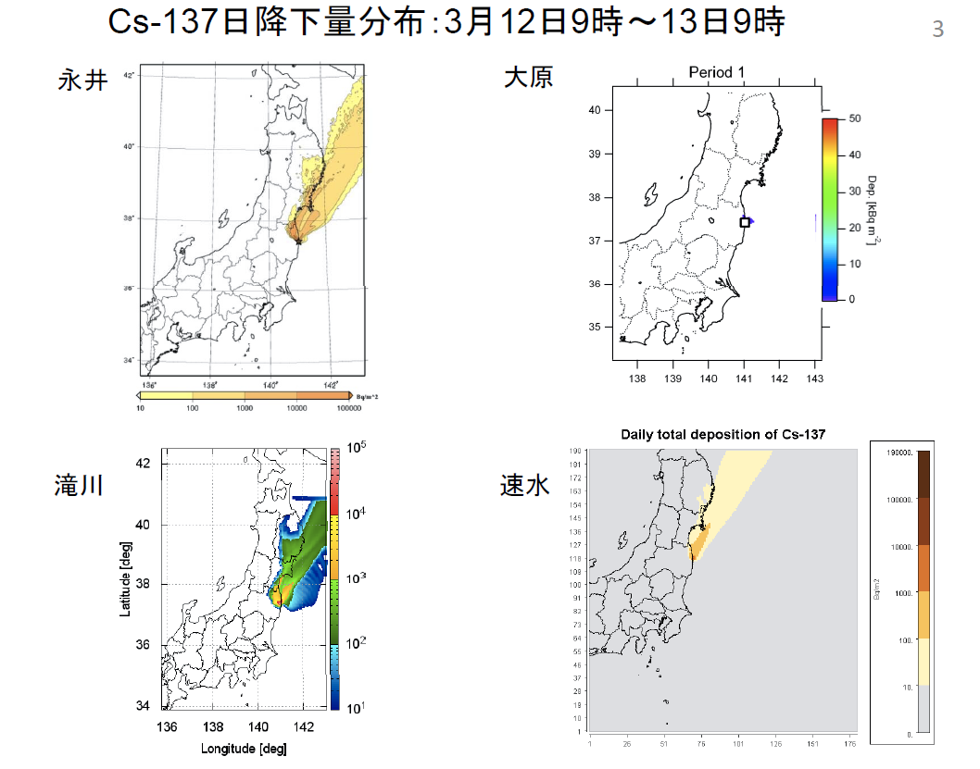
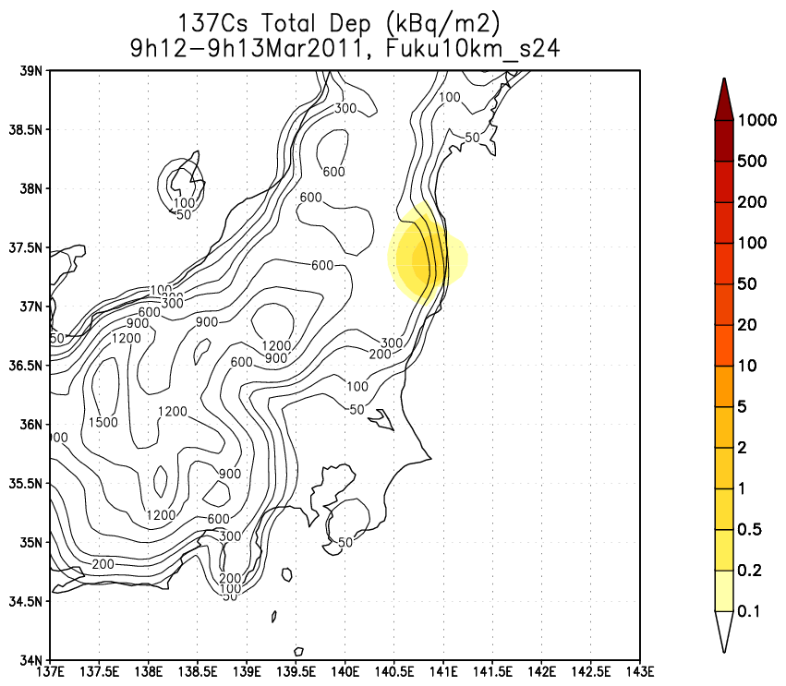
Comparison with similar effort (3/12)

Slide 12
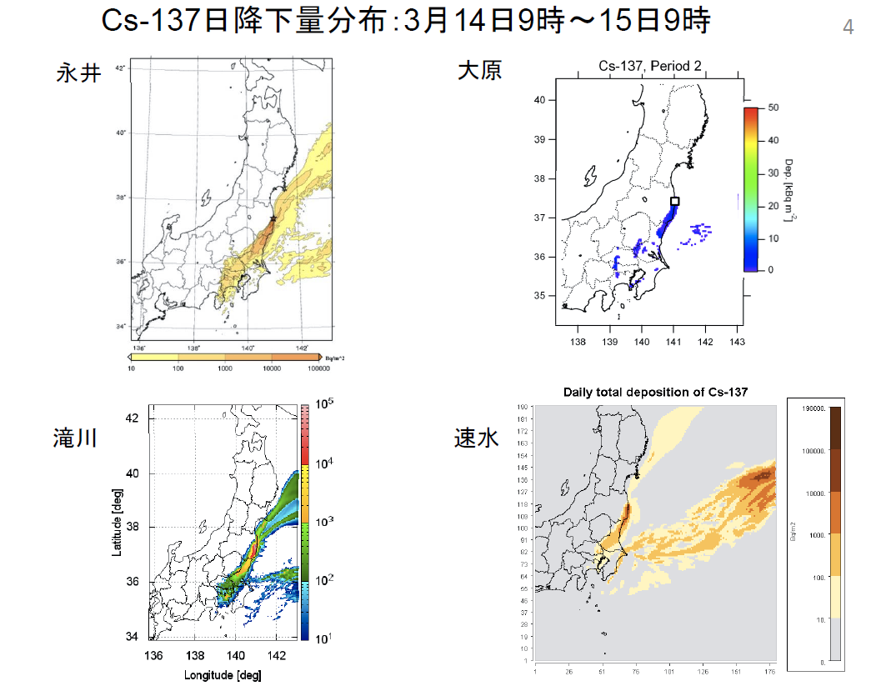
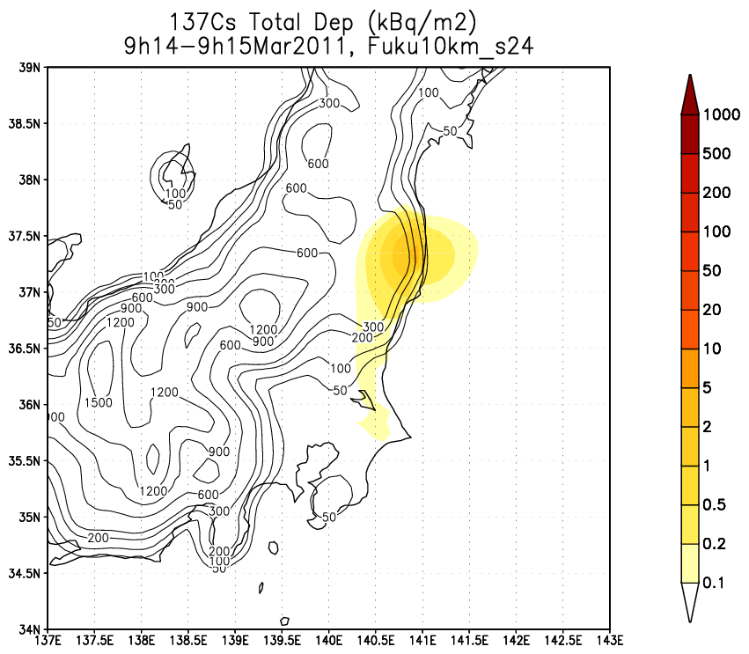
Comparison with similar effort (3/14)

Slide 13
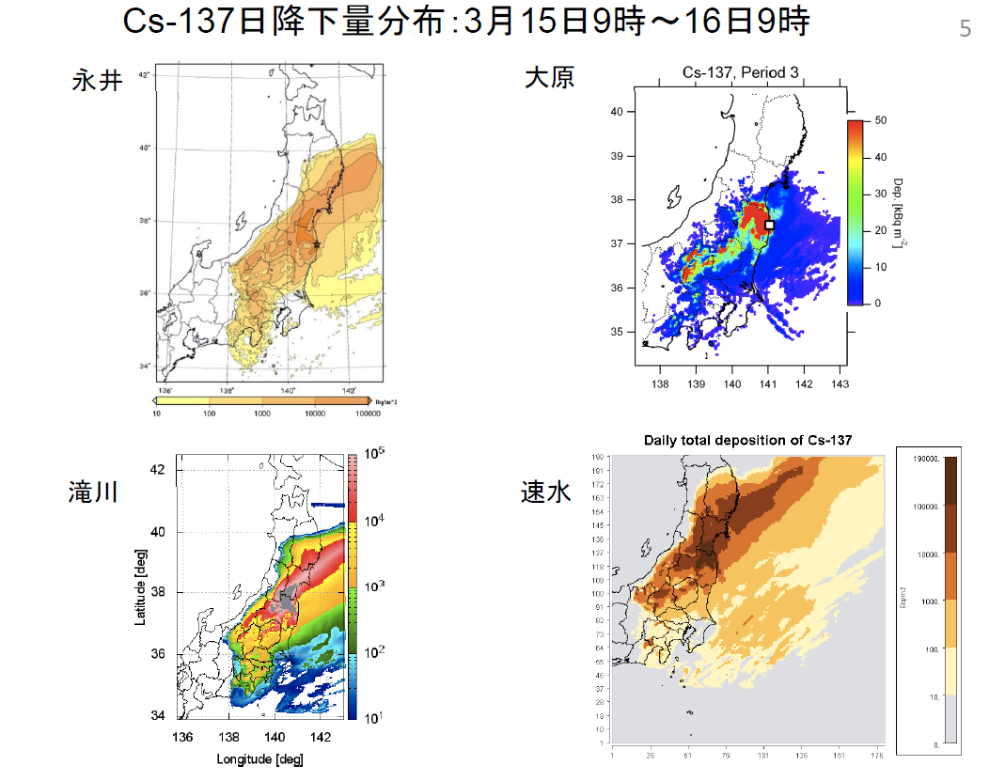
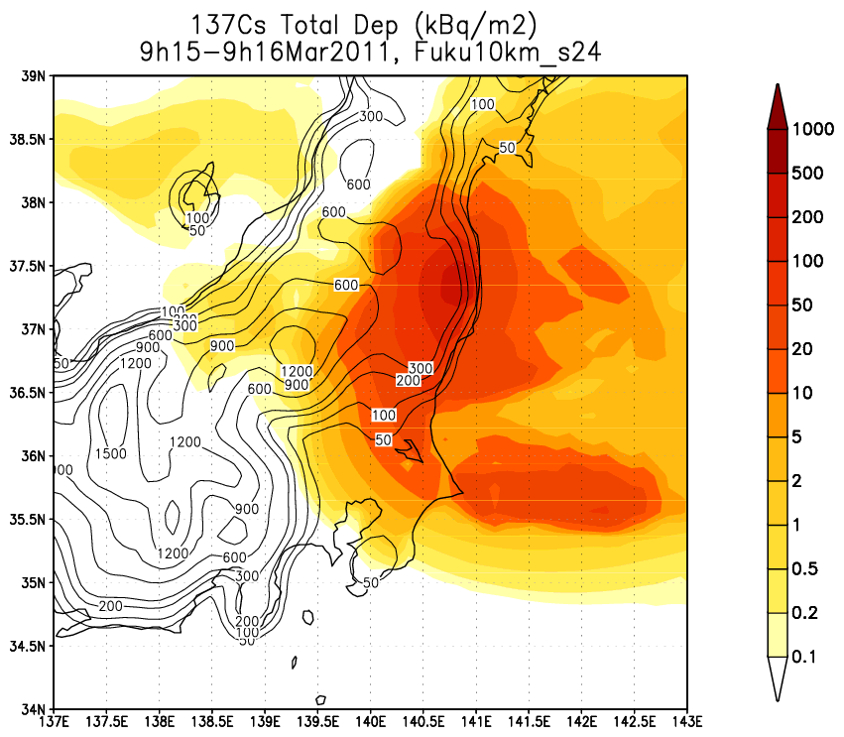
Comparison with similar effort (3/15)

Slide 14
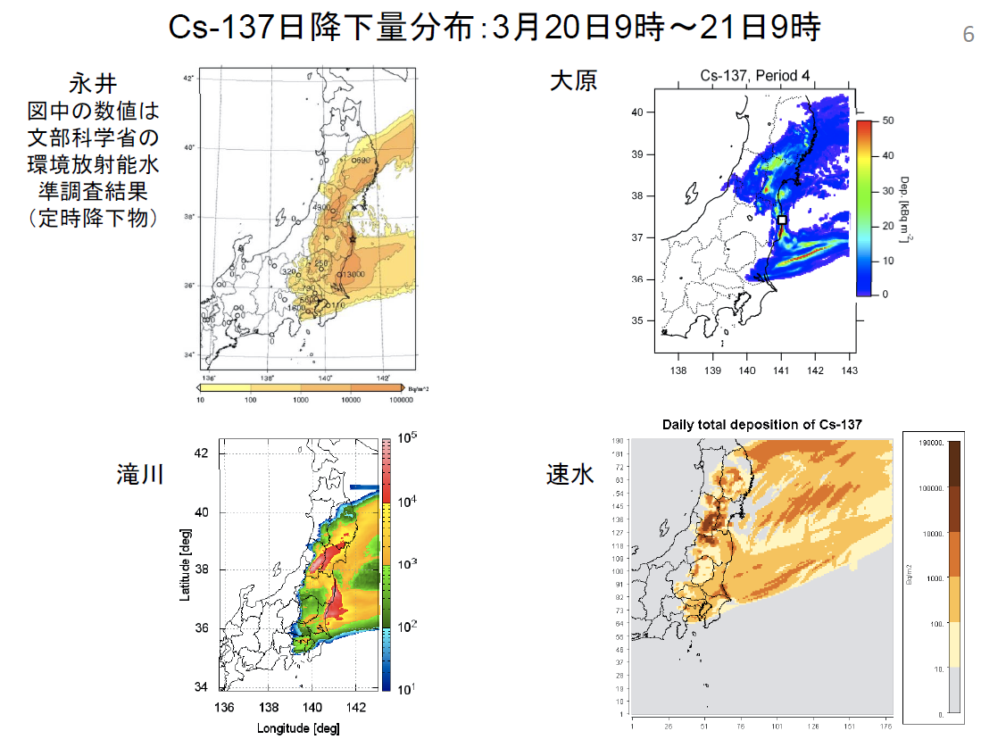
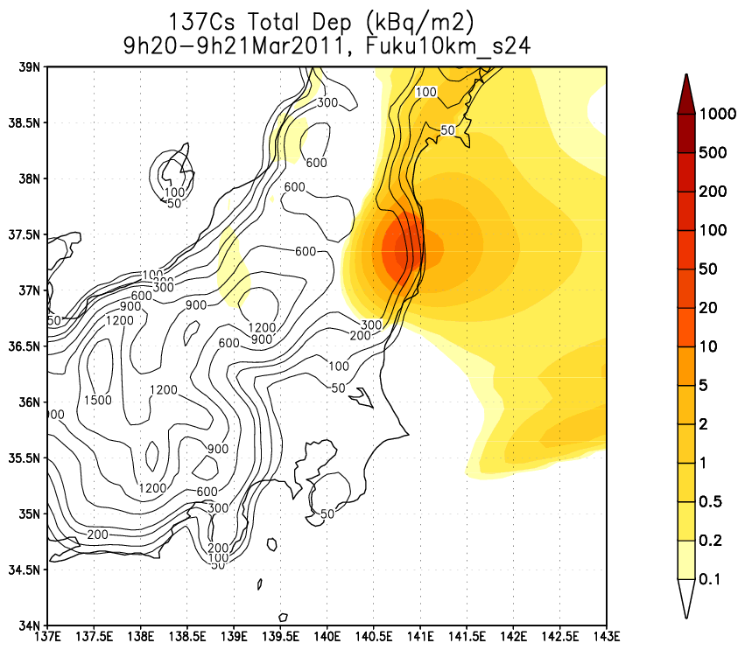
Comparison with similar effort (3/20)

Slide 15
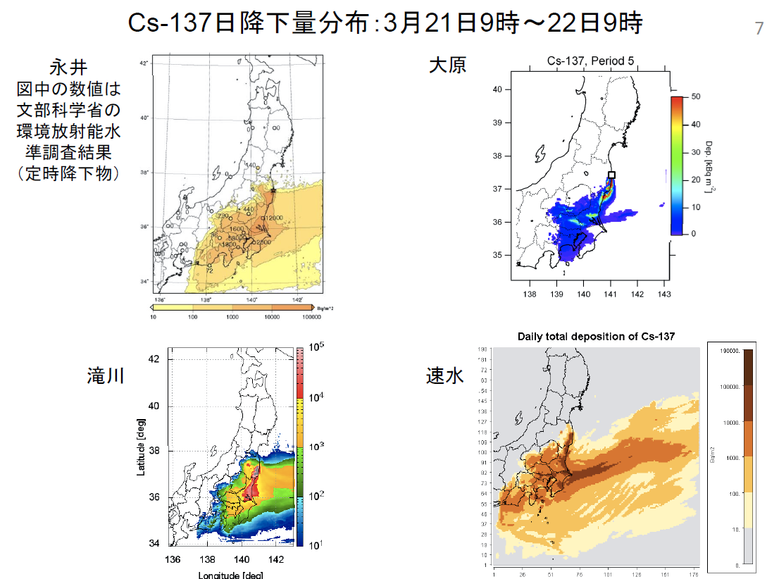
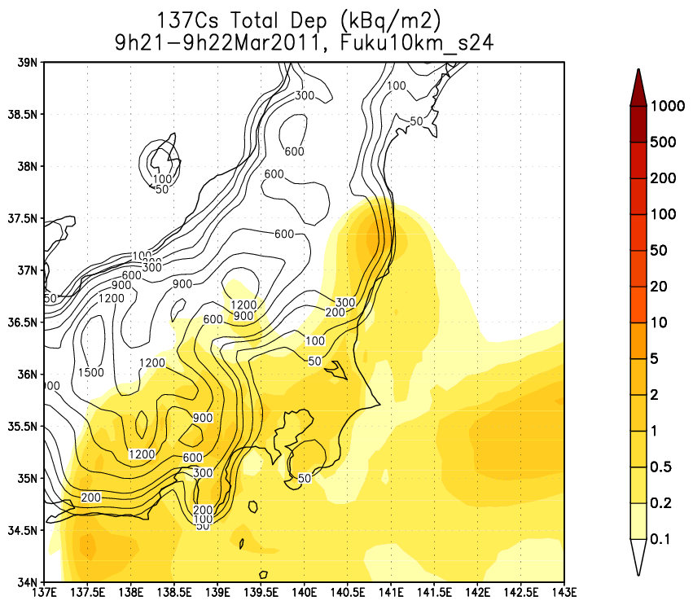
Comparison with similar effort (3/21)

Slide 16
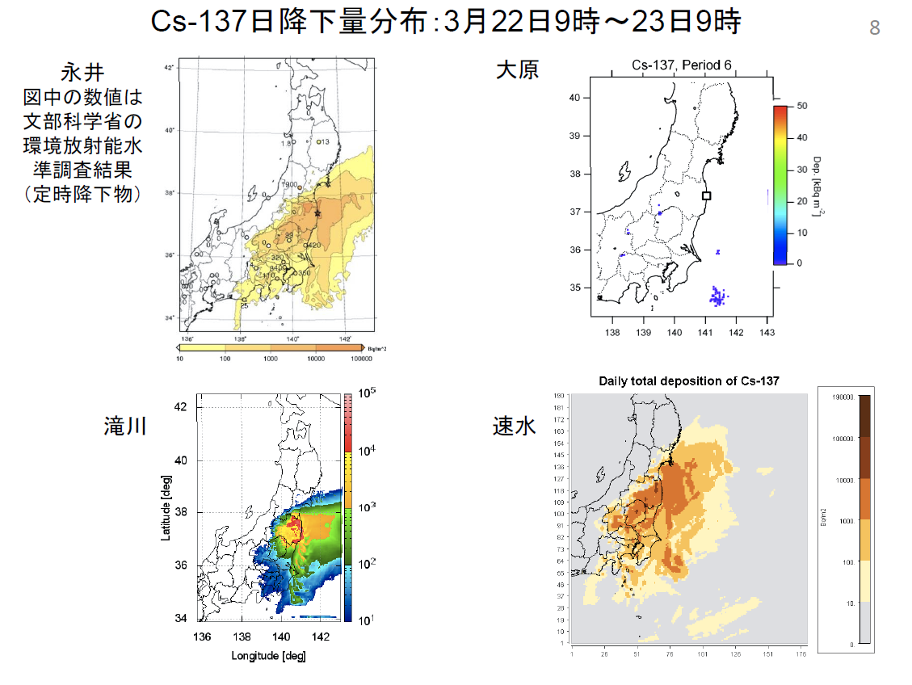
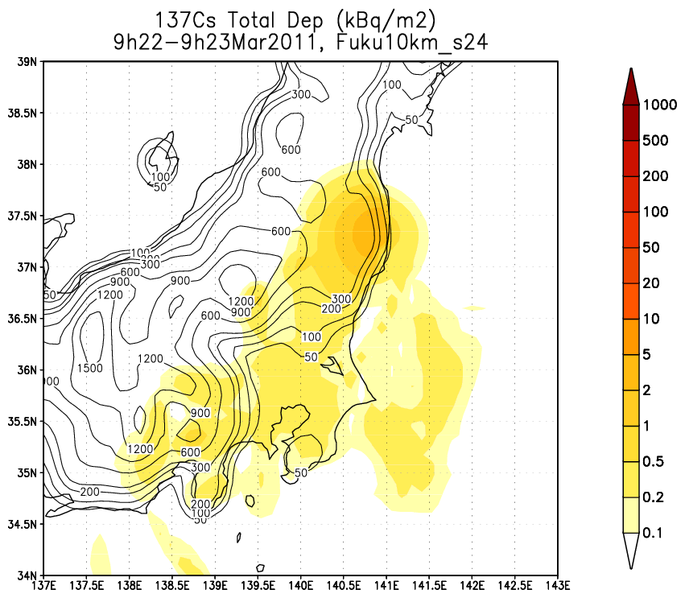
Comparison with similar effort (3/22)

Slide 17
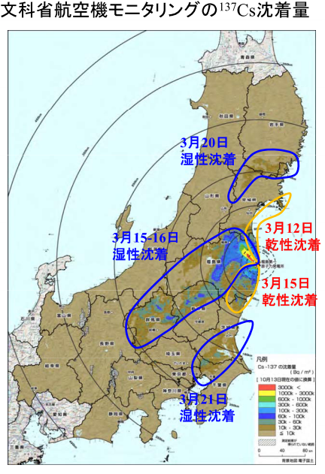
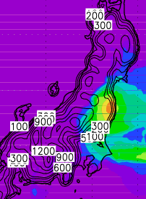
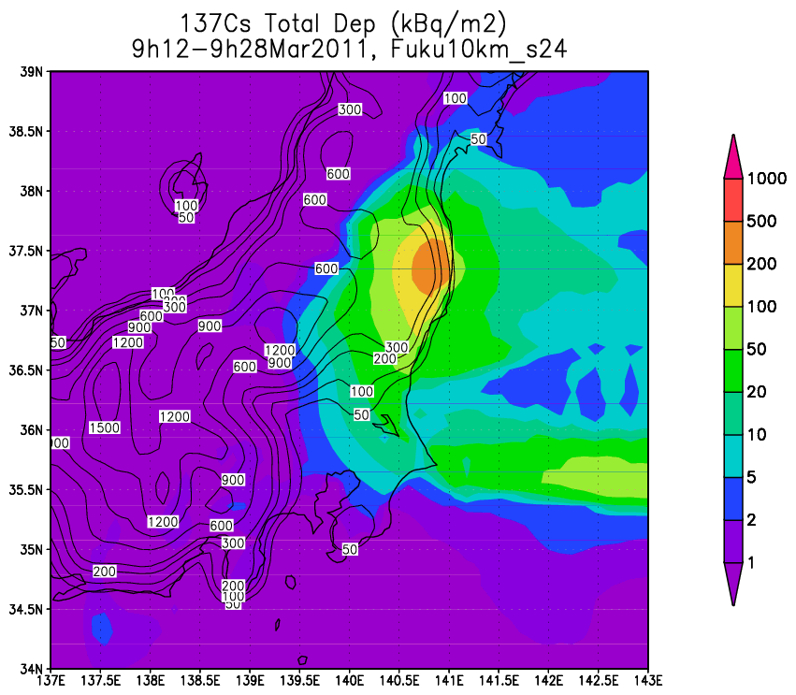
Cs137 Total Deposition in Mar2011

Slide 18
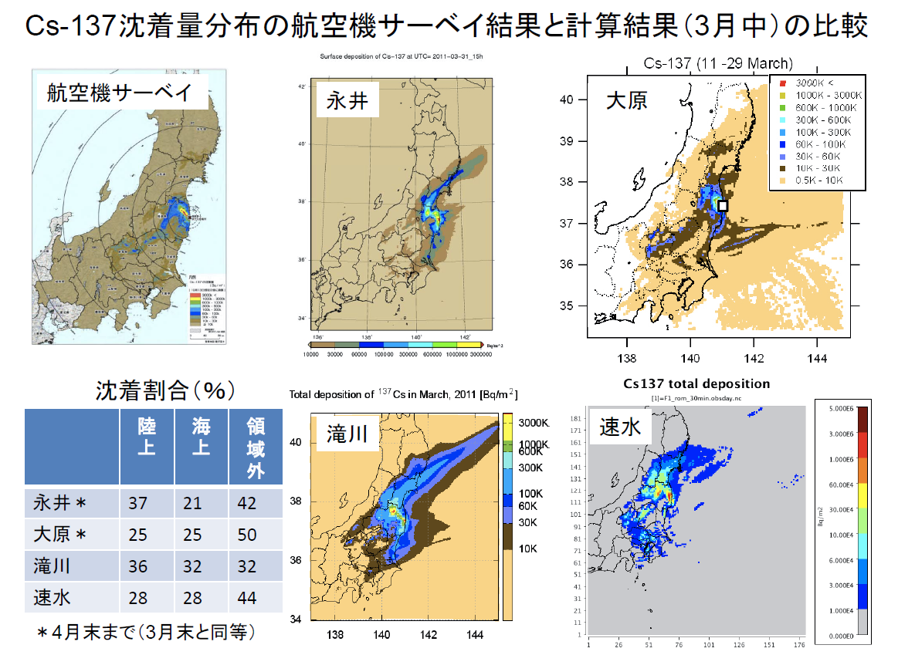
With other models
Deposition Rate (%)
Land
Sea
OB
Our study | 17 | 33 | 50

Slide 19
Sensitivity Experiments
Cs137 | E | WD_tot | WD_land | WD_sea | Atm | DD_tot | DD_sea | TD_tot | TD_land | TD_sea
S24 α=1 Vd=1e-3 Dc=0.2 | 8.56 | 2.72 | 0.27 | 2.45 | 0.53 | 1.56 | 0.40 | 4.28 | 1.43 | 2.85
 | 100.00% | 31.81% | 3.21% | 28.60% | 6.16% | 18.20% | 4.65% | 50.01% | 16.76% | 33.25%
S25 α=1 Vd=1e-3 Dc=2 | 8.56 | 2.84 | 0.24 | 2.60 | 0.49 | 1.73 | 0.38 | 4.57 | 1.59 | 2.98
 | 100.00% | 33.19% | 2.77% | 30.42% | 5.71% | 20.23% | 4.39% | 53.42% | 18.61% | 34.81%
S26 α=1.5 Vd=0.2e-3 Dc=2 | 8.56 | 4.23 | 0.36 | 3.87 | 0.53 | 0.40 | 0.08 | 4.63 | 0.68 | 3.95
 | 100.00% | 49.44% | 4.22% | 45.22% | 6.23% | 4.67% | 0.98% | 54.11% | 7.91% | 46.20%
Control
Less
Diffusive
More wet/
Less Dry Dep.
I131 | E | WD_tot | WD_land | WD_sea | Atm | DD_tot | DD_sea | TD_tot | TD_land | TD_sea
S24 α=1 Vd=5e-3 Dc=0.2 | 147.74 | 28.38 | 2.61 | 25.77 | 7.08 | 71.94 | 25.28 | 100.32 | 49.28 | 51.05
 | 100.00% | 19.21% | 1.77% | 17.44% | 4.79% | 48.69% | 17.11% | 67.90% | 33.35% | 34.55%
S25 α=1 Vd=5e-3 Dc=2 | 147.7 | 26.9 | 2.1 | 24.8 | 6.5 | 75.4 | 23.7 | 102.3 | 53.8 | 48.5
 | 100.00% | 18.21% | 1.42% | 16.79% | 4.40% | 51.04% | 16.03% | 69.25% | 36.43% | 32.81%
S26 α=1.5 Vd=1e-3 Dc=2 | 147.7 | 55.4 | 4.2 | 51.3 | 9.2 | 24.0 | 6.9 | 79.5 | 21.2 | 58.2
 | 100.00% | 37.53% | 2.83% | 34.70% | 6.24% | 16.25% | 4.70% | 53.78% | 14.38% | 39.40%
Control
Less
Diffusive
More wet/
Less Dry Dep.

Slide 20
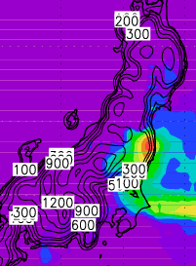
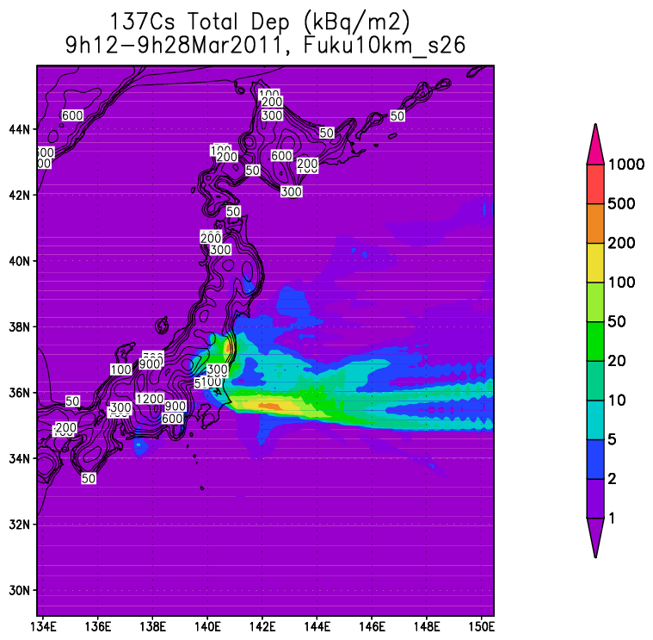
Sensitivity Experiments
(Deposition Distribution)
Less Diffusive +
More Wet/Less Dry dep.
Control
Less Diffusive

Slide 21
Concerns
Too strong diffusivity compared to the real.
Less land deposition compared to other models.
Too little (too large) wet (dry) deposition?

Slide 22
Todo
More accurate dynamics
  Semi-lagrangian transport (Eun-Chul)
  Sensitivity Experiments (A. Saya)
  Non-hydrostatic behavior (prognostic vertical motion)
More sensitivity experiments.
  The three Parameters.
  Lateral BC (NCEP2, JRA25, ERA-I)
  Initial BC (starting from 3/10, 11, 12, etc.)
  Emission (Chino et al., Stohl et al., etc.)
  Domain size
Imaginary situations
  Ooi NP in Fukui
  “What if”s (e.g., what if the Earthquake occurred on 10 Mar?)

Slide 23
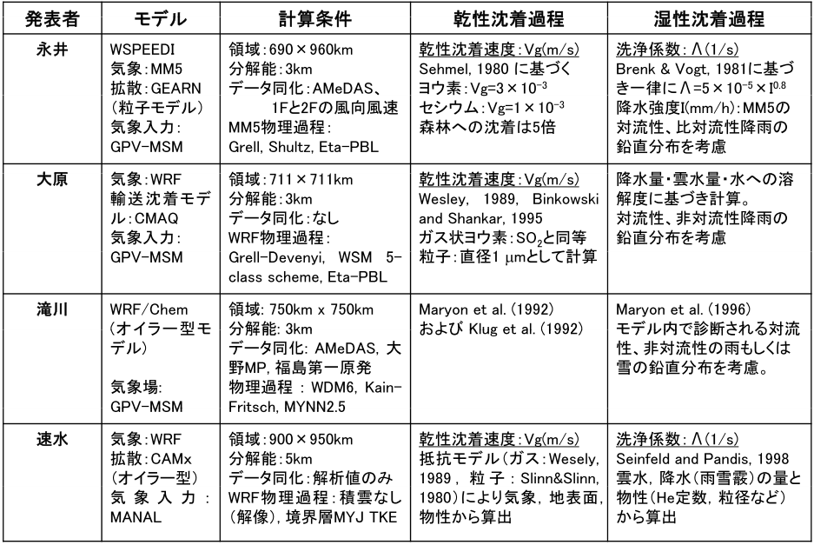
他機関大気拡散解析
機関
JAEA
国環研
JAMSTEC
¹³¹I : 5×10⁻³ m/s
¹³⁷Cs : 1×10⁻³ m/s
電中研

