Slide 1
Semi-Lagrangian advection scheme for radioactive tracers in a regional spectral model
Eun-Chul Chang and Kei Yoshimura

Slide 2
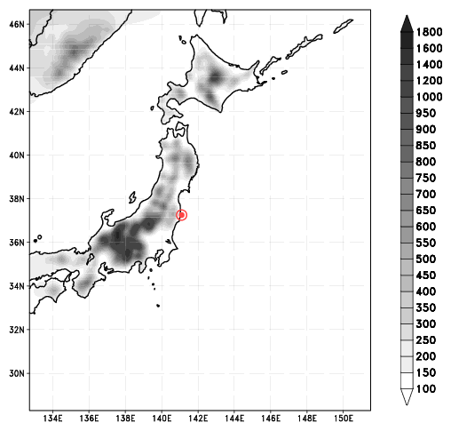
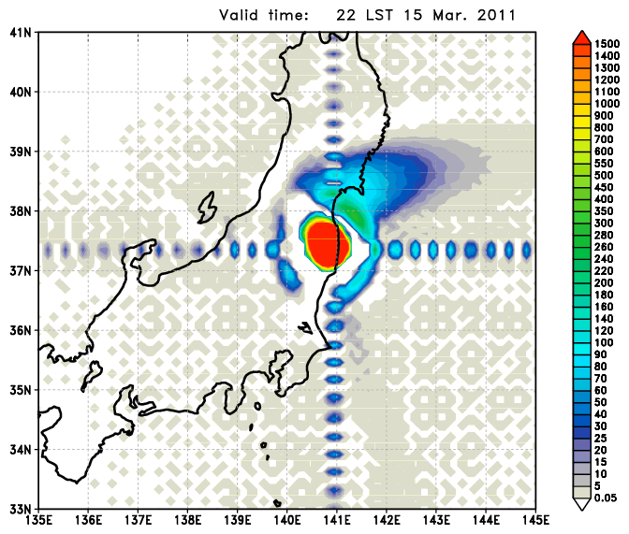
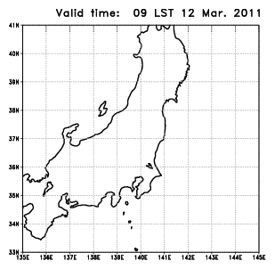
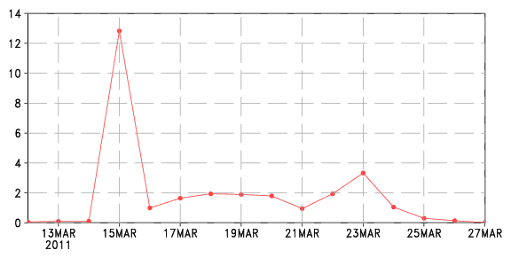
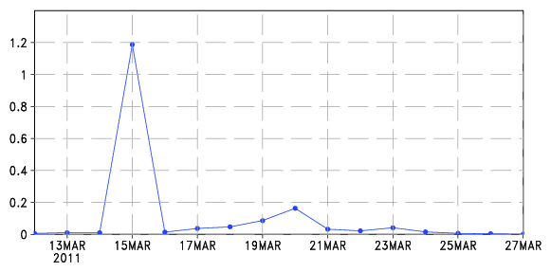
Motivation Simulation of Fukushima case
Experimental domain
(shaded : orography)
Model | IsoRSM (Yoshimura et al., 2010)
Domain | Horizontal : 10 km (161 × 200) vertical : 28 layers
I.C. & B.C. | NCEP-DOE Reanalysis II
Run period | 2011. 03. 12. 00 UTC − 2011. 03. 28. 00 UTC (16 days)
Atmosphere column accumulated I131 [Bq m⁻² hr⁻¹]
Daily averaged emission rate [MBq m⁻² d⁻¹] (Chino et al., 2011)
I131
Cs137

Slide 3
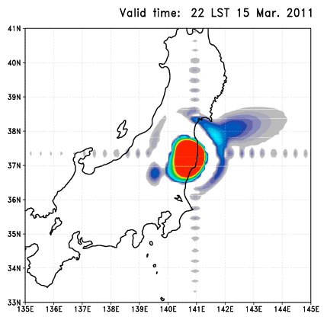
Motivation
“Gibbs phenomenon”
Gibbs phenomenon is one disadvantage of spectral model system.
In this study, tracer advection part is replaced by the semi-Lagrangian advection scheme to avoid Gibbs phenomenon.
Ringing artifacts

Slide 4
Semi-Lagrangian method
n : time step
D : departure point
A : arrival point
q : quantity of tracer
Numerical model grid is “regular grid”

Slide 5
NDSL scheme
Non-iteration dimensional-split semi-Lagrangian (NDSL; Juang 2007, 2008)
remapping to find q
at regular grid from irregular A
dimensional-split
interpolation to find q
at irregular D from regular grid
iteration to find q at D
Final result is mean of
x - y advection and
y - x advection
values are defined at regular grid
values are defined at regular grid
NDSL scheme was only applied to Global model version (NCEP GFS and GRIMs GMP).
There was no regional version of NDSL scheme.

Slide 6
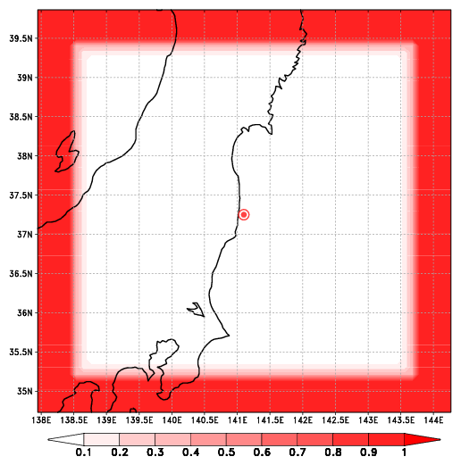
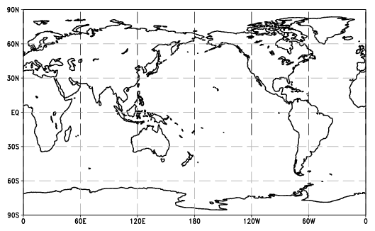
Non-cyclic boundary in a regional model
Weighting function for boudanry
In a global model : cyclic boundary
cyclic domain
Actual domain
cyclic domain
In a regional model
10 km resolution, Δt = 40 sec
Fastest wave (Sound wave): 300 m/s
Longest distance in one Δt : 300 m/s × 40 sec = 12 km
(less than 2Δx, 2Δy)
Boundary for Semi-Lagrangian = 5 grids (50 km from domain edge)

Slide 7
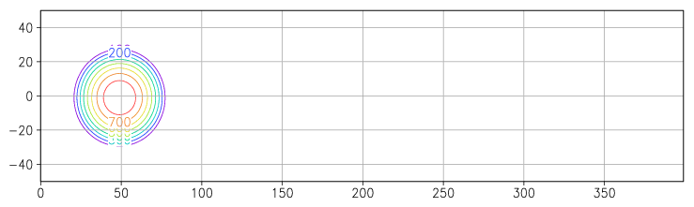
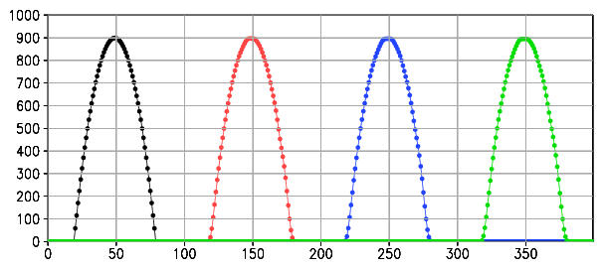
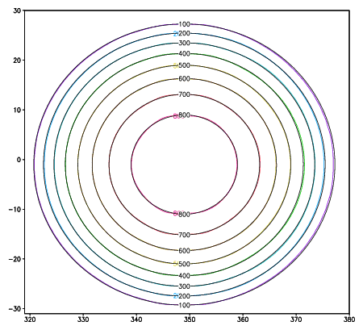
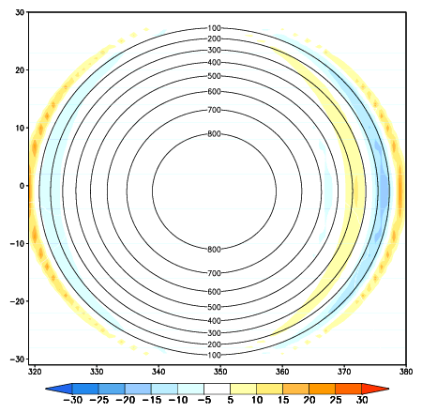
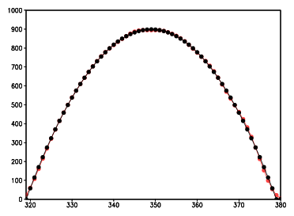
Ideal test of NDSL in regional version
x directional advection only
∆x = 10 km
∆y = 10 km
∆t = 100 sec
uniform u-wind : 10 m s⁻¹
initial
1000 step
2000 step
3000 step
at 3000 step (~ 83 hour)
NDSL : rainbow
analytic solution : black
analytic solution : contour
NDSL - Analytic : shaded
values at y = 0
semi-Lagrangian : red
analytic solution : black
value
x grid

Slide 8
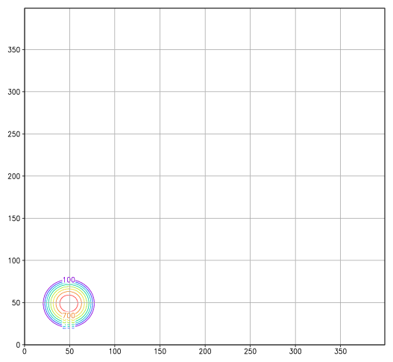
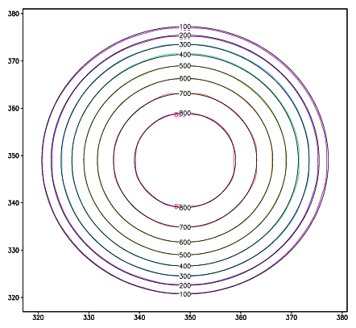
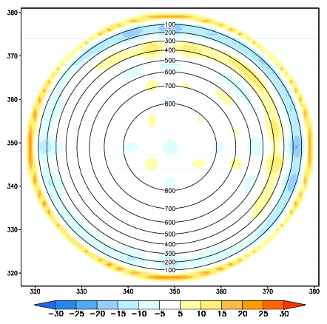
Ideal test of NDSL in regional version
x-y directional advection
∆x = 10 km
∆y = 10 km
∆t = 100 sec
uniform u-wind : 10 m s⁻¹
uniform v-wind : 10 m s⁻¹
at 3000 step (~ 83 hour)
NDSL : rainbow
analytic solution : black
analytic solution : contour
NDSL - Analytic : shaded

Slide 9
Real case run : Fukushima case
Domain and orography
Model | IsoRSM (Yoshimura et al., 2010)
Domain | Horizontal : 10km (161 x 200) Vertical : 28 layers
I.C. & B.C | NCEP-DOE Reanalysis II
Integration period | 2011. 03. 12. 00 UTC − 2011. 03. 28. 00 UTC (16 days)
Experiment | Description
Original IsoRSM | IsoRSM (Yoshimura et al., 2010)
NDSL IsoRSM | Same as the IsoRSM, but tracers are calculated by NDSL (hydrometeor & radioactive particles)
Daily averaged emission rate [MBq m⁻² d⁻¹] (Chino et al., 2011)
I131
Cs137

Slide 10
Result
Original IsoRSM
NDSL IsoRSM
Atmospheric column
integrated I131 [Bq m⁻²]
(1 hourly)
Atmospheric column
integrated Cs137 [10⁻² Bq m⁻²]
(1 hourly)

Slide 11
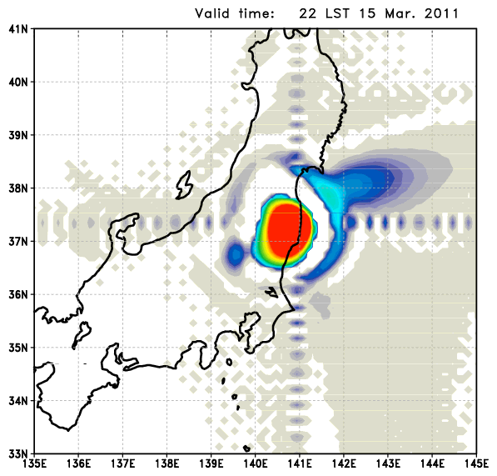
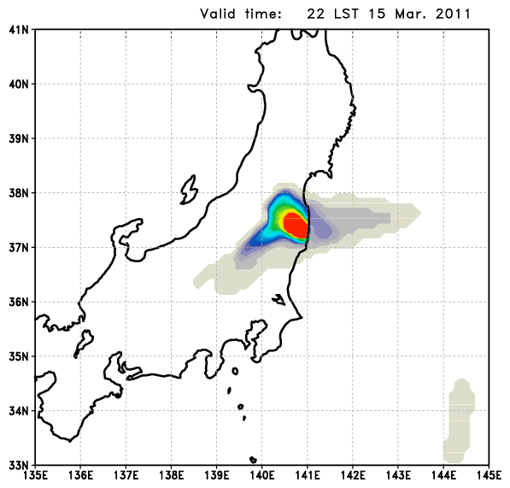
Result
Atmospheric column integrated I131 [Bq m⁻²] (1 hourly)
Original IsoRSM
NDSL IsoRSM

Slide 12
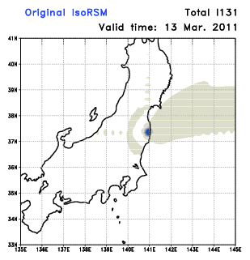

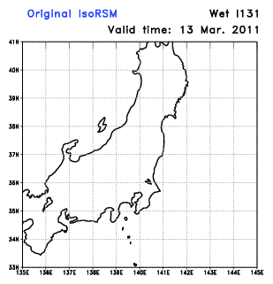
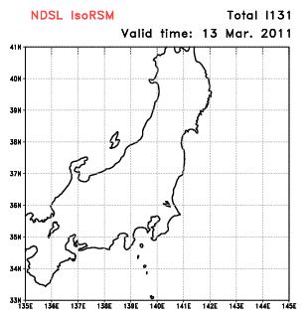
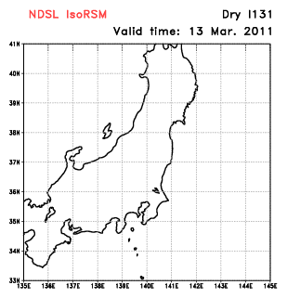

Result
Daily deposition I₁₃₁
Original IsoRSM
NDSL IsoRSM

Slide 13
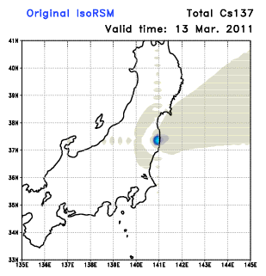
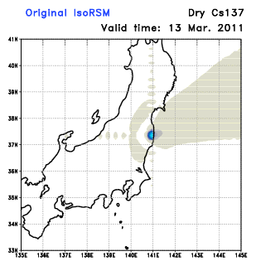




Result
Daily deposition Cs₁₃₇
Original IsoRSM
NDSL IsoRSM

Slide 14
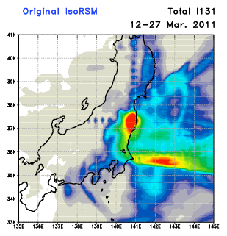
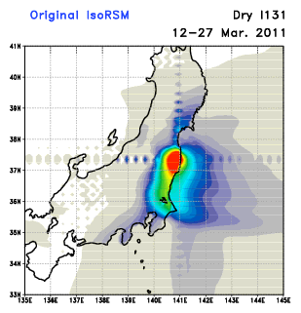
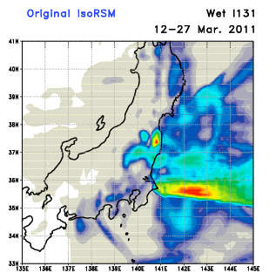
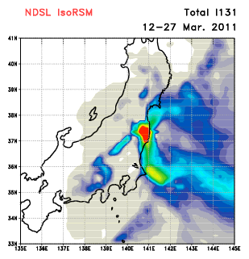
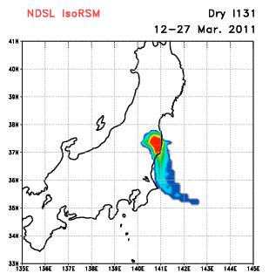
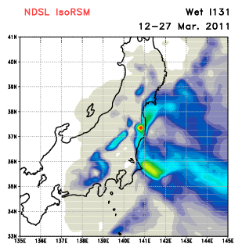
Result
Surface deposition
I₁₃₁ [kBq m⁻²]
12. March – 28. March

Slide 15
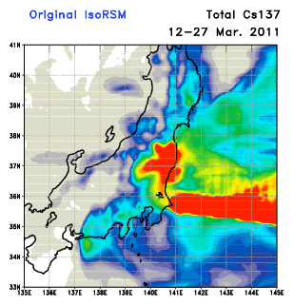
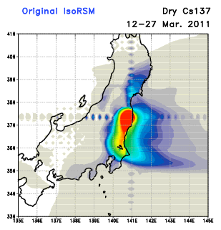
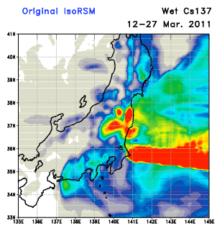
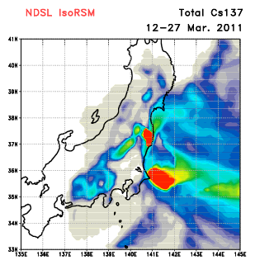
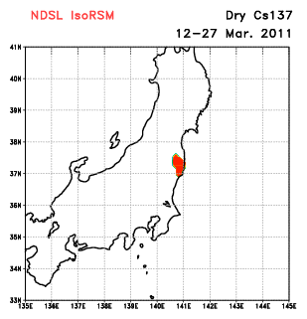
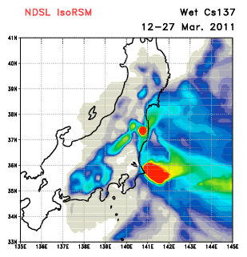
Result
Surface deposition
Cs₁₃₇ [10⁻² kBq m⁻²]
12. March – 28. March

Slide 16
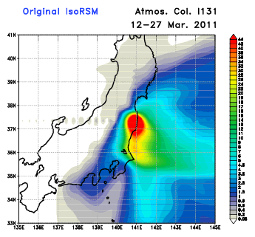
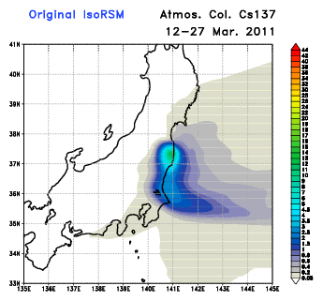
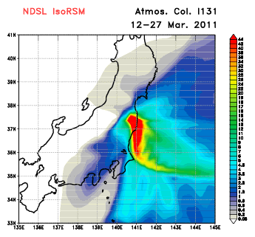
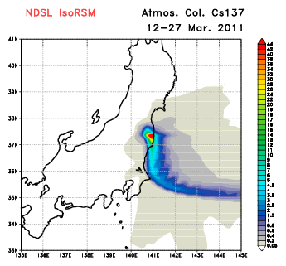
Result
Atmospheric column accumulated
tracers for 16 days [MBq m⁻²]

Slide 17
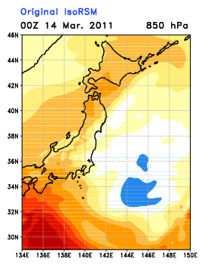
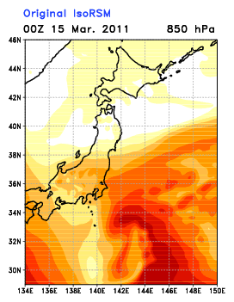
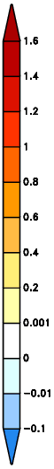
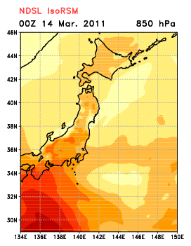
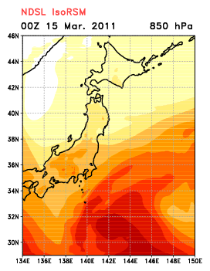
Result
Specific humidity [g kg⁻¹]
at 850 hPa

Slide 18
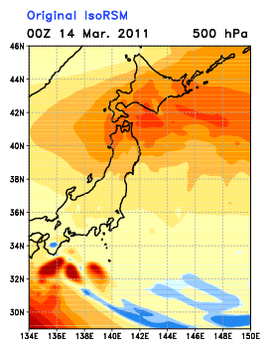
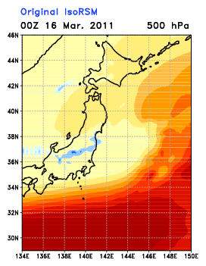
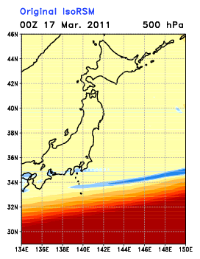
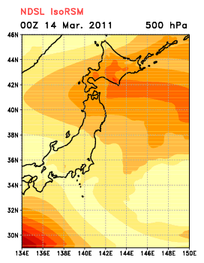
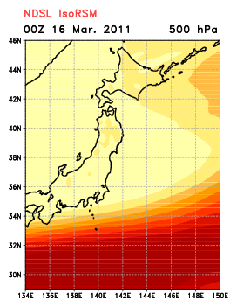

Result
Specific humidity [g kg⁻¹]
at 500 hPa

Slide 19




Result
16 days averaged precipitation [mm d⁻¹]
TMPA
Original IsoRSM
NDSL IsoRSM

Slide 20


Result
16 days averaged precipitation [mm d⁻¹]
TMPA
Original IsoRSM + RAS
NDSL IsoRSM + RAS
Original IsoRSM + SAS
NDSL IsoRSM + SAS

Slide 21
Summary
1. Original IsoRSM has problem in simulation of radioactive particles : Gibbs phenomenon
2. Non-iteration dimensional split semi-Lagrangian (NDSL) scheme is applied
for tracers transport to solve the problem
3. NDSL successfully reproduced radioactive particle transports without Gibbs phenomenon
4. Land surface deposition of tracers in NDSL is too small than in original IsoRSM
Plan
1. Evaluation of surface deposition of I131 and Cs137 with observation
2. Diffusion for tracers
3. Implementation of improved physical parameterizations (e.g., Convection, cloud, PBL)
4. Check for dry and wet deposition processes

Slide 22
Thank you

Slide 23








Result
Daily deposition

Slide 24








Result
Daily deposition

Slide 25






Result
1 day total deposition [kBq m⁻² hr⁻¹]
wind at 10 m
1 day total deposition [kBq m⁻² hr⁻¹]
wind at 975 hPa
wind difference
NDSL – Original
wind difference
NDSL – Original

Slide 26




Result
Tracers at 2 m height
for 16 days [kBq m⁻²]

Slide 27



