Slide 1
A “data-based” hydrological modeling approach of Cs-137 concentration in the dehydrated sewage sludge in Fukushima
Yoshiyuki Yokoo (& Naoya Miura)
Faculty of Symbiotic Systems Science, Fukushima University

Slide 2
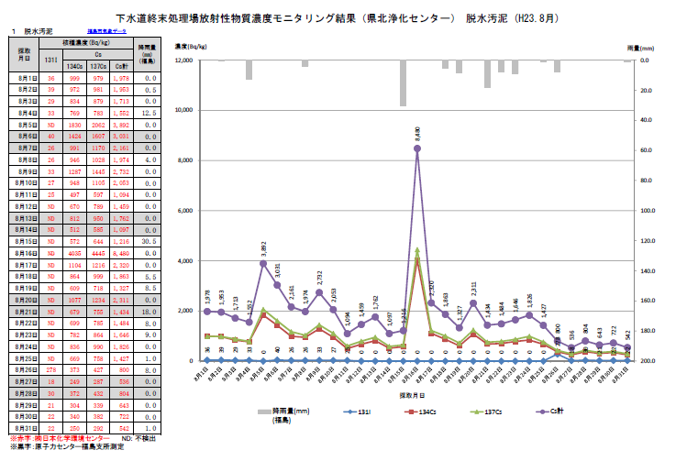
I-131, Cs-134, Cs-137 Concentration in the dehydrated sludge in Fukushima

Slide 3
Background
Daily Cs-137 concentration data indicates Cs-137 flows with surface water driven by rainfall.
  Hydrograph separation
  techniques are
  applicable?
  Indicates flow processes
  of Cs-137 in urban (?)
  sludge?

Slide 4
Aim
Identification and understanding of Cs-137 flow processes by hydrograph separation technique.
Suggestion of a possible model structure of Cs-137 flow in urban drainage systems.
Exploring a potential of validating the local model outputs of modeling team.

Slide 5
Methodology
Daily Cs-137 concentration & dehydrated sludge weight data
  Not easy to get from Fukushima prefecture
Separation of daily Cs-137 data
  Filter separation by Hino (1981)
Identifying the time sources of Cs-137 concentration.

Slide 6
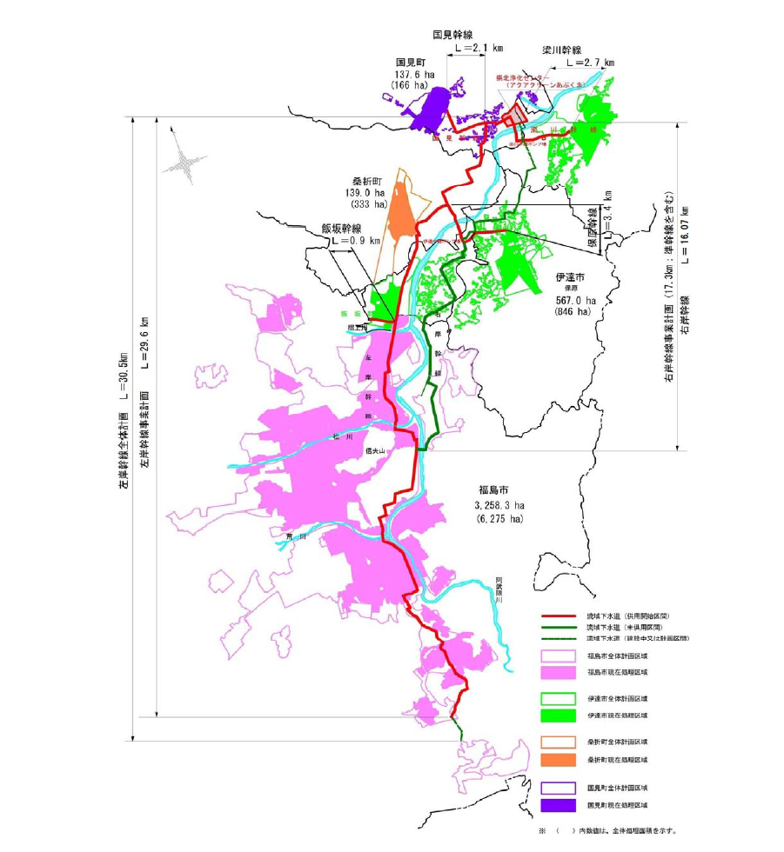
Study areas: Kenpoku (Kunimi town)
Drainage area: 4102ha=41.02km²
Service population: 185400
Treatment capacity: 70240 m³/d
Treatment method: “separated”
Servicing city: Fukushima, Date, Kori, Kunimi
公益財団法人福島県下水道公社，阿武隈川上流流域下水道（県北処理区・県中処理区）・阿武隈川あだたら流域下水道（二本松処理区）・大滝根川流域下水道（田村処理区）維持管理年報，第24号，平成23年度，公益財団法人福島県下水道公社，2012.

Slide 7
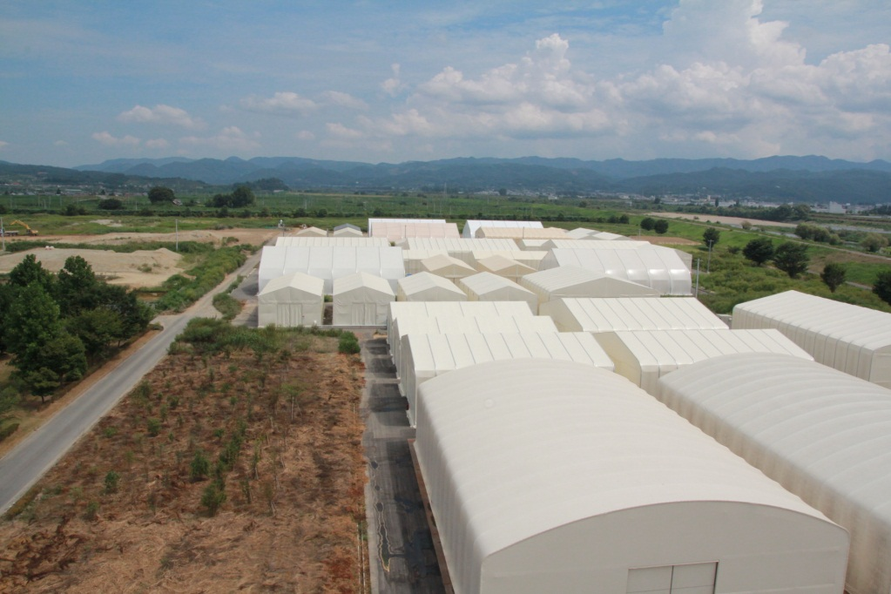
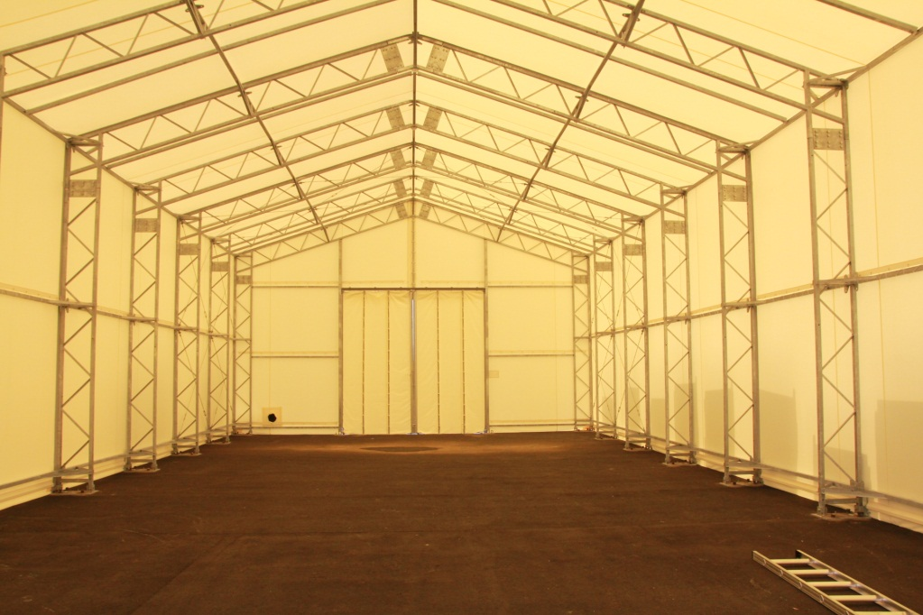
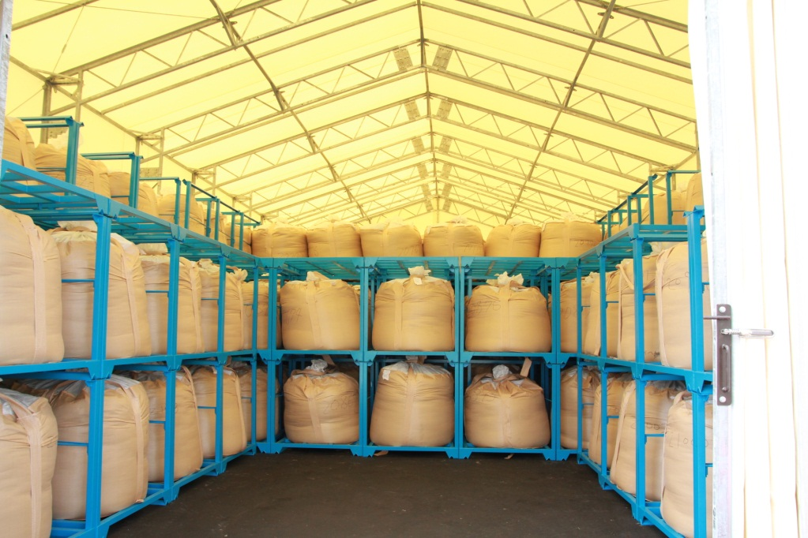
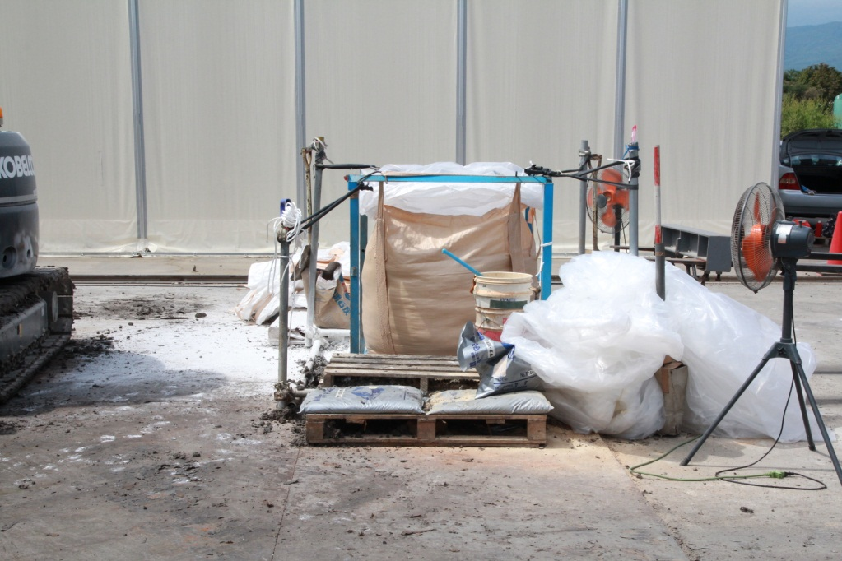
In Kenpoku sludge treatment plant

Slide 8
Sludge Cs-137 concentration (Bq/kg)
Driven by precipitation (and hence fast flow)?

Slide 9
Sludge production rate (kg/d)
Independent of precipitation?
Miscatch?

Slide 10
+ Sludge production rate (t/d)
Almost constant, mean=41700kg/d=41.7t/d

Slide 11
Cs-137 production rate (Bq/d)
Just multiply mean production rate=41.7t/d?

Slide 12
Cs-137 production rate (Bq/d/sq m)
Useful for validation in modeling team?

Slide 13
Recession analysis of Cs-137?
Recession characteristics? 3 components?

Slide 14
Time constant T_{c} of recession curve

Slide 15
Filter separation by Hino (1981)
Numerical filter
Attenuation rate(2.0~2.5)
=2.1 (fixed)
Baseflow
Time constant T_{c}=1/α
Parameter
Slower flow
=0 (fixed)
Faster flow

Slide 16
A time source separation of Cs-137
3 process in Kenpoku? T_{c}1=58.0d, T_{c}2=5.43d

Slide 17
A time source separation of Cs-137
3 process in Kenpoku? T_{c}1=58.0d, T_{c}2=5.43d

Slide 18
What can we learn?
Cs-137 concentration in the sludge consists of 3 different components with respect to its time source.
  Specified time constant: 58 days and 12 days.
    Fastest: Flushes by rainfall?
    Intermediate: Recession by delayed flush?
    Slowest: Seasonal trend?
  Suggesting necessity of 3 sub-model in Cs-137 transport model?

Slide 19
Future work?
Travel times of Cs-137 sub-flows
  Fast flow
  Intermediate flow
  Slow flow
Comparison with Kenchu (Koriyama)

