Slide 1
Semi-Lagrangian advection scheme for radioactive tracers in a regional spectral model
2013. 6. 3. CREST meeting
Eun-Chul Chang and Kei Yoshimura

Slide 2
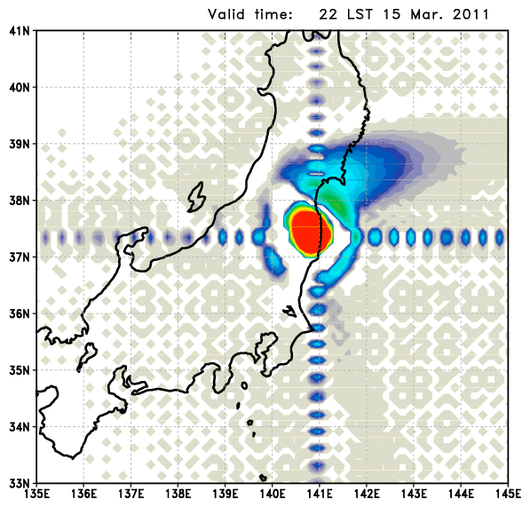
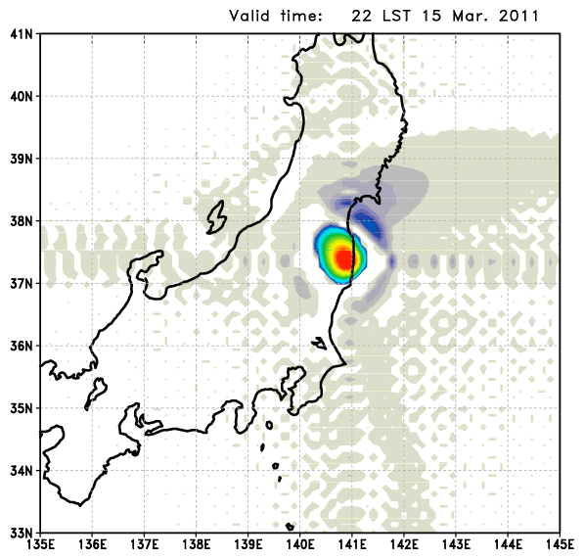
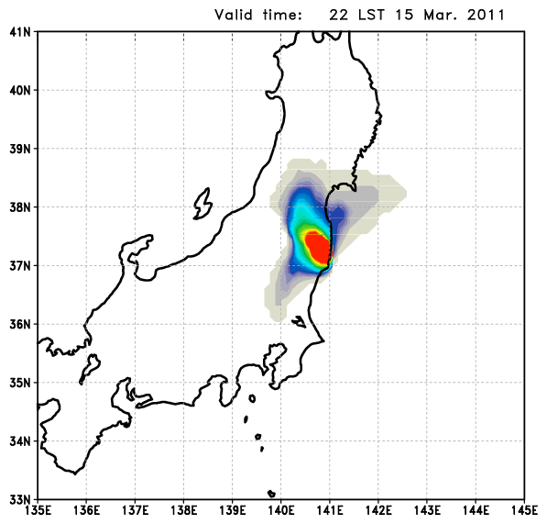
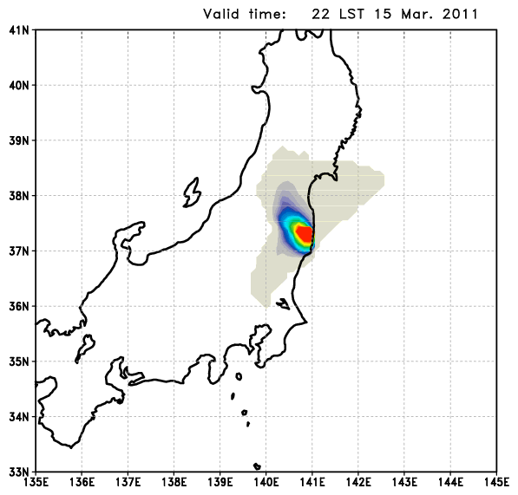
Previous achievement
Atmospheric column accumulated tracers
¹³¹I
¹³⁷Cs
Original
In the original IsoRSM, radioactive tracer fields have Gibbs phenomenon which is one disadvantage of spectral model system.
¹³¹I
¹³⁷Cs
Semi-Lagrangian
The Gibbs phenomenon is removed by replacing spectral tracer advection part with semi-Lagrangian advection scheme.

Slide 3
¹³⁷Cs 3D field
Animation by Prof. Yoshimura
Original IsoRSM
Semi-Lagrangian IsoRSM
Gibbs phenomenon
No Gibbs phenomenon
Less diffusion
Less upward propagation

Slide 4
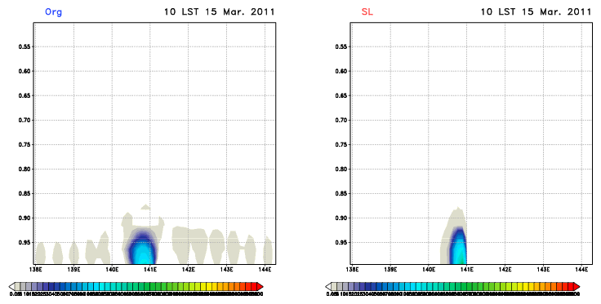
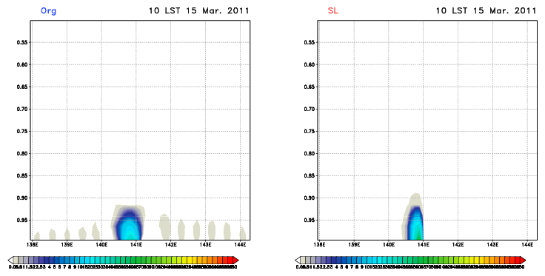
vertical cross section for ¹³¹I averaged for 37~38°N
vertical cross section for ¹³⁷Cs averaged for 37~38°N

Slide 5
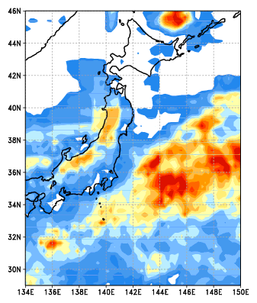
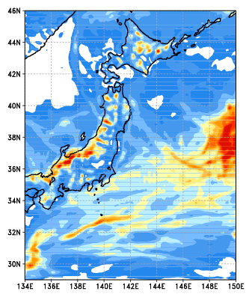
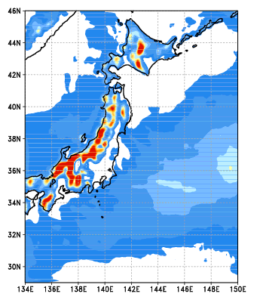
Precipitation
16 days averaged precipitation (mm d⁻¹)
TMPA
Original IsoRSM
Semi-Lagrangian IsoRSM
Too weak precipitation
in semi-Lagrangian version

Slide 6
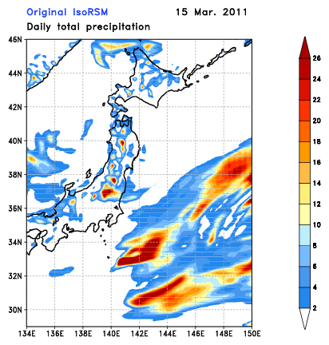
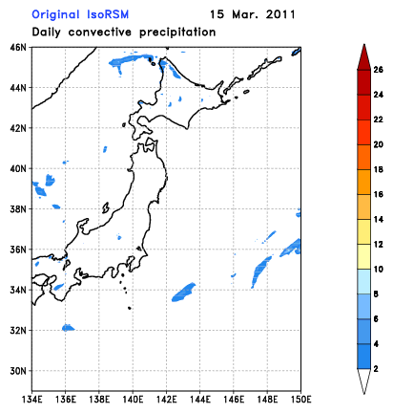
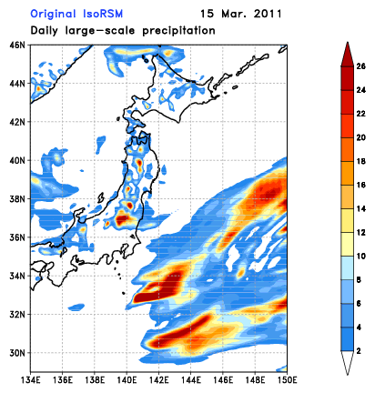
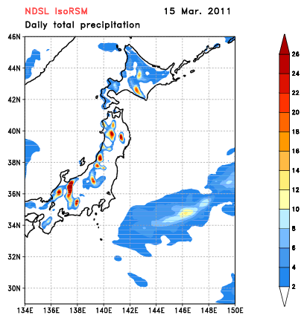
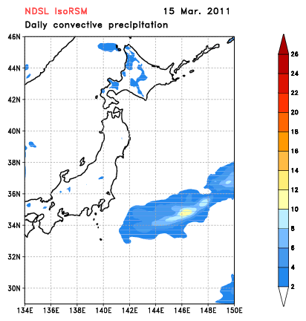
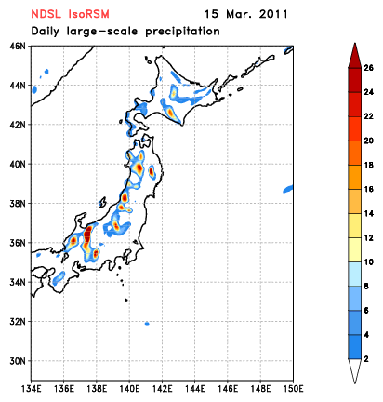
Precipitation
Total precipitation
Convective precipitation
Large-scale precipitation
Org
SL
Most of rainfall in the original version consist of large-scale precipitation which is calculated by cloud physics.
But, there are no large-scale rainfall over the ocean in the semi-lagrangian version.

Slide 7
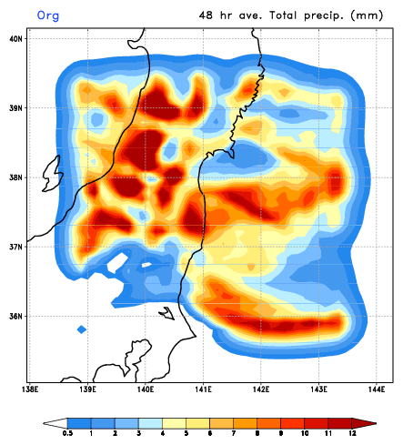
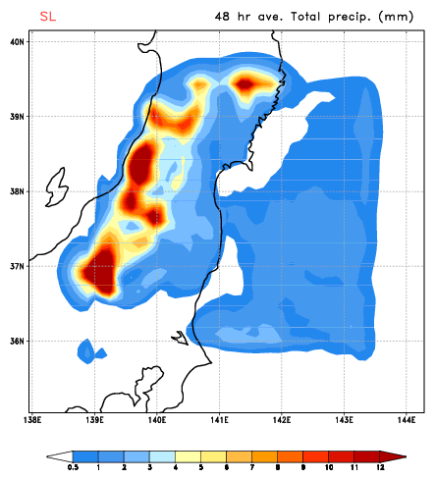
Hybrid tracer calculation
Vapor part : spectral
Tracer part : semi-Lagrangian
48 hour averaged Precipitation (mm d⁻¹)
Org
SL
Hybrid

Slide 8
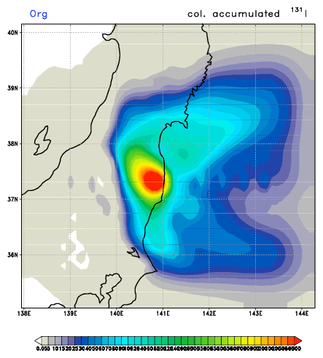
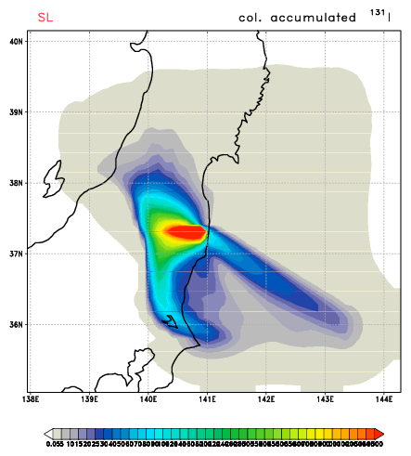
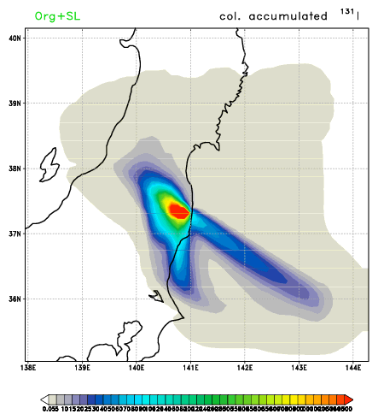
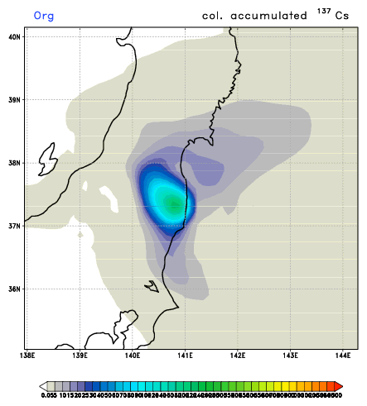
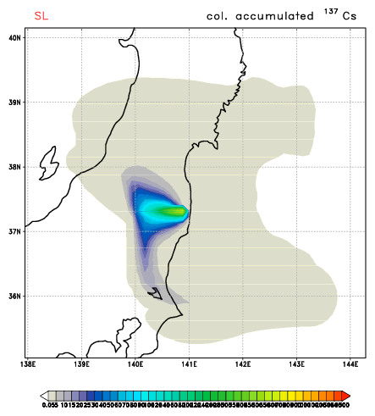
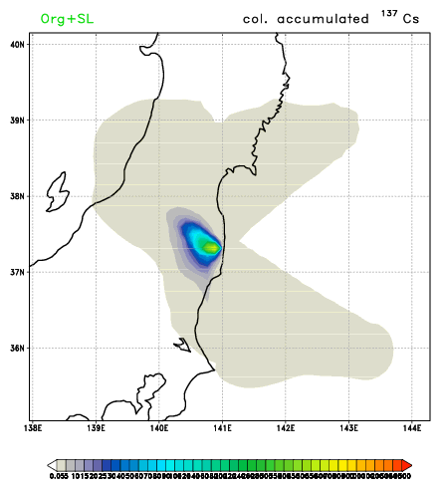
Hybrid tracer calculation
Column accumulated tracer
Org
SL
Hybrid
¹³¹I
Org
SL
Hybrid
¹³⁷Cs

Slide 9
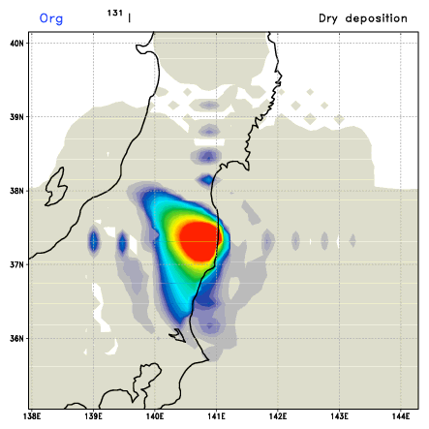
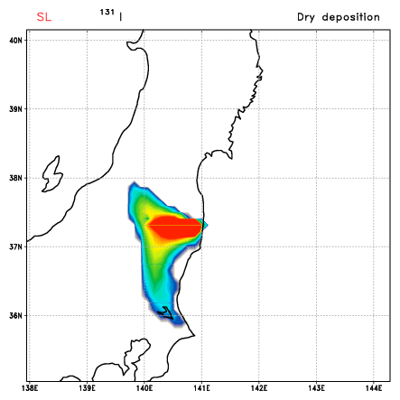
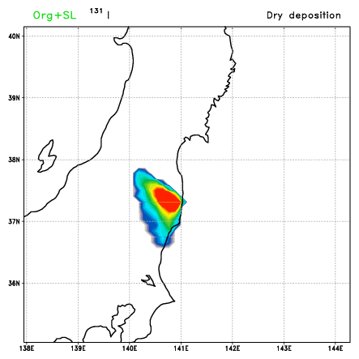
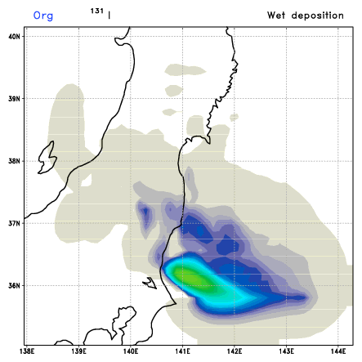
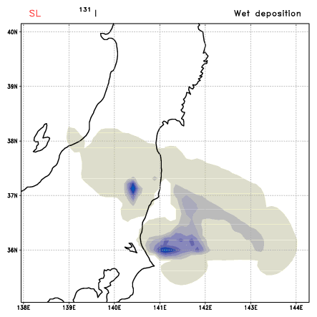
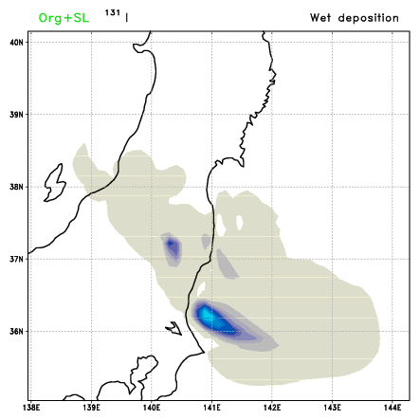
Hybrid tracer calculation
Surface deposition : ¹³¹I
Org
SL
Hybrid
Dry deposition
Org
SL
Hybrid
Wet deposition

Slide 10
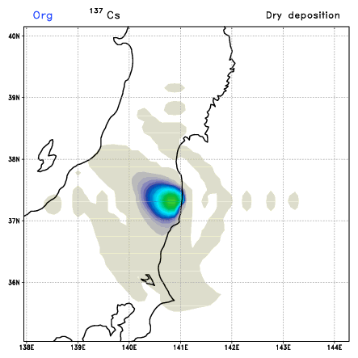
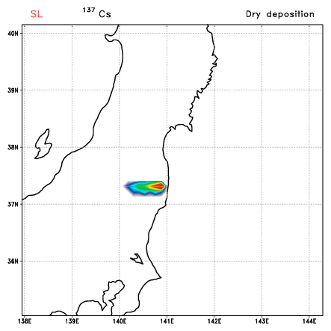
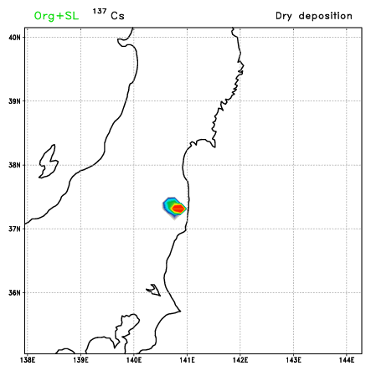
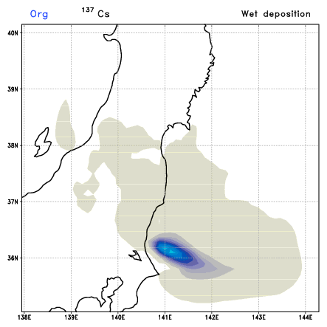
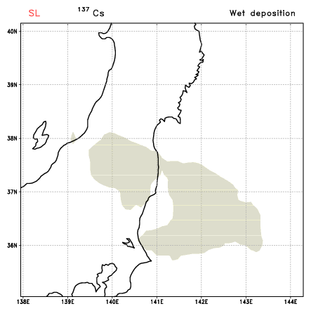
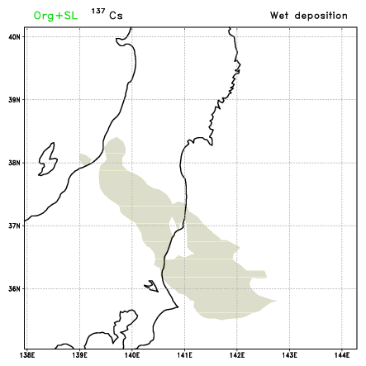
Hybrid tracer calculation
Surface deposition : ¹³⁷Cs
Org
SL
Hybrid
Dry deposition
Org
SL
Hybrid
Wet deposition

Slide 11
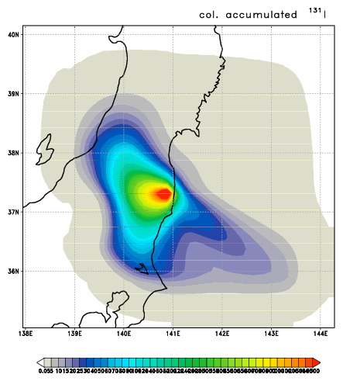
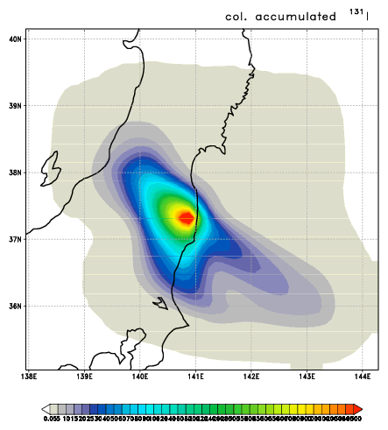
Diffusion effect
Simple smoothing for consideration of horizontal diffusion
F_{i} = 0.025F_{i-1} + 0.95F_{i} + 0.025F_{i+1}
Org
SL
Hybrid
SL + diff
Hybrid + diff
Column accumulated ¹³¹I

Slide 12
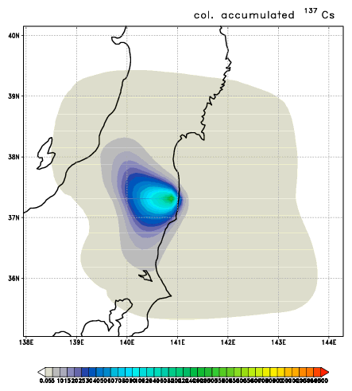
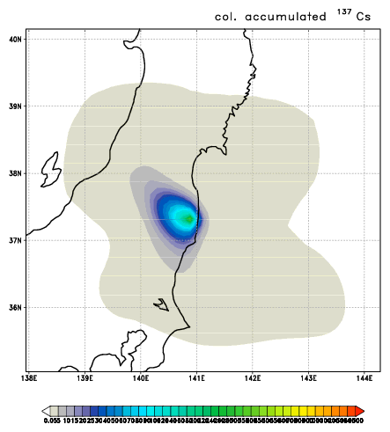
Diffusion effect
Simple smoothing for consideration of horizontal diffusion
F_{i} = 0.025F_{i-1} + 0.95F_{i} + 0.025F_{i+1}
Org
SL
Hybrid
SL + diff
Hybrid + diff
Column accumulated ¹³⁷Cs

Slide 13
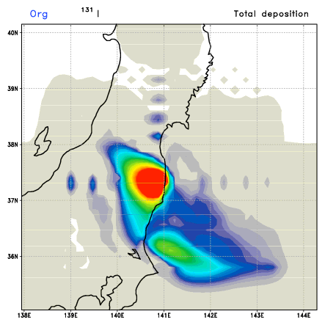
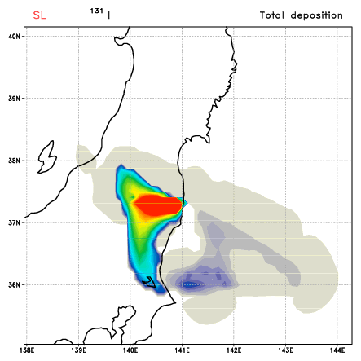
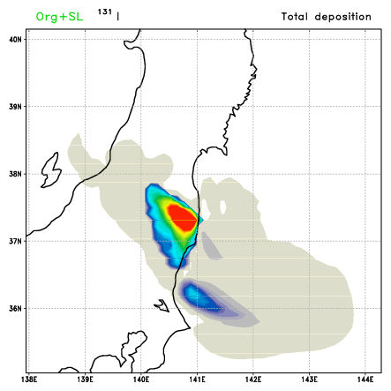
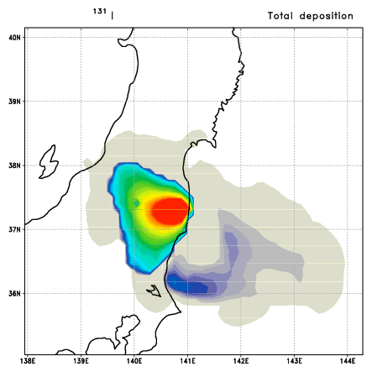
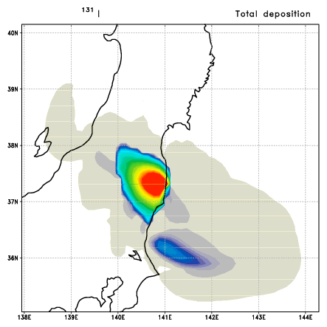
Diffusion effect
Org
SL
Hybrid
SL + diff
Hybrid + diff
Surface total deposition ¹³¹I

Slide 14
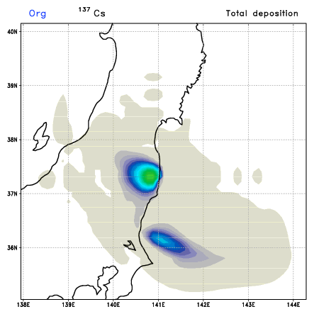
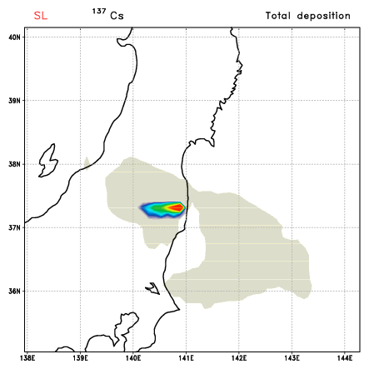
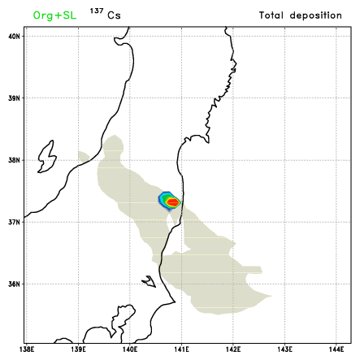
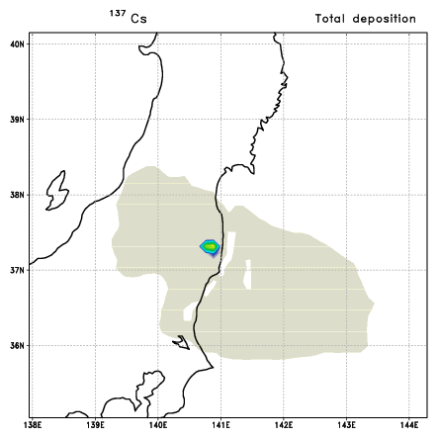
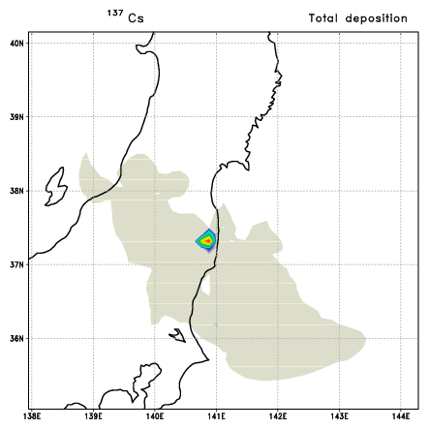
Diffusion effect
Org
SL
Hybrid
SL + diff
Hybrid + diff
Surface total deposition ¹³⁷Cs

Slide 15
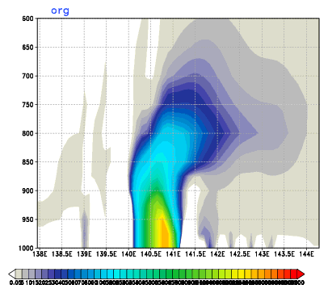
Vertical structure
Org
SL
Hybrid
SL + diff
Hybrid + diff
48 hour averaged ¹³¹I
averaged for 37~38N

Slide 16
Vertical structure
Org
SL
Hybrid
SL + diff
Hybrid + diff
48 hour averaged ¹³⁷Cs
averaged for 37~38N

Slide 17
Summary
Semi-Lagrangian can remove the Gibbs phenomenon in IsoRSM.
Precipitation from semi-Lagrangian is too weak in comparison with the spectral version.
Surface deposition from semi-Lagrangian is smaller than from the spectral version.
Vertical transport of tracer is weaker in semi-Lagrangian version than in spectral version.
Diffusion (smoothing) has some effect.
Hybrid version is current choice. But, fully semi-Lagrangian version should be revised.
Plan
Revise semi-Lagrangian part for vapor (lateral boundary treatment)
Physically based diffusion consideration
Surface deposition process
EVALUATION with available observation

Slide 18
Thank you

Slide 19
Daily averaged variables from 15UTC 15 March 2011 to 15UTC 16 March 2011
total precipitation
Precipitable water
vertical velocity
specific humidity
Relative humidity (%)
Specific humidity (g kg⁻¹)
initiation of large-scale precipitation is supersaturation (>100%)
initiation of convective precipitation is instability

Slide 20
Specific humidity (g kg⁻¹)

Slide 21
Relative humidity (%)
White contour : RH 99% level

