Slide 1
河川・沿岸域における
放射性物質の動態・予測
クレスト 村上グループ
新学術 恩田グループ
検討事項
  放射性物質の挙動
    TokyoBay東京湾（Edogawa江戸川、Arakawa荒川、Sumidagawa隅田川）
    Teganuma lake手賀沼（Ohori大堀川）
  Sediment transport土砂輸送のトレーサー
    Budget収支
    Flux細粒土砂の輸送プロセス
    Suspended&Bedload(Washload)浮遊砂・掃流砂のイベントごとの輸送割合の変化
    Watershed流域の土地利用と流出の関係
    CSO合流式下水道雨天時越流水との関係
  Comparison between different watershed流域（河川）ごとの比較
  Biological impact沿岸域の生態系への影響

Slide 2
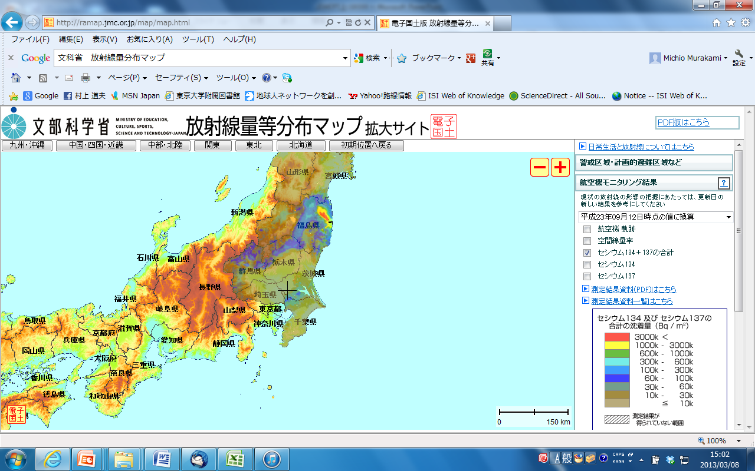
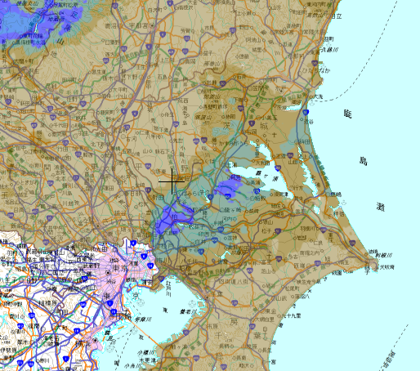
Cesium Distribution in center part of Japan
・Power Plant
200km
Tokyo Bay
Tokyo Bay
cesium concentration (Bq/m2)
12th September 2011
Radioactive contamination is less than 10k Bq/m2.
Hot spot of cesium higher than 10kBq is made only by sediment transport in this area.
Notes:
These figures show the cesium distribution on land.
Left figure shows around center part of Japan,
right figure shows around Tokyo Bay.
Tokyo Bay is about 200km far from the Fukushima power plant,
As a result, Radioactive contamination is less than 10k Bq/m2.
The most important point here, if we find hot spot of cesium higher than 10kBq is made only by sediment transport in this area.

Slide 3
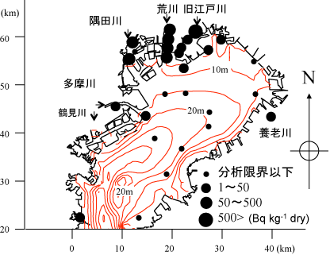
¹³⁴Cs Distribution
Arakawa river
Kyu-Edogawa river
Sumidagawa river
単位cpm

Slide 4
粒径補正による分布の変化
Normalize by sediment size
Before
補正前
After
補正後
¹³⁴Cs
¹³⁷Cs
Cs (Bq kg-¹ dry)
河口からの距離(km)
基準
Cs (Bq kg-¹ dry)
¹³⁴Cs
¹³⁷Cs
河口からの距離(km)

Slide 5
荒川におけるCs時系列
Arakawa river
¹³⁴Cs
¹³⁷Cs
December 2011
June 2012
September 2012
The peak, located 3 km upstream in December 2011, moved downstream with time.
It means, the fine-grained sediment was transported to the downward as bed-load and reached river mouth in September 2012.
Bed-load/Total sediment = 11percent
Cs (Bq kg-¹ dry)
Distance from river mouth(km)
Notes:
This slide shows the temporal variation of cesium in the Arakawa estuary.
The peak, located 3 km upstream in December 2011, moved downstream with time.
It means, the fine-grained sediment was transported to the downward as bed-load and reached river mouth in September 2012.
From this result, the bed-load moved at a speed of 3.5 km/year in this river.
Based on this result bed-load flux was calculated. At the same time I calculated suspended and wash load.
Bed load is 1 percent for total SS flux in nomal condition. 11 percent during rain event.
----------------------------------------------------
By comparing the Edogawa and Arakawa Rivers, the observed river flow rate is 1.5 times greater in the Arakawa River, making the downstream movement less prominent in the Edogawa River.
(In addition, the Edogawa River is a distributary of the Tone River, and the upstream junction has a dam to contain the river flow. During large water flow, peak flow volume is cut, thus accelerating sedimentation and decreasing sediment transportation toward the river mouth. )
As shown above, the space–time variation of cesium delineated the characteristic differences between the two rivers and helped clarify the transport of bed-load, which had been difficult to evaluate in the past.

Slide 6
江戸川
Edogawa estuary
Didn’t move the peak
December, 2011
June, 2012
September, 2012
Cs (Bq kg-¹ dry)
Distance from river mouth (km)

Slide 7
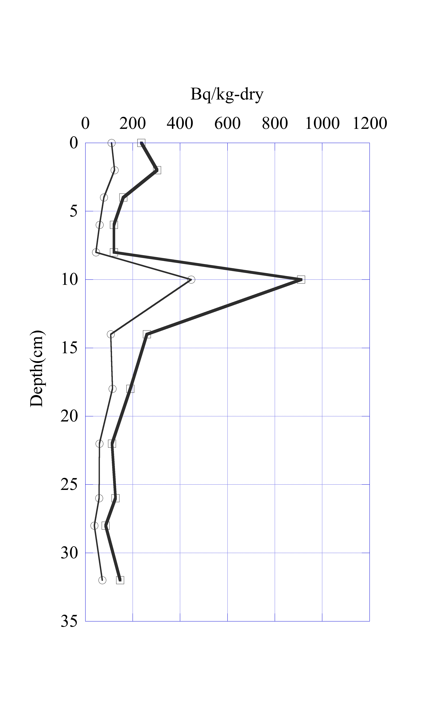
Cs Profiles 江戸川
Riverbed
2012年梅雨後に出現
2012年梅雨後に出現
2011年梅雨後に出現
2011年梅雨後に出現
10cm
¹³⁷Cs
¹³⁴Cs
¹³⁷Cs
¹³⁴Cs
At river mouth
10km from river mouth
September2012
Notes:
These figures show the vertical distribution of cesium in the sediment both at the river mouth of the Edogawa River(left) and at 10 km from the river mouth(right).
Zero refers to the surface layer of the riverbed.
Both at the river mouth and 10 km upstream, a peak is found at 10 cm below the riverbed surface.
In the Edogawa River, the peak was 10 km upstream of the river mouth and tended to decrease with time.
Because the peak is 10 cm below the surface of the sediment core, it may be assumed that the fine-grained sediment deposited in 2011 is being buried under the recent, much less contaminated sediment. It was also found that the downstream flow of bedload is extremely small.
堆積物をみてみました。
堆積物の深さ１０ｃｍのところに高濃度のセシウムがあり、
表層は低濃度となっています。
これは2011年当初にたまった土砂の上に、汚染の少ない土砂が混合しながら滞積した結果とみられます。

Slide 8
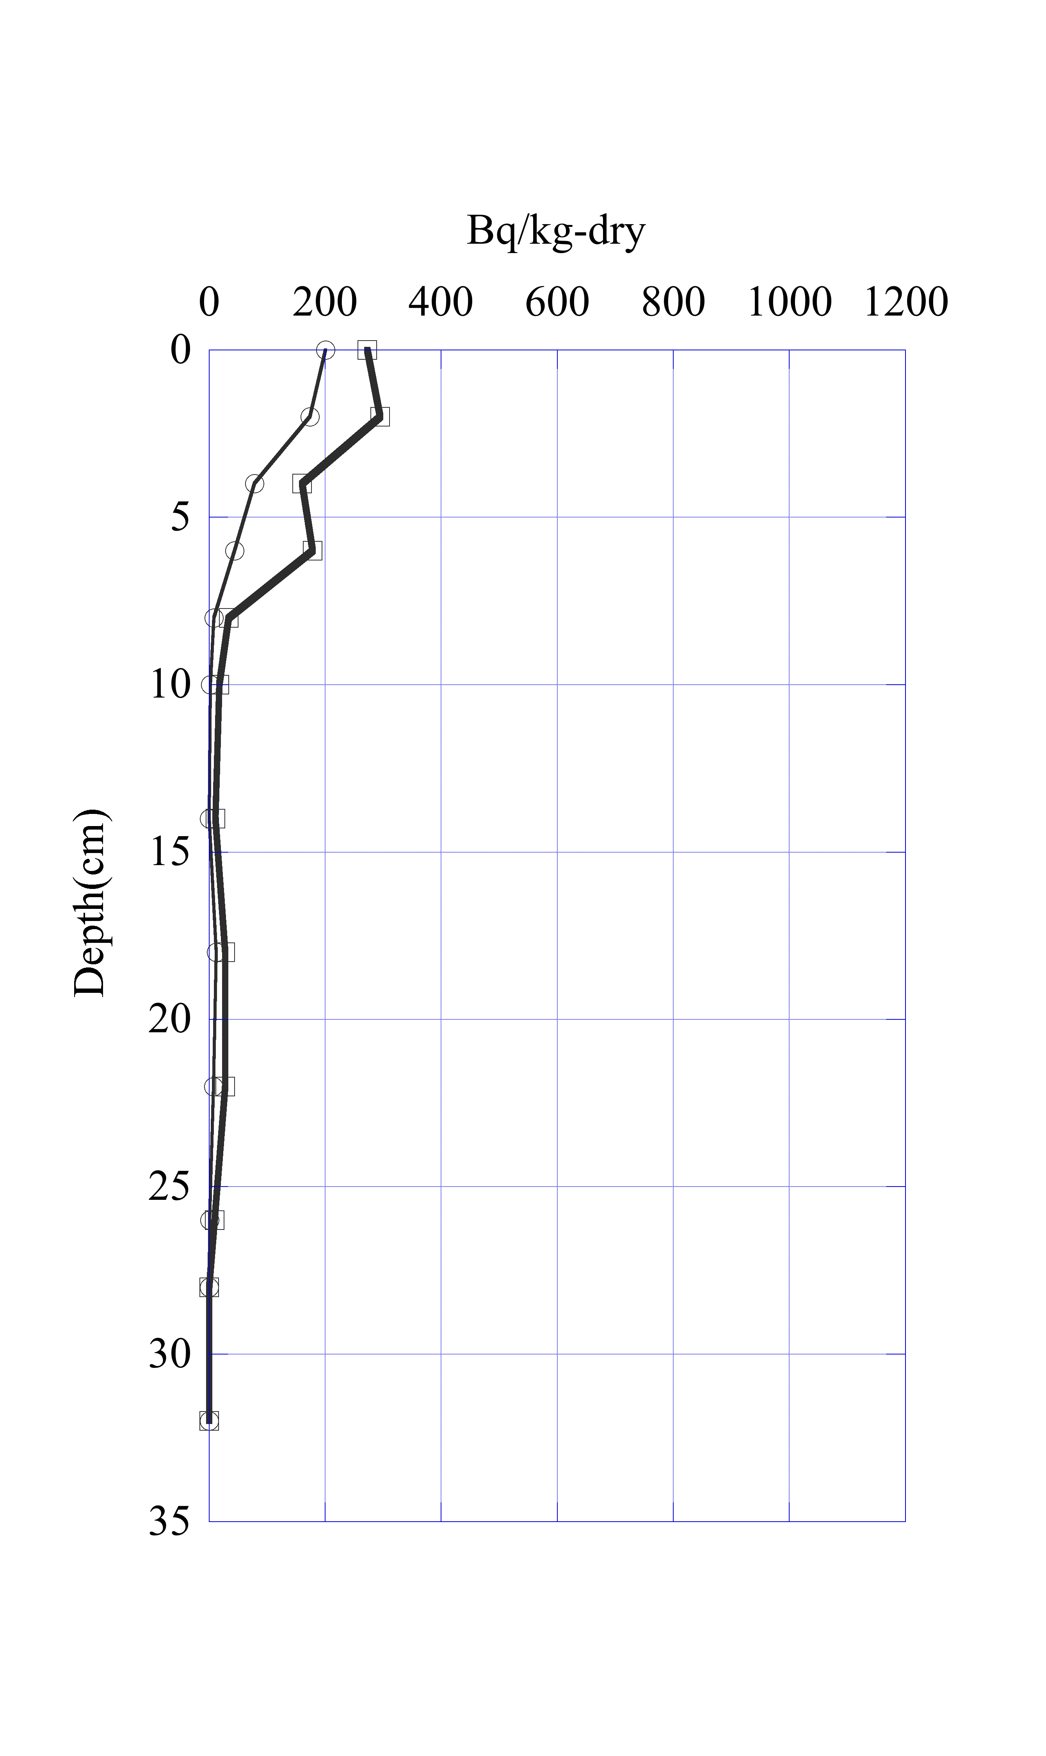
Cs Profiles 荒川
¹³⁷Cs
¹³⁴Cs
¹³⁷Cs
¹³⁴Cs
0km from river mouth
10km from river mouth
September2012
表層だけを比較すると河口の方が高濃度
Notes:
堆積物をみても、河口から１０ｋｍの深さ８ｃｍ程度が最も高く、
表層に向かって濃度が減少しています。
江戸川のように完全に堆積しているわけではないが、
下層への輸送量は小さい

Slide 9
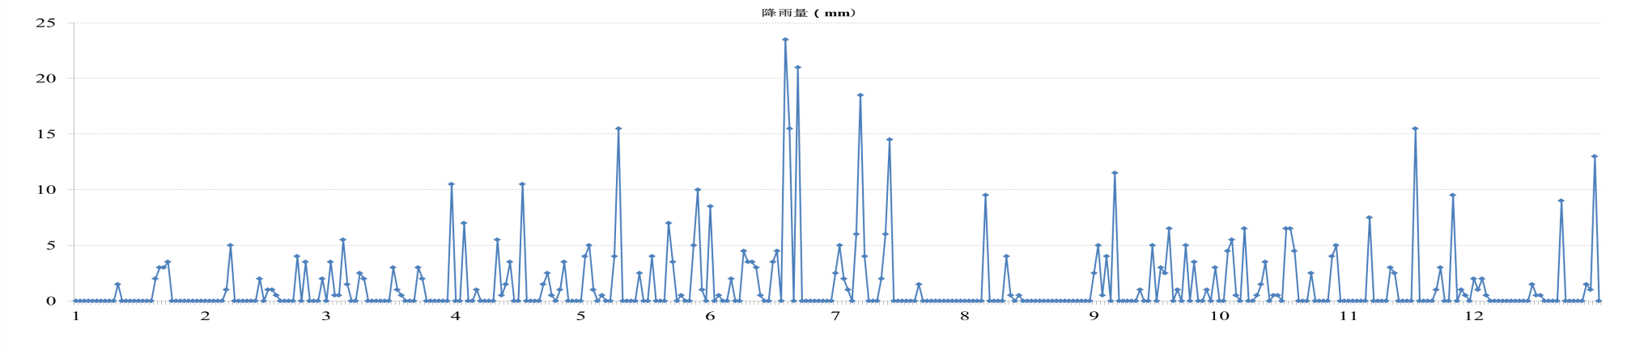
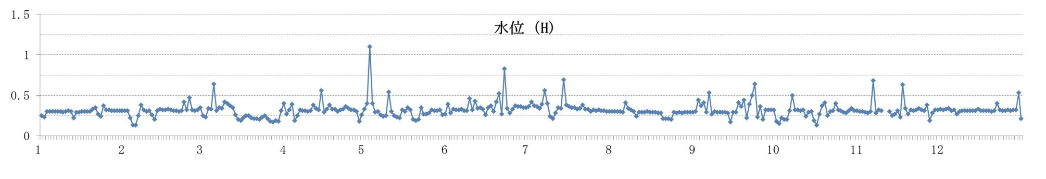
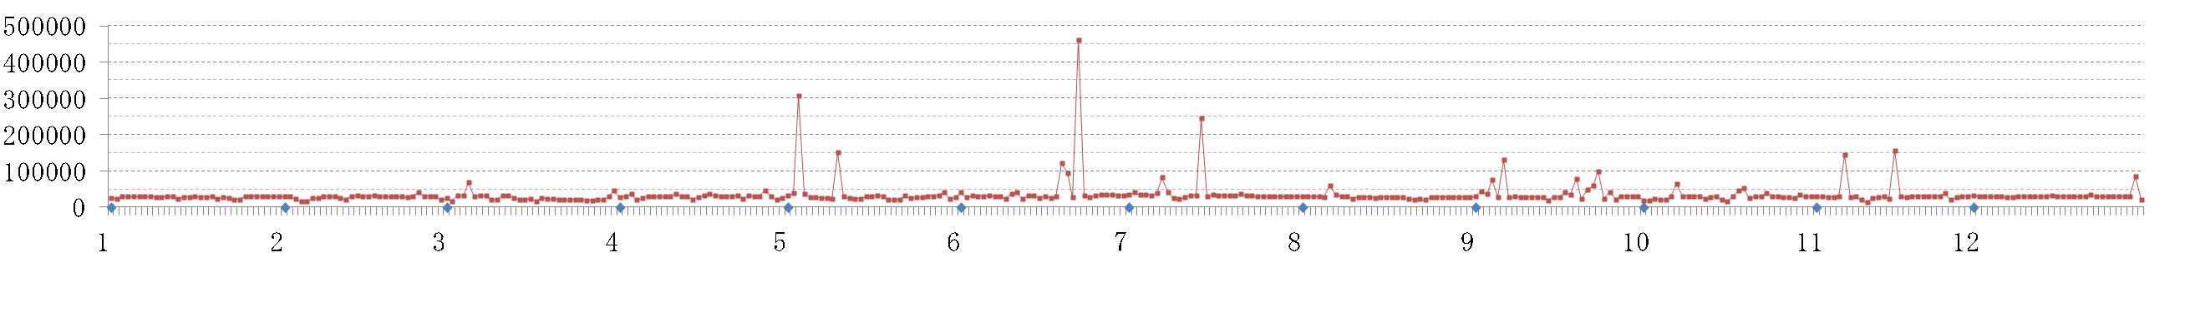
大堀川昭和橋の2012年度時系列
Timeseries of Ohorigawa river in 2012
降雨量（mm）
水位（m）
流量（ ｍ³/s ）
2012年

Slide 10
Cs 輸送パターン
Classification
Dominant支配因子
Advection移流
Large impact 蓄積大
Advection&Diffusion(mix)
移流＋拡散
Diffusion(mix)
拡散
東京湾への蓄積小
Ohorigawa
大堀川
7kt/year
230kt
手賀沼
Arakawa
荒川
Sumida
隅田川
Edogawa
江戸川

Slide 11
Time series of Cs in Tokyo Bay
River mouth
Center of Tokyo Bay
Cesium is being buried by the much less contaminated sediment in rivers.
Also, since the dissolution of cesium from the bed-load is minimal,
2012
Notes:
Here you can see time series of cesium concentration in Tokyo Bay.
At the river mouth, cesium increased after the rain event.
On the other hand, cesium decreased gradually with time at the center of Tokyo Bay.
This is due to sedimentation at river mouth.
As a result, cesium is being buried by the much less contaminated sediment in rivers.
Also, since the dissolution of cesium from the bed-load is minimal,
Cesium is likely to be more deeply buried in the future, and the possibility for cesium to spread from Tokyo Bay to the Pacific Ocean is extremely low.
河口部では、河川からの輸送によって、降雨後に増加して、その後減少している
湾中央でも減少している
この減少は湾内での輸送の影響とみられるが、今のところその速度は不明である。
2012年の10月に若干高いものが到達したので、その拡がりの時系列から、湾内でのベッドロードトランスポートも定量化しようと考えています。

Slide 12
Future Plan今後のプラン
コアサンプリング
Continue core sampling every 3 months at Edogawa, Arawaka, Sumidagawa,
Continue monthly sampling at Tokyo Bay, Ohorigawa river, and so on.
During rain and after rain. SS sampler
  3ヶ月に１回程度（梅雨前後、台風前後）の頻度
  江戸川・荒川・隅田川(東京湾）
  大堀川（手賀沼）
  柏の公園の池
表層土砂サンプリングによる分布の確認
  Estimate contributions of each event for SS load and Bed load and wash load.
  Estimate total mass of sediment and Cs and other radionuclide for example pb-210 and Sr(Strontonium) with Professor Onda team.
  月1回底質表面100カ所 コミュニティサンプリング
  SS測定、流量測定（高頻度）、浮遊砂サンプラー（２週間に1度）、表層測定による重心の移動速度推定、総量変化
Biological impact 生物への影響
  Sea warm to know the effect of ecosystem of Teganuma Lake and Tokyo Bay.
  Measured biological exchange late was about 2 weeks/individual and modeled it.
  Community sampling is continued for fish, shell fish and sediment to know the large area of this effect.
  汚染底質でのゴカイ飼育、コミュニティーサンプリング（貝、魚、海藻）
Publish論文
  Publish new results. Published only a part of 2011. and did not of 2012 and 2013
  2011年の一部のみ公表済み

Slide 13
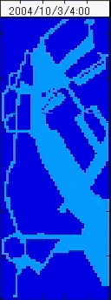
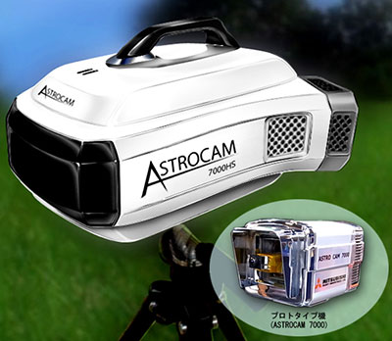
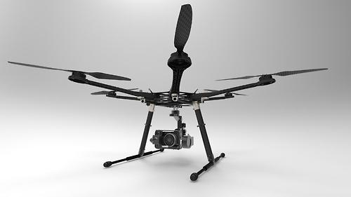
Challenge
Simulation
Compton Camera
  Aerial image
  supply
In situ Sensor
  Surface river bed

