Slide 1
Semi-Lagrangian advection scheme for radioactive tracers in a regional spectral model
2013. 10. 29. CREST meeting
Eun-Chul Chang and Kei Yoshimura

Slide 2
Progress
Motivation
In the original IsoRSM, radioactive tracer fields have Gibbs phenomenon which is one disadvantage of spectral model system.
Semi-Lagrangian
The Gibbs phenomenon is removed by replacing spectral tracer advection part with semi-Lagrangian advection scheme.
Debugging (vertical wind)
Too weak vertical motion in semi-Lagrangian is fixed.
MPI (parallel computing)
MPI coding for semi-Lagrangian is done. More possibility for more experiments.
High-resolution run
Test high-resolution (10 km → 5 km) experiment to capture detailed features of surface deposition.

Slide 3
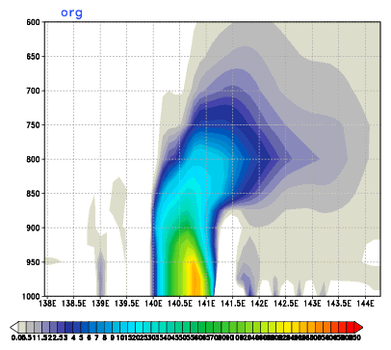
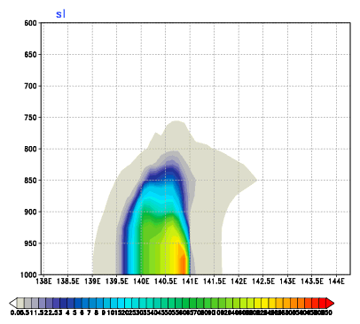
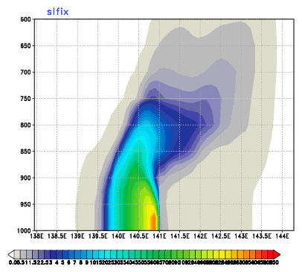
Debugged vertical velocity
Vertical acceleration is used in where vertical velocity is required
: Revised
48 hour averaged ¹³⁷Cs averaged for 37~38N
Org
SL error
SL

Slide 4
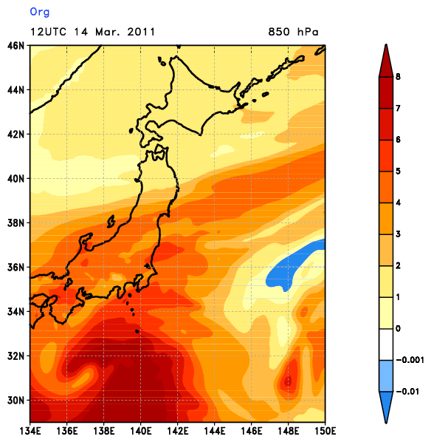
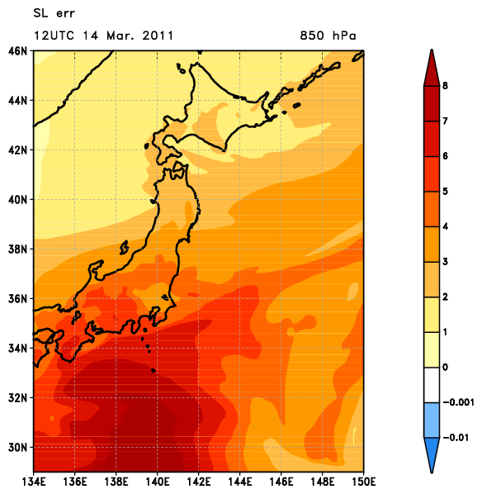
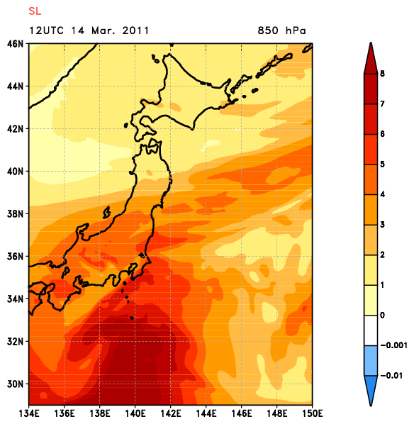
Specific humidity (g kg⁻¹)
Org
SL error
SL

Slide 5
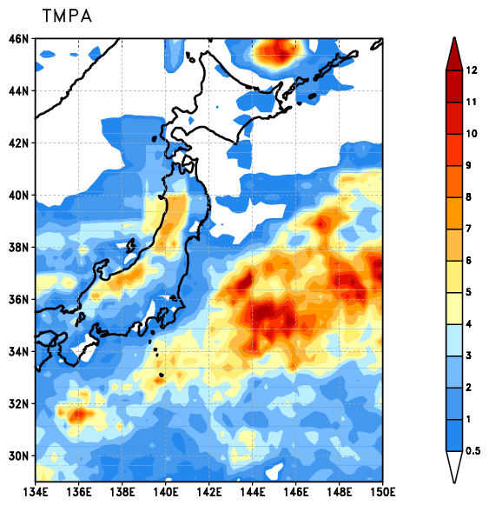
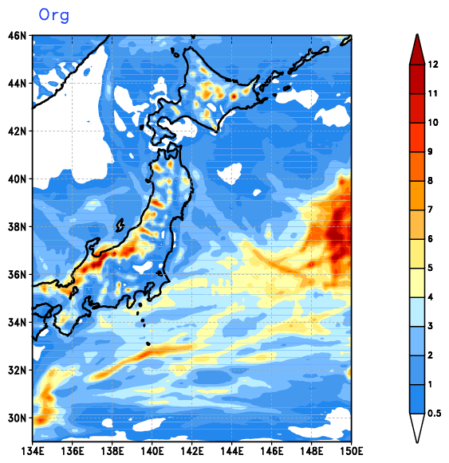
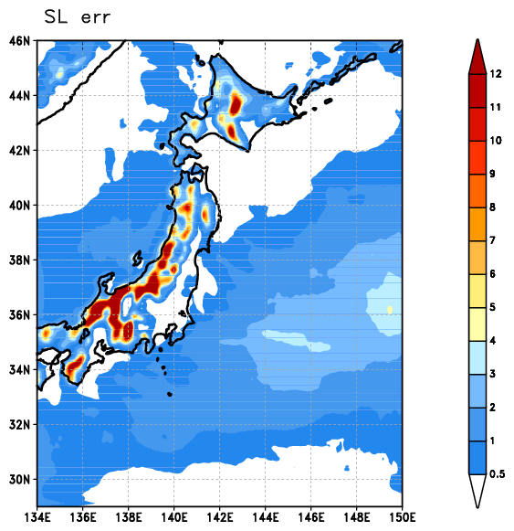
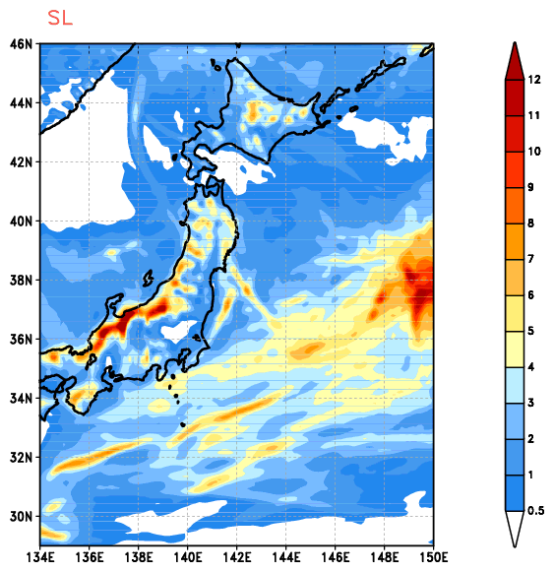
16 days averaged precipitation (mm d⁻¹)
TMPA
Org
NDSL IsoRSM
SL error
SL

Slide 6
Result : 3-D tracer advection
Org
NDSL
Org
NDSL

Slide 7
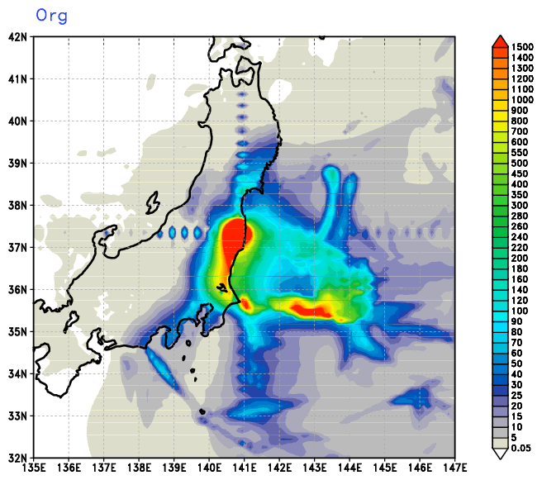
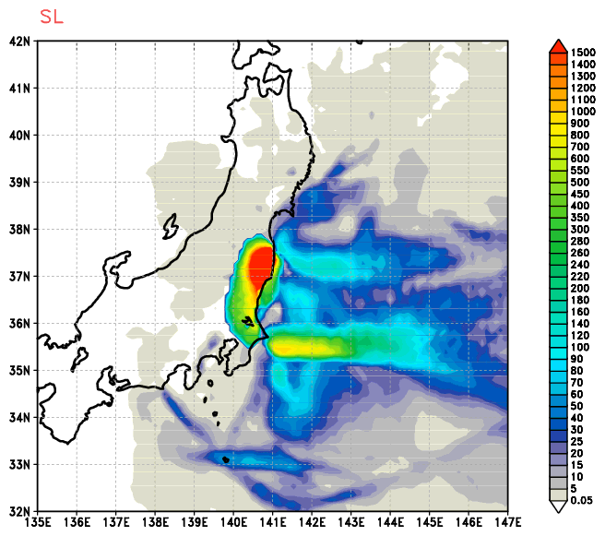
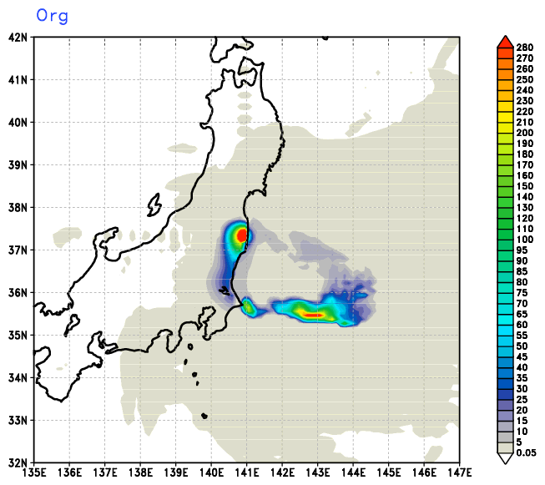
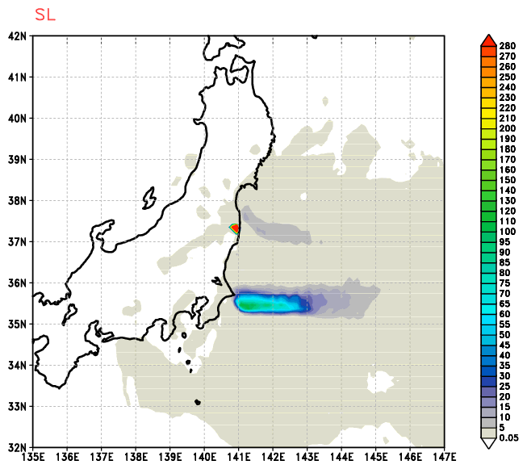
16 days averaged total surface deposition of ¹³¹I (kBq m⁻²)
16 days averaged total surface deposition of ¹³⁷Cs (kBq m⁻²)

Slide 8
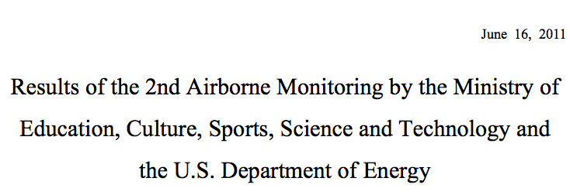
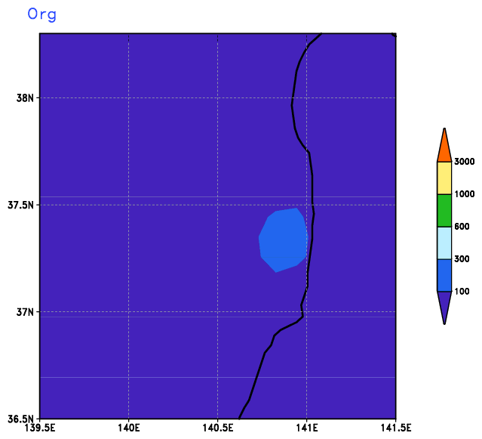
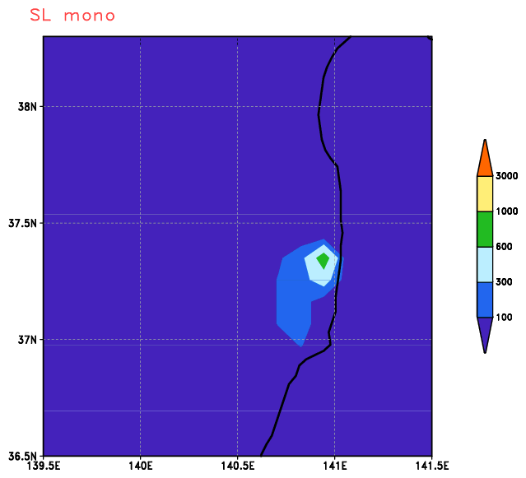
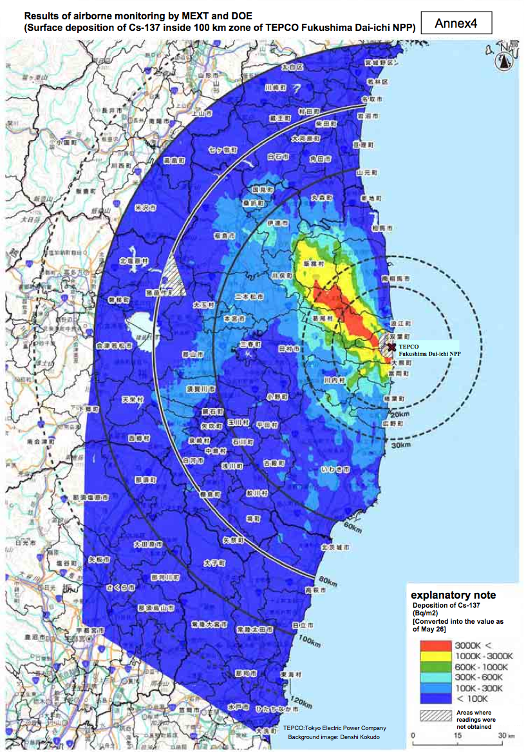
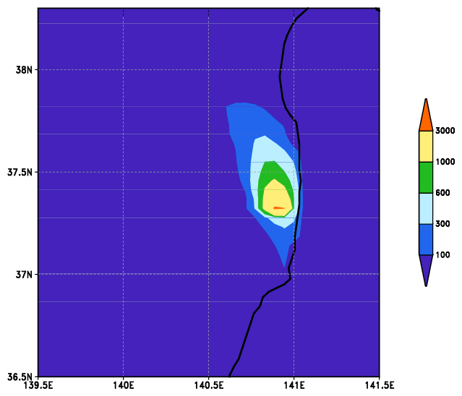
¹³⁷Cs surface deposition
Org 10km
NDSL 10km
NDSL 5km

Slide 9
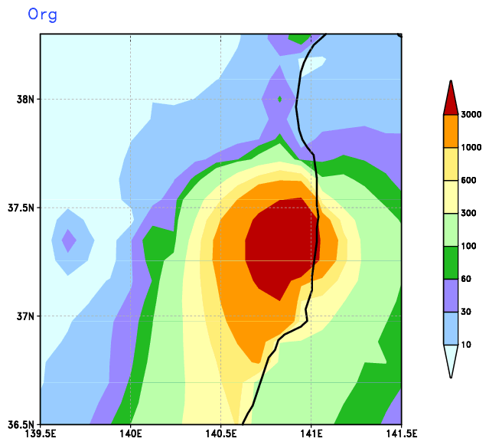
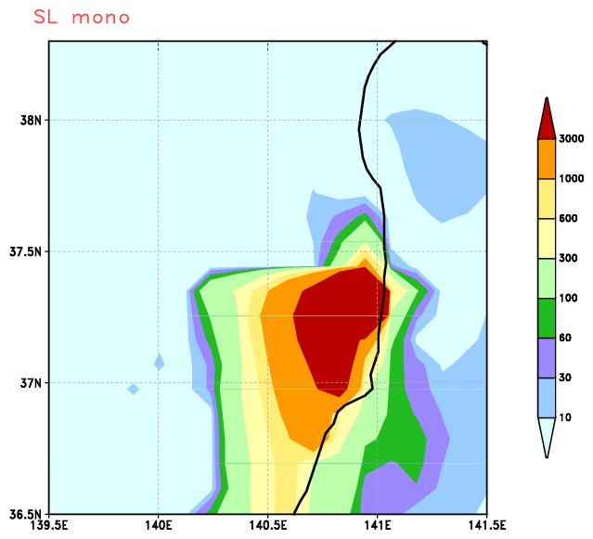
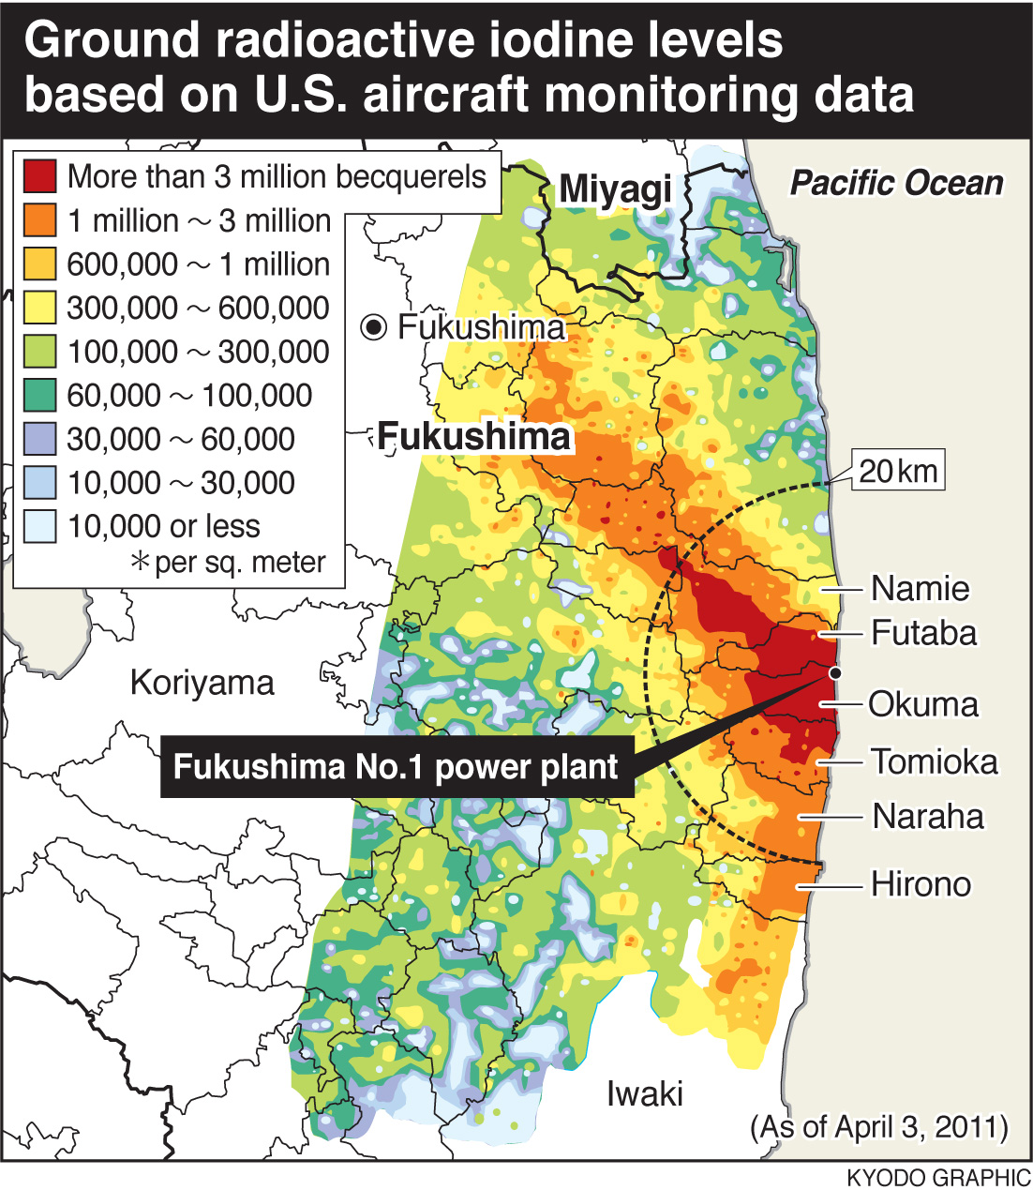
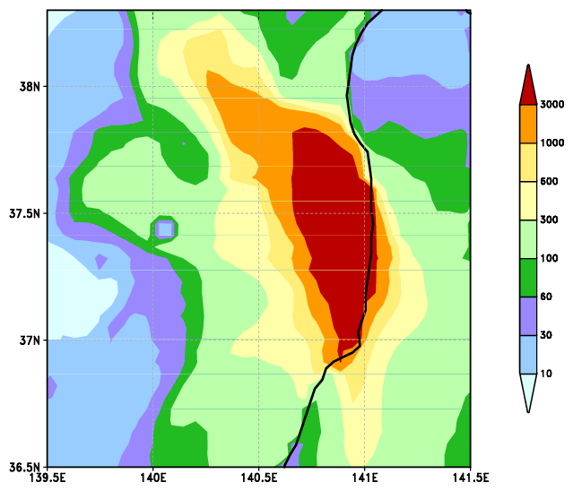
¹³¹I surface deposition
Org 10km
NDSL 10km
NDSL 5km

Slide 10
Summary
Too weak vertical transport is fixed.
Surface deposition is still not realistic.
Higher resolution (5 km) shows some possibility to capture north-western transport.
Plan
Physics parameterization update (PBL, microphysics, and deep convection schemes)
Surface deposition process (dry and wet)

Slide 11
Thank you

Slide 12
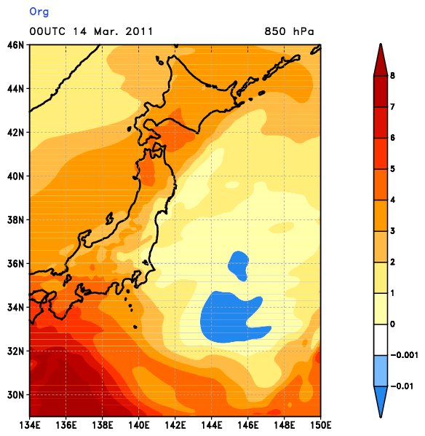
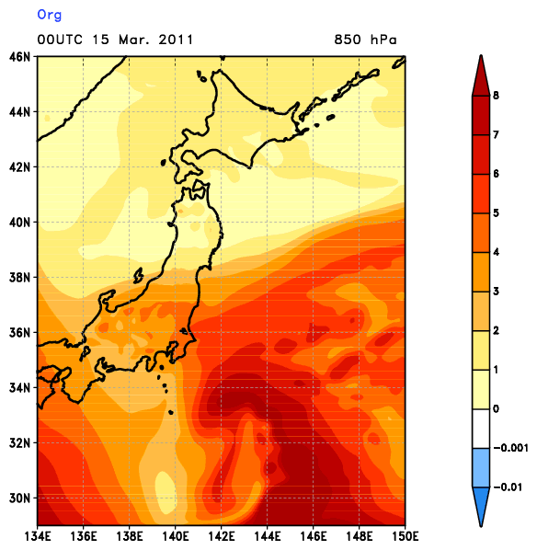
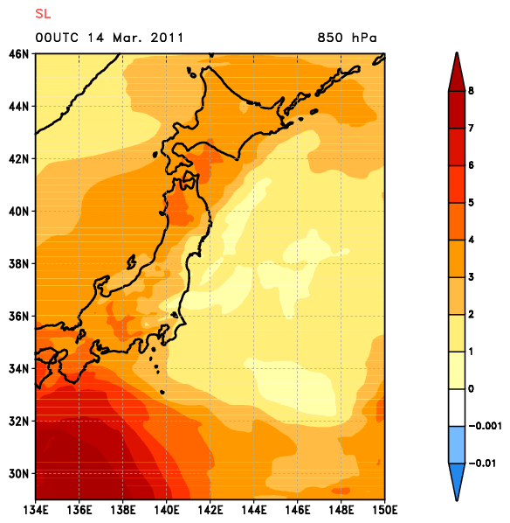
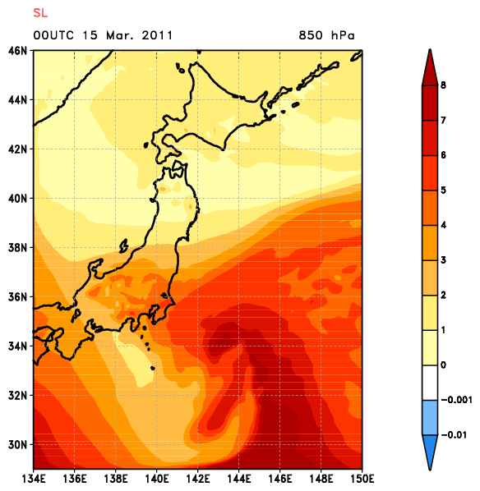
Specific humidity (g kg⁻¹)
Org
NDSL

