Slide 1
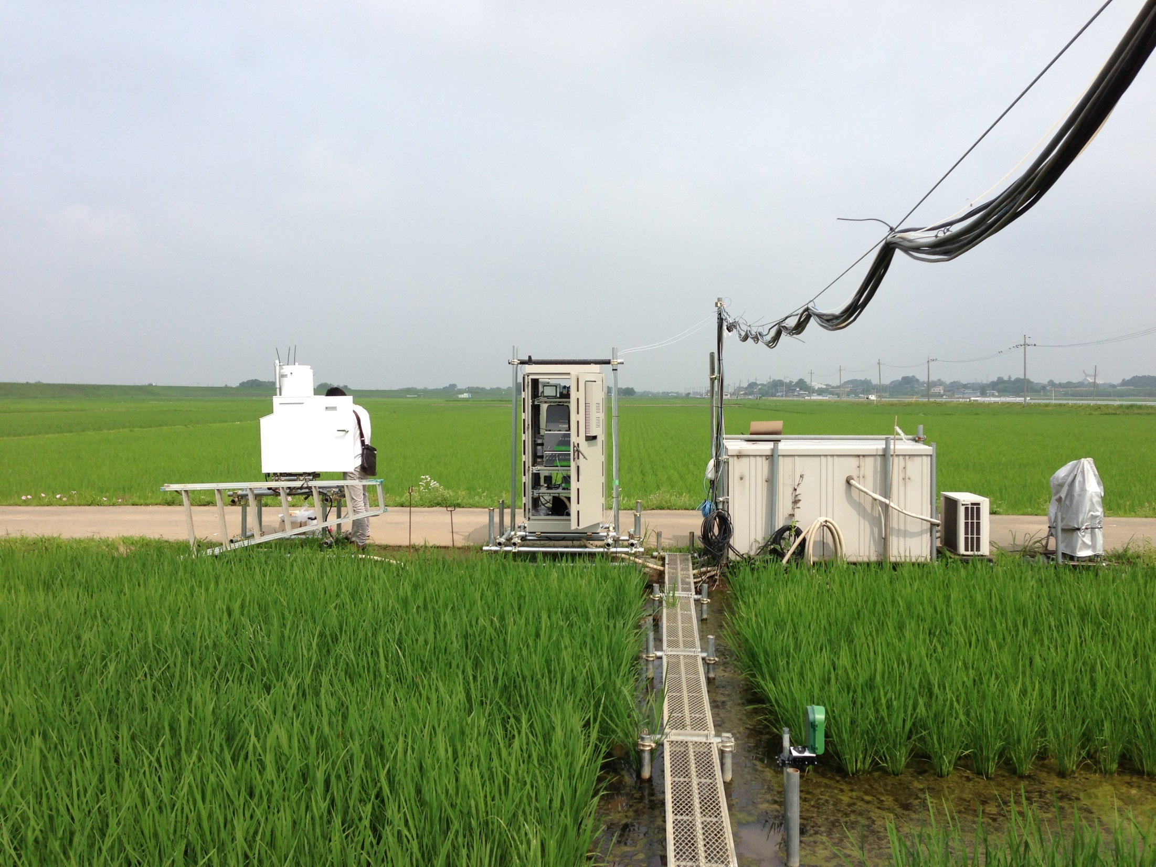
真瀬での水蒸気同位体比測定
芳村圭*・魏忠旺・岡崎淳史・前田英俊・
乃田啓吾・木口雅司・小池雅洋・金元植・横井正治
＊東京大学大気海洋研究所
２０１４年２月７日＠NIAES

Slide 2
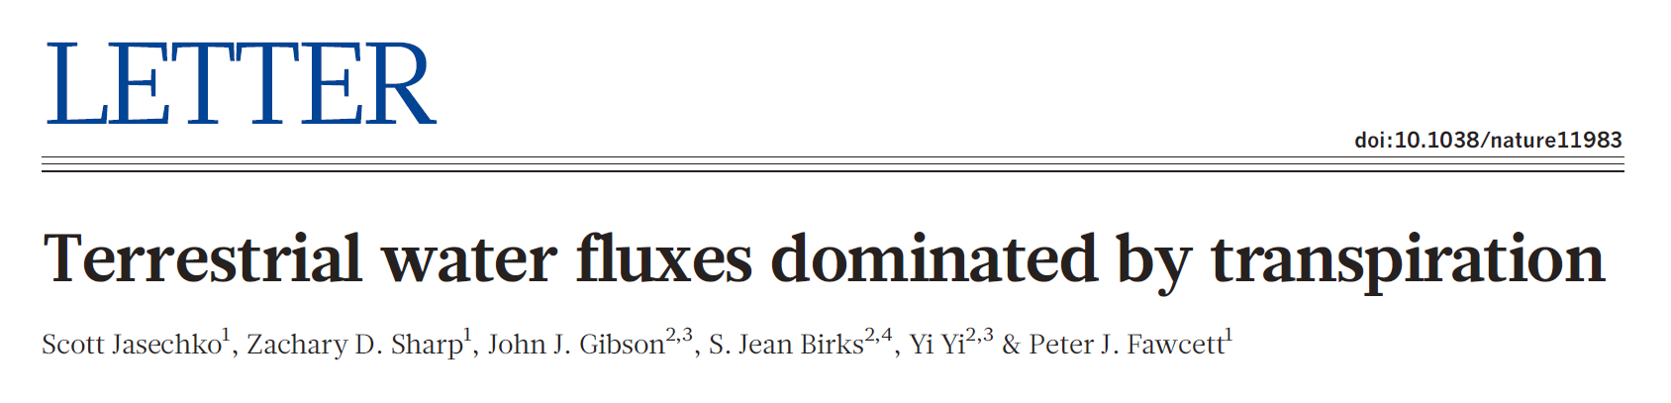
Published on 2013/4/3
Here we use the distinct isotope effects of transpiration and evaporation to show that transpiration is by far the largest water flux from Earth’s continents, representing 80 to 90 per cent of terrestrial evapotranspiration. (Previously spanning 20 to 65 per cent of total terrestrial evapotranspiration (14,000 to 41,000 km³ per year))
The dominance of transpiration water fluxes in continental evapotranspiration suggests that, from the point of view of water resource forecasting, climate model development should prioritize improvements in simulations of biological fluxes rather than physical (evaporation) fluxes.

Slide 3
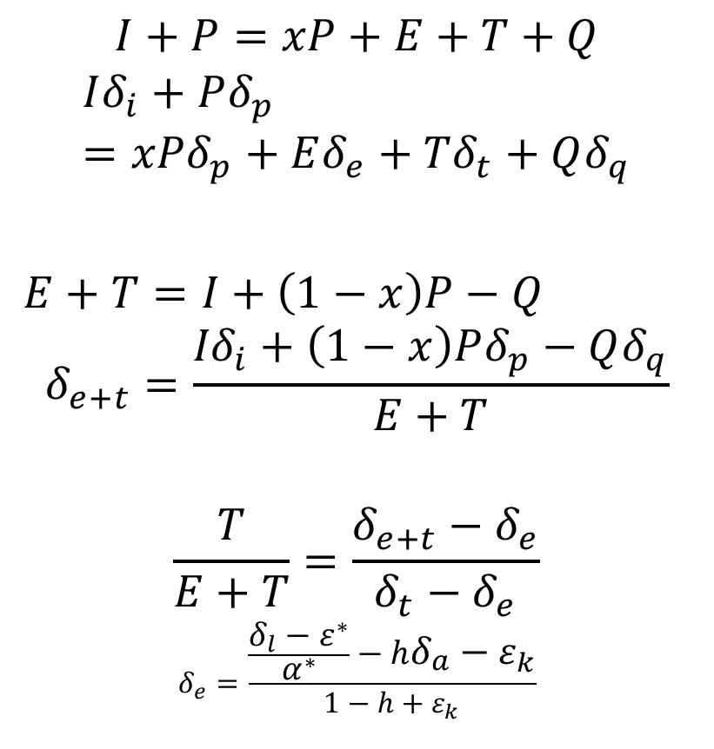
Lake Basin Scale Budget Analysis
Surface
h, δa
I, δi
$$I+P=xP+E+T+Q$$
$$Iδ_{i}+Pδ_{p}=xPδ_{p}+Eδ_{e}+Tδ_{t}+Qδ_{q}$$
$E+T=I+\left(1−x\right)P−Q$
$$δ_{e+t}=\frac{{Iδ}_{i}+\left(1−x\right)Pδ_{p}−Qδ_{q}}{E+T}$$
$$\frac{T}{E+T}=\frac{δ_{e+t}−δ_{e}}{δ_{t}−δ_{e}}$$
$$δ_{e}=\frac{\frac{δ_{l}−ε^{∗}}{α^{∗}}−hδ_{a}−ε_{k}}{1−h+ε_{k}}$$
Interception
xP, δp
P, δp
Soil/Open water E
E, δe
Transpiration
T, δt
δlake
Q, δq

Slide 4
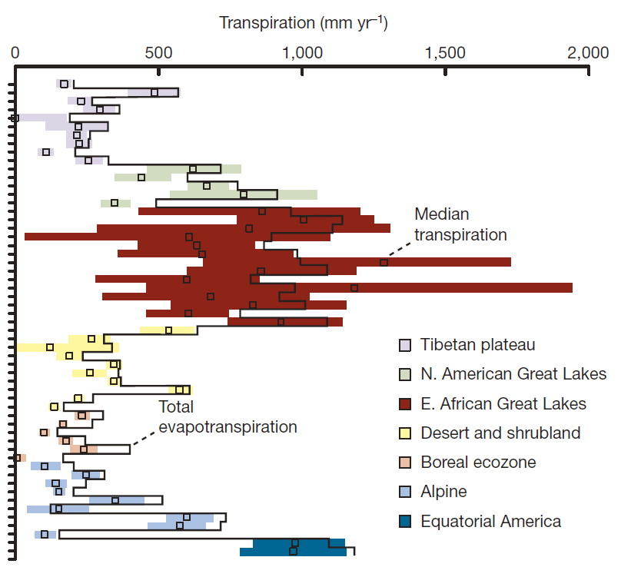
Result
At most of the lake catchments, T/ET is pretty high.

Slide 5
Offline MATSIRO experiment
(as a typical LSM)

Slide 6
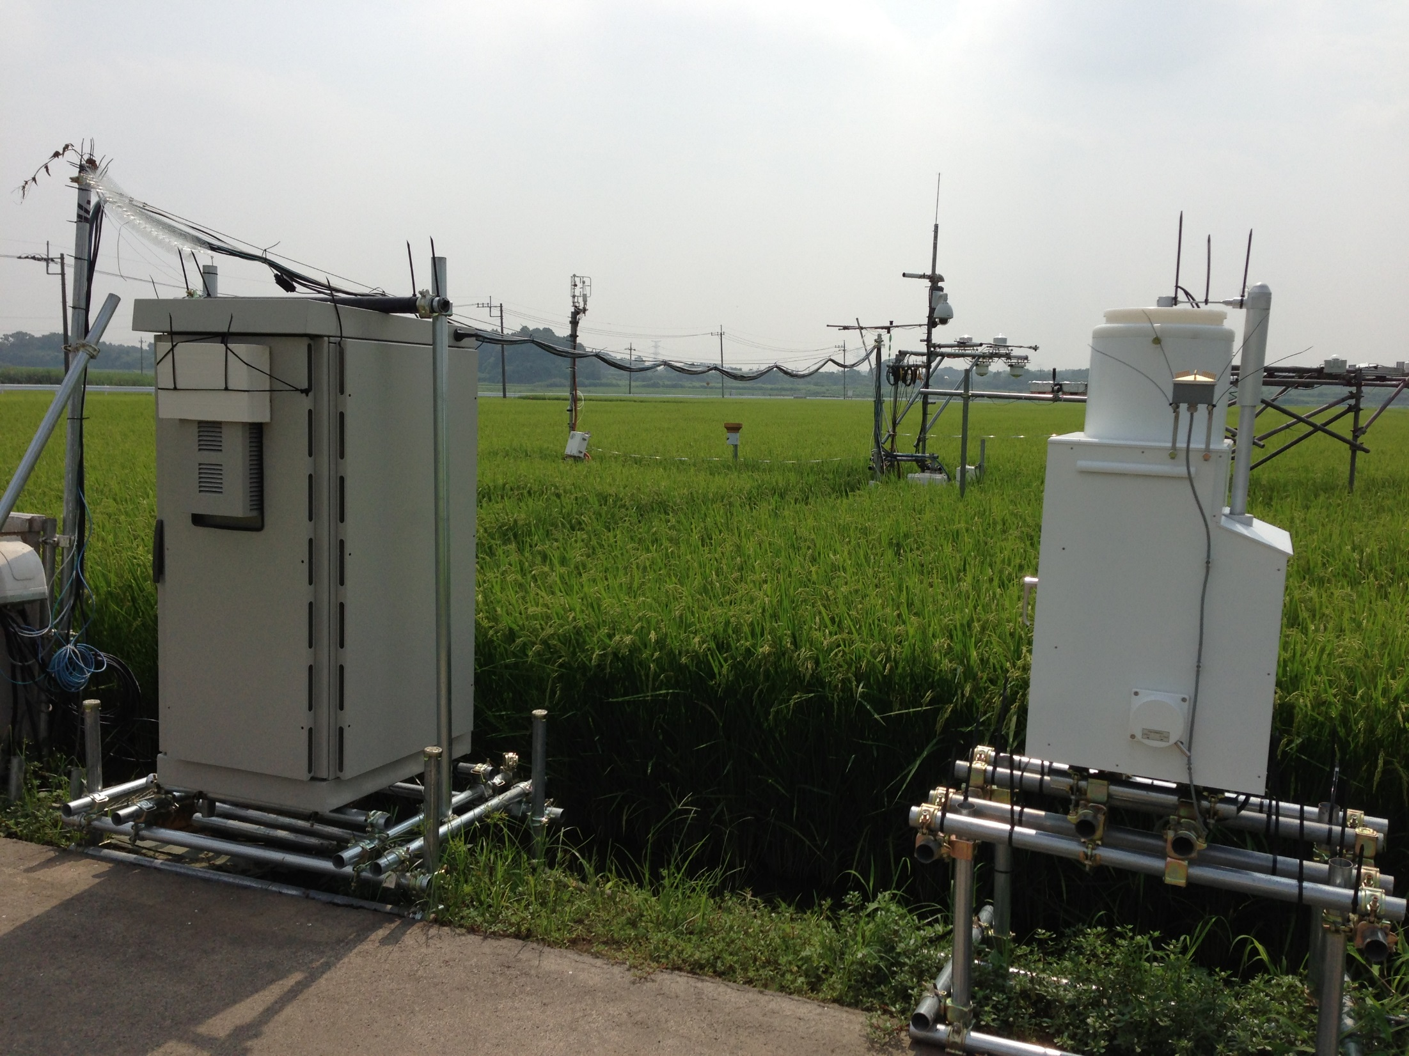

Slide 7
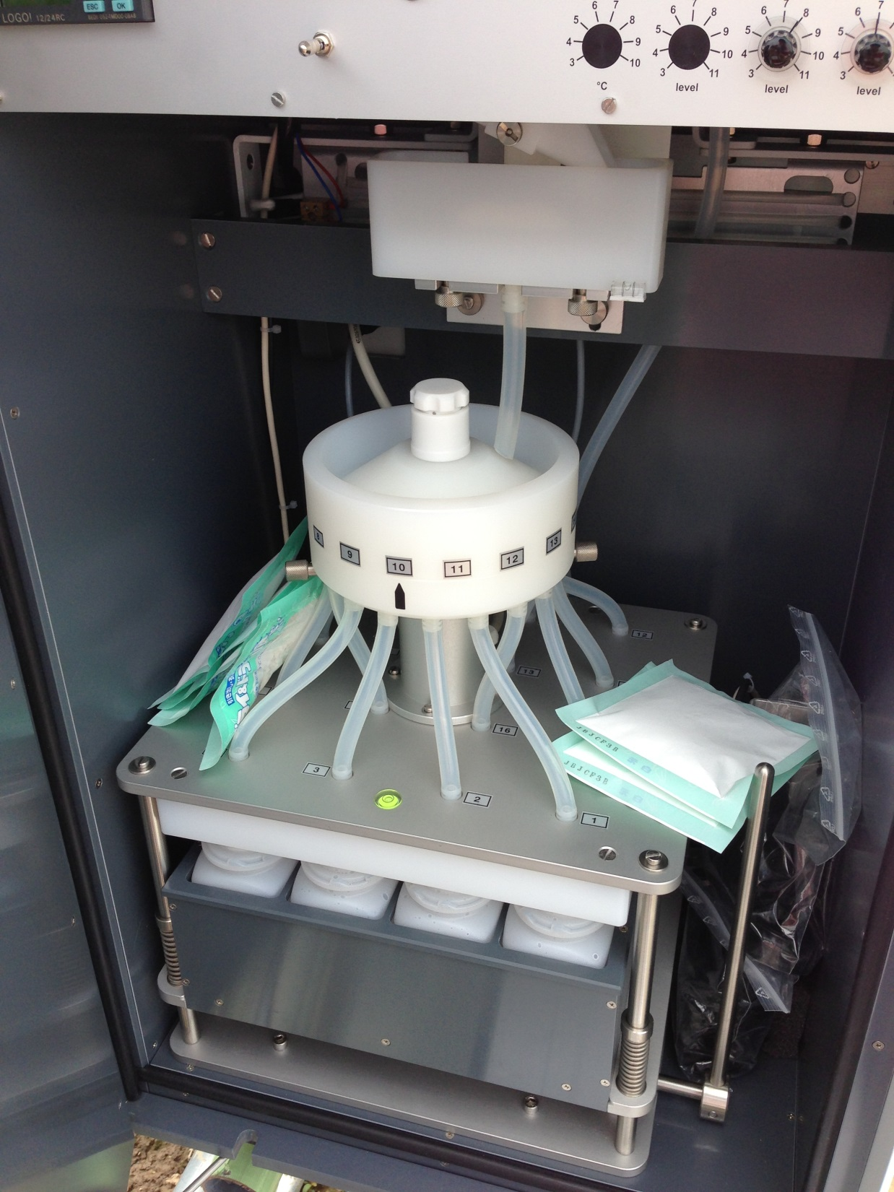

Slide 8
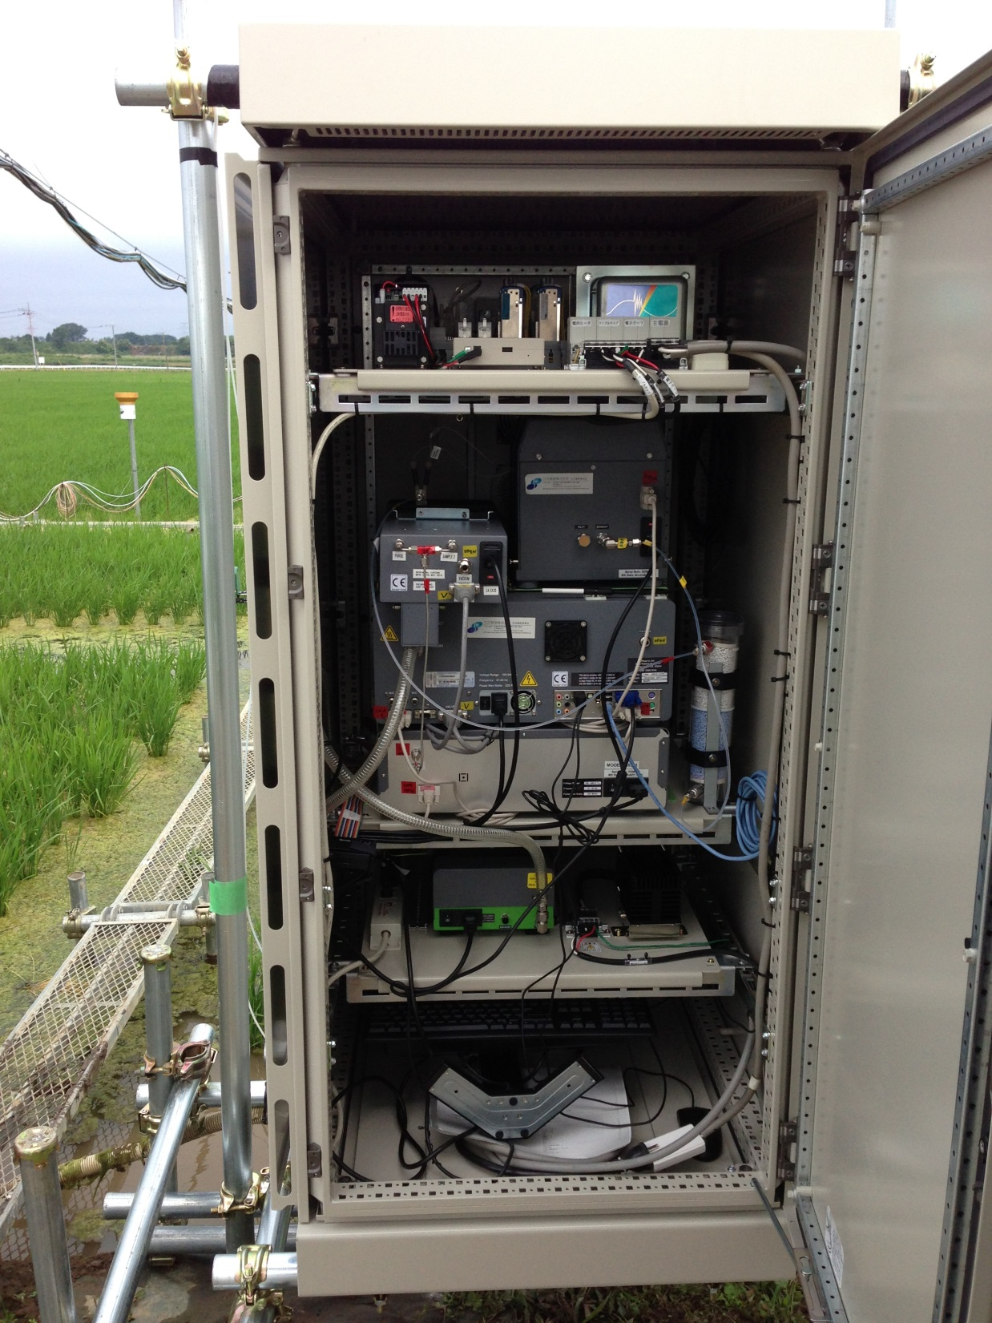

Slide 9
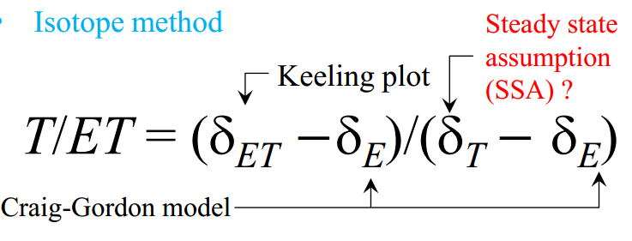
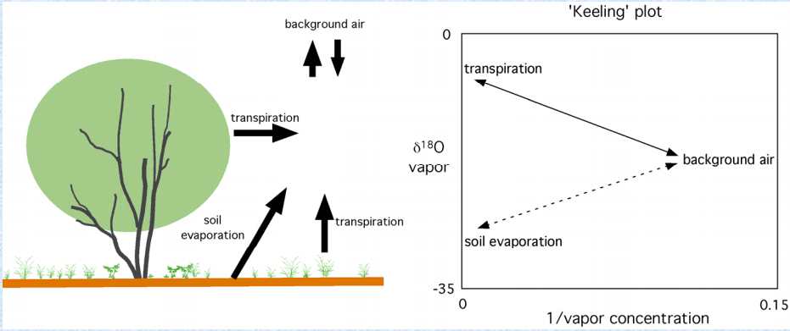
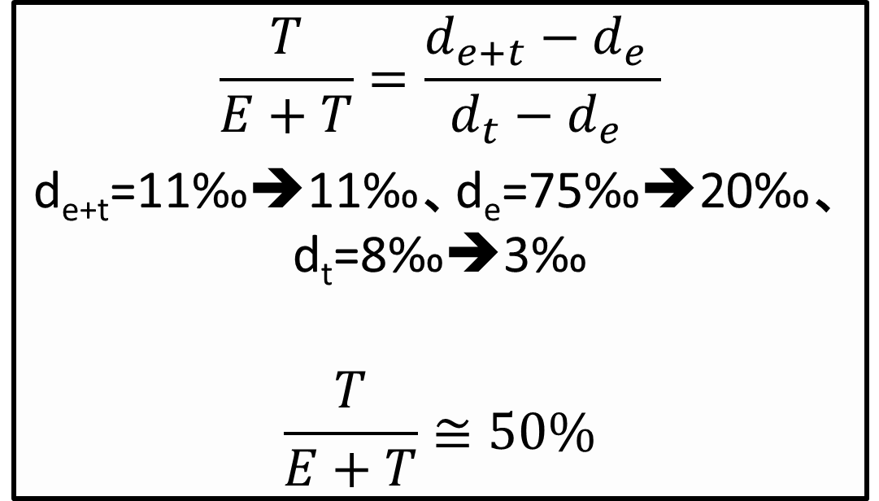
Evapotranspiration estimation
A Keeling plot of 1/[water vapor] vs. δ of water vapor is a mixing line between atmosphere and evapotranspiration
=-6.37
Lin (2008)
An example in our measurement(2013/07/03)
Date | a | δ_{ET} (‰) | R²
2013/06/17 | -2.71e+05 | -20.45 | 0.79
2013/07/02 | -1.39e+05 | -6.37 | 0.80
2013/07/03 | -0.85e+05 | -47.92 | 0.97
2013/07/07 | -2.55e+05 | -2.67 | 0.87
2013/07/13 | -1.01e+05 | -57.55 | 0.80
2013/07/16 | -1.32e+05 | -68.21 | 0.78
2013/07/17 | -1.00e+05 | -55.87 | 0.75
2013/08/14 | -1.91e+05 | -31.46 | 0.96
2013/08/24 | -2.62e+05 | -3.26 | 0.77
2013/09/11 | -1.43e+05 | -5.28 | 0.98
2013/09/30 | -1.39e+05 | -4.63 | 0.91

Slide 10
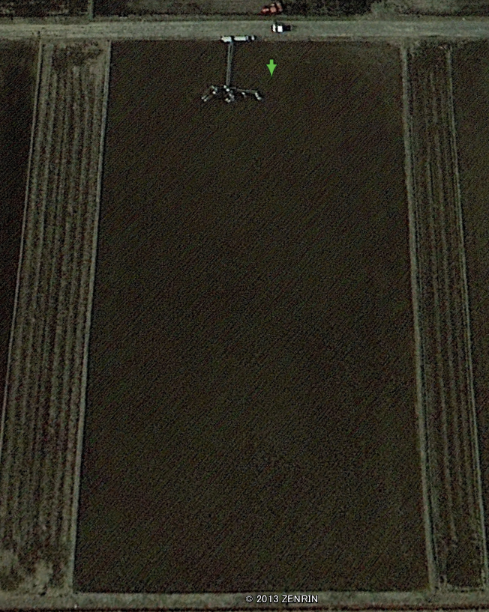
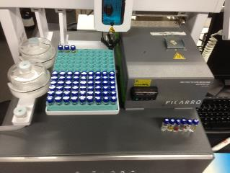
Surface water isotopes observation results
:Transpiration estimation
?
Transpired water = surface water
Input
3
7
2
1
LAI increasing
No LAI
High LAI
Output
4
5
6

Slide 11
Surface water isotopes observation results
June
July
Close to LMWL
Close to Evaporation line
All data distributed along the local meteoric water line in July. However the data in June tended to close to the evaporation line, possibly due to the effect of evaporation of the surface water. After July, the transpiration may play a more important role!

Slide 12
100% transpiration after harvest?
It is reasonable because of high LAI
Not decrease!
Reason:
the uneven distribution of water isotopic ratios observed in our site….
Will be solved at next year
LAI: About 5.0 m² m⁻² (maximum) in Mase site
In IsoRSM and IsoGSM (FT=100% transpiration)

Slide 13
Water vapor isotopes observation results
Precipitation event: isotope ratios in precipitation higher than those in water vapor and keep same phases.
But d-excess almost keep same values.
=>Liquid and vapor phases of water reach the state of equilibrium.
Precipitation
Water vapor
Before and after harvest : isotope ratios: No many difference.
d-excess: Significant different !
Vapor mix ratios: Significant different !
=>Vegetation play a important role in surface moisture!
High LAI
No LAI

Slide 14
Big change in diurnal cycle in d-excess
Wang et al.(2012) suggested the temperature influence on d-excess is limit
Before harvest
Humidity is not the main reason!
After harvest

Slide 15
Wind River Obs/Model comparison on d-excess diurnal cycle of vapor
Courtesy of Dr Lai

Slide 16
FY2014 Plan and Request
Measurement throughout a year!!
Multiple heights sampling
  → Is it OK to add one or two tube(s)?
More frequent surface water sampling
  → It’d be very appreciated if any volunteer.
Measurement of paddy water inflow/outflow
  Is it OK to install flow meter at inlet tap(s)?
  Is it OK to install discharge meter at outlet(s)?

Slide 17
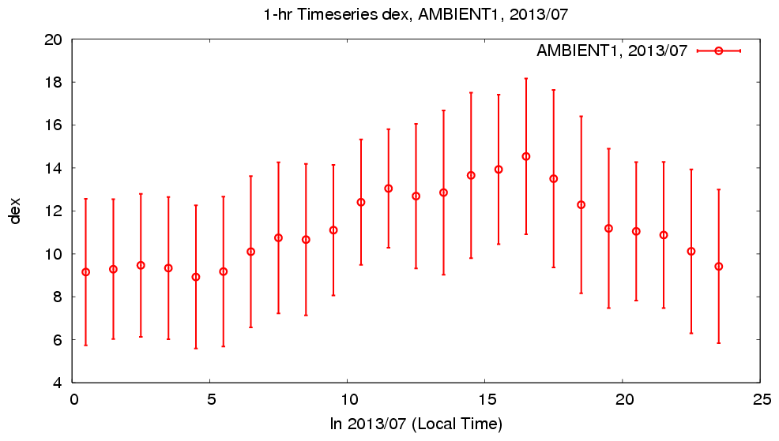
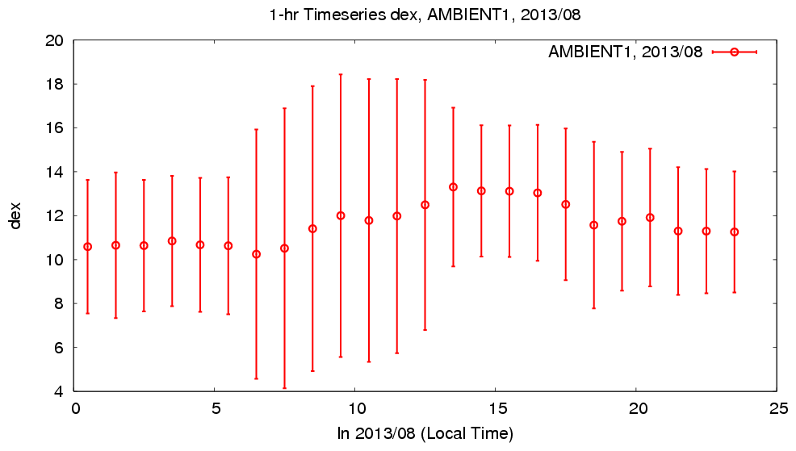
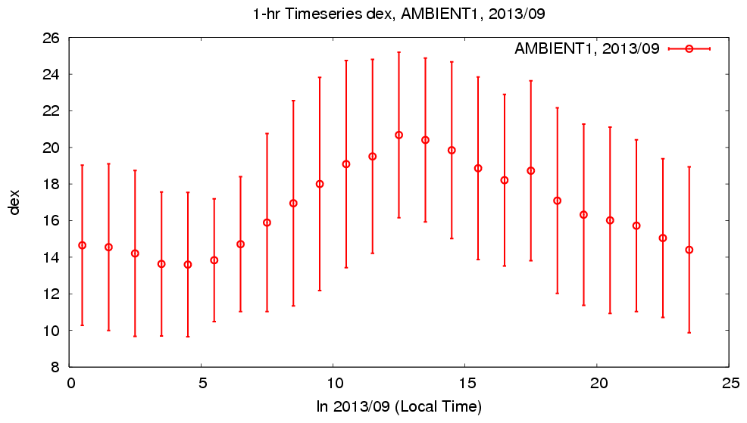
Diurnal cycle of D-excess
Simulated ET
Observed Vapor
(‰)
20
Jul.
4
20
Aug.
4
Sep.
26
8
ピーク
Significant diurnal cycle in ET flux is simulated in the model even with no diurnal cycle in forcing vapor isotope.
Surface vapor isotope cannot be simulated with online experiment. (It is forcing.)
Notes:
実験設定上ピークタイミングの変化が表れないことは問題ではない（モデル内に「収穫」はないため）

Slide 18
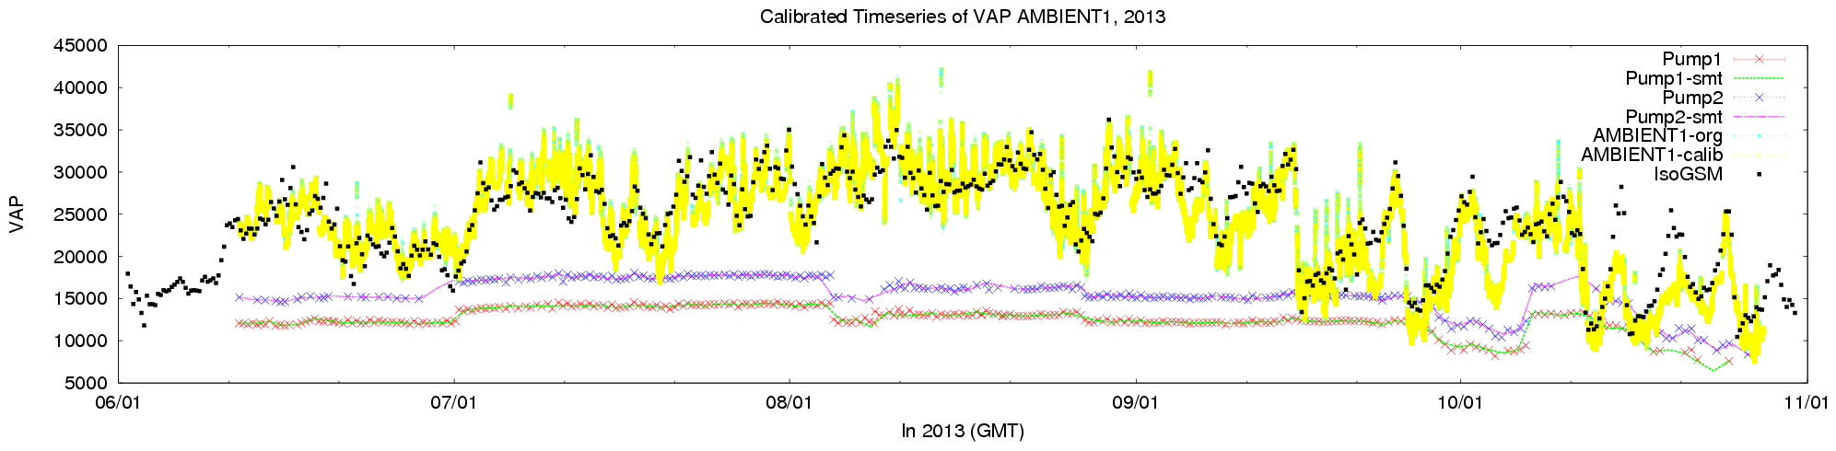
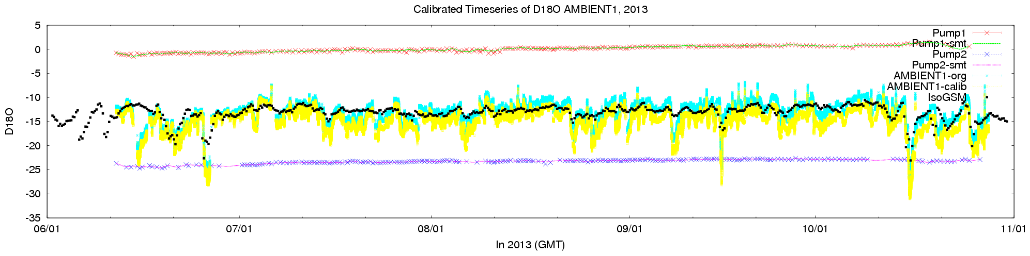
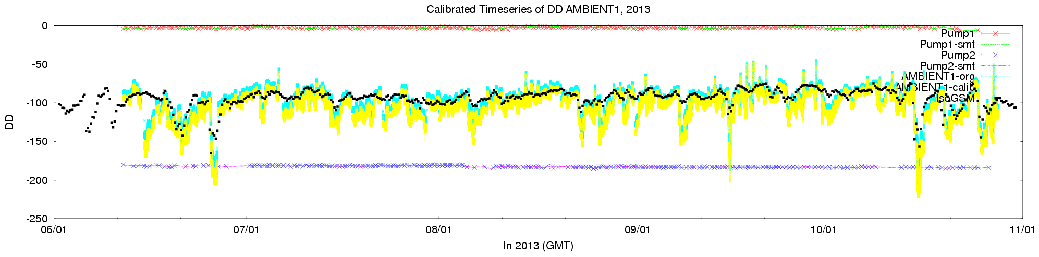
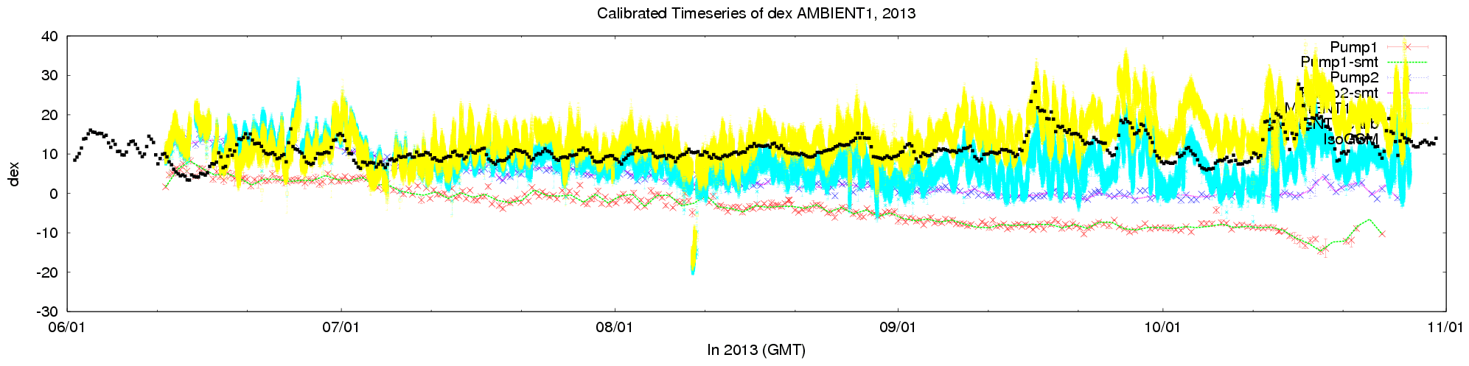

Slide 19
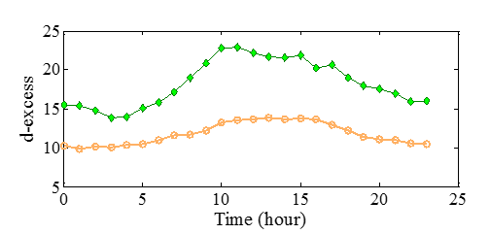
Why different between Before and After harvest
The variable d-excess occurred in different period which might reflect by difference of the dominant component of evapotranspiration.
Before harvest, steady state of transpiration: small variation and small value （close to the soil water..）.
After harvest, the curve resulted by the transpiration in growing season shifted to the peak resulted evaporation which can be found earlier.
The kinetic fractionation is stronger for surface water evaporation than the vegetation transpiration might in charge of this phenomenon.
Steady state assumption : OK!

Slide 20
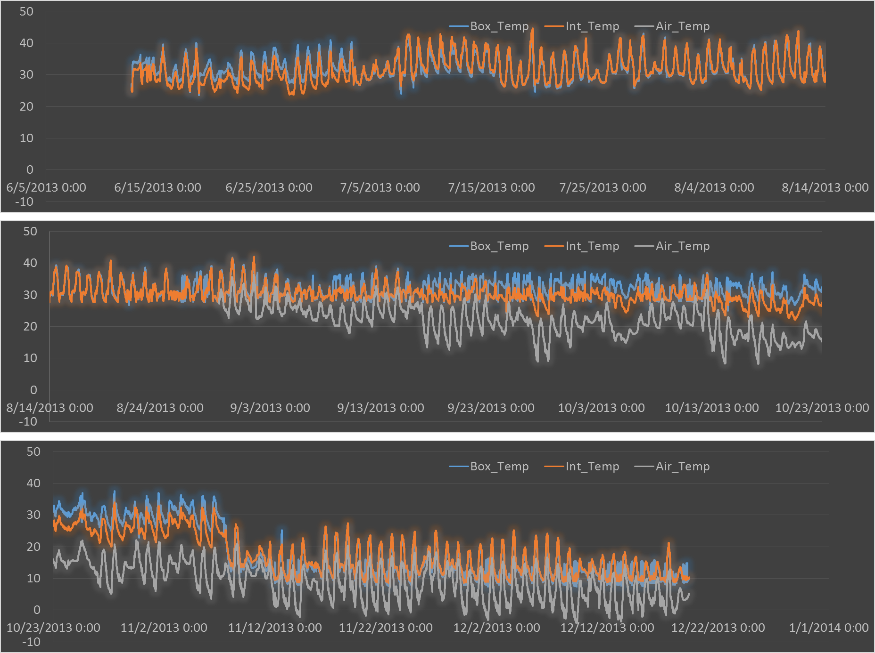
6/15 庫内温度上昇による初の強制終了（外気温30℃でアウト）
6/12観測開始
7/5 扉の付け替え
8/5 AC追加（外気温上限が35℃に）
9/10 稲刈り
8/28 気温計追加
10/7 サンプラー故障（10/14復旧）
11/12 本体引き揚げ

Slide 21
2013重要な知見
庫内温度の調整は大変。クーラー・ヒーターの容量はやってみないとわからない部分が多い。
  AC2台体制により外気35℃までOK。
外気吸入の時差は意外に短い（約2分/30m@1/8”チューブ）
降水サンプラーの時間間隔：
  いろいろ試した結果、下記の設定がベスト。
  イベントごとx16ボトル
  10分間連続Wetでイベントスタート
  1イベント：6時間継続
消耗品交換時期
  水とりぞうさん：点検時毎回（1-2週間に一度）
  ドライライト：2-3か月に一度
  標準水：1年1回？
  SDMシリンジ：数か月に一回？（SDMが悪くなったら）

Slide 22
2014に向けて
田植えから稲刈りまでの観測は必須。できれば1年間継続。
複数高度観測
  時系列によるKeeling plotはNG?
  20分ごと3高度などとして、1時間ごとに傾度を求める？
定点撮影機能追加？（農環研にあり）
降水サンプラーのシリアルケーブルを外に出す
地表面水サンプリング頻度を上げる。→どうやって？
  空間分布は大事
  自動化？人間？
流入量を測る！圧力流量計→サンプリング
流出口は、三角堰？→サンプリング
葉面温度、水面温度（農環研？）
川の水？用水路の水：どのようなリサイクリングが起こっているのか？
集中観測？
その他？？

Slide 23
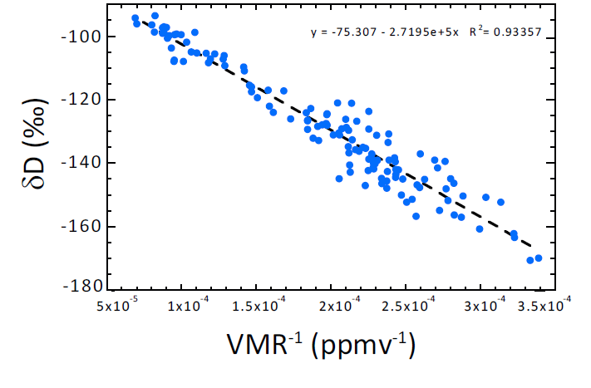
Keeling plot
Keeling Plot:
Mixing of Two end-member
δET
c_{b}*(δb-δET)
Background Air: δb, c_{b}
Mixed Air: δa, c_{a}
Source Air: δET, c_{a}-c_{b}
Farlin et al., 2013
δa*c_{a}=δET*(c_{a}-c_{b})+δb*c_{b}
➔ δa=c_{b}*(δb-δET)/c_{a}+δET

Slide 24
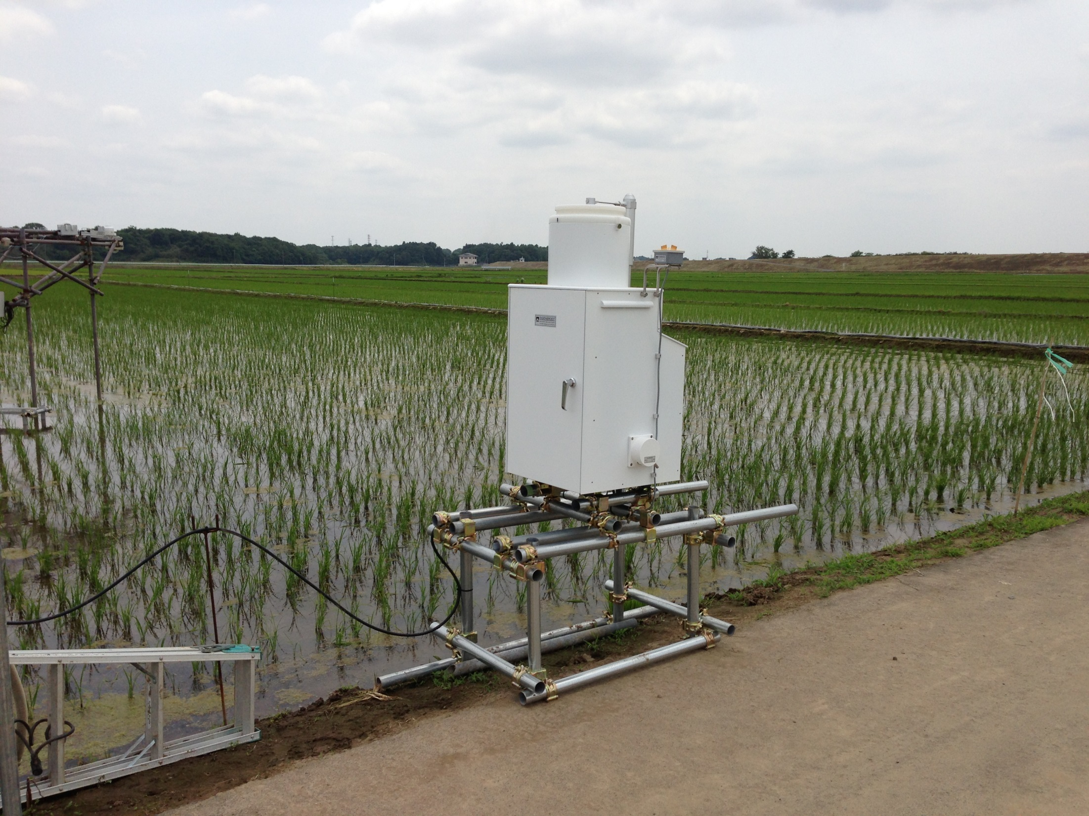

Slide 25
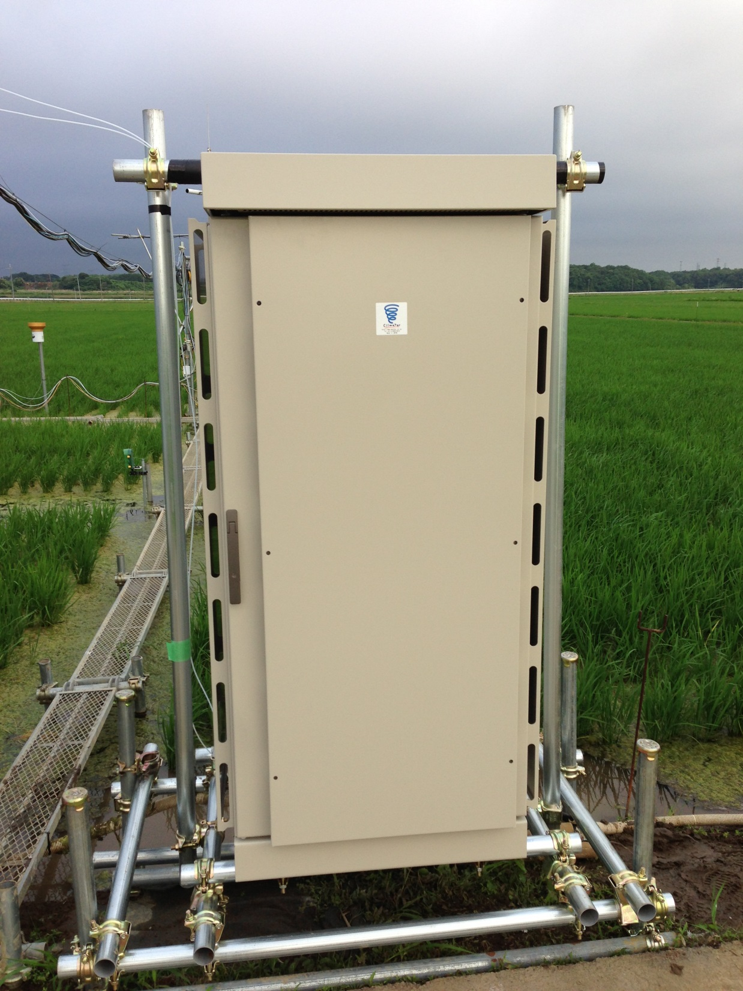

Slide 26
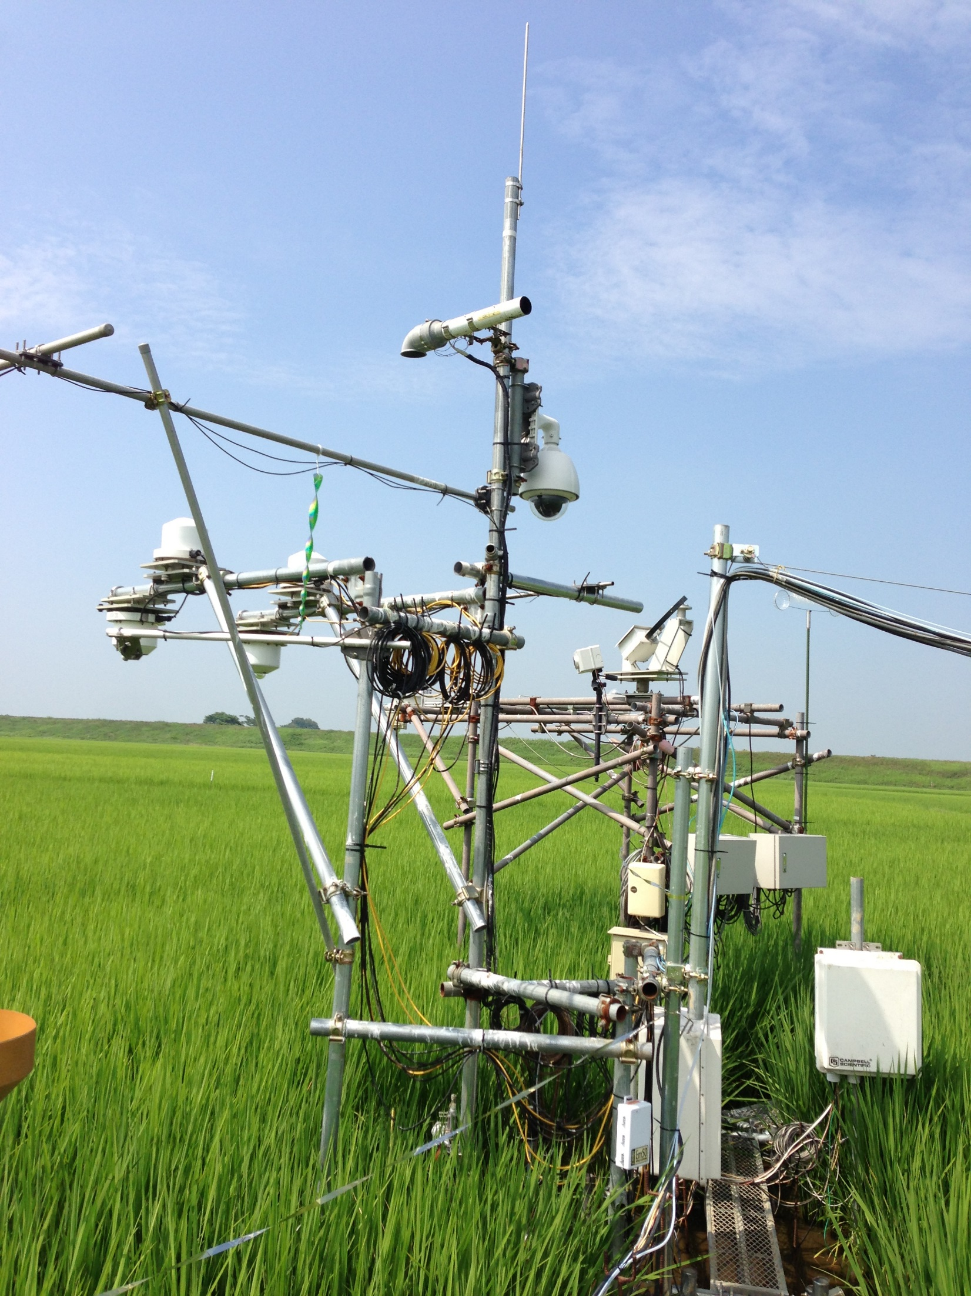

Slide 27
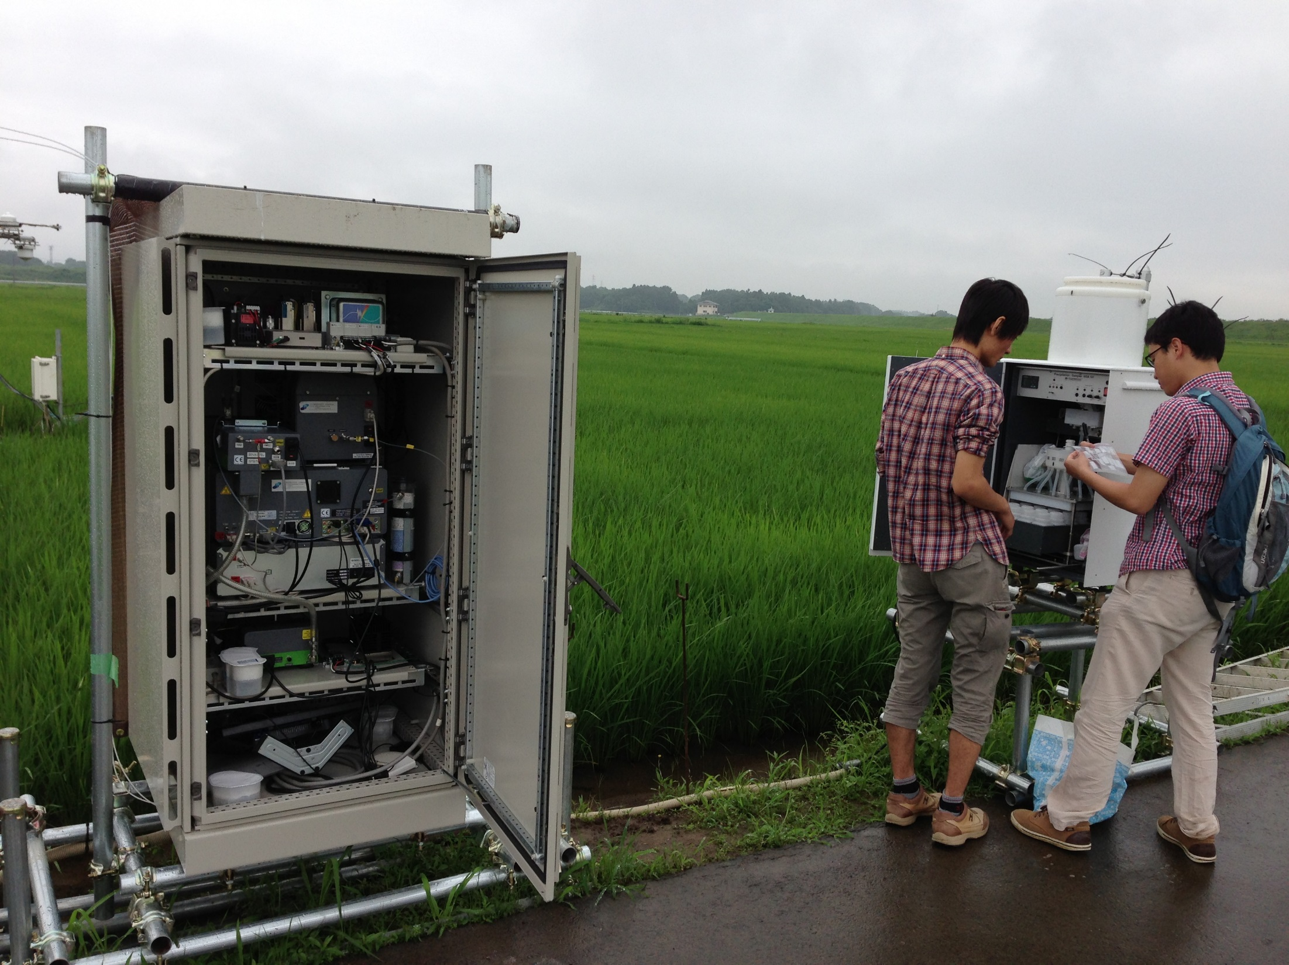

Slide 29
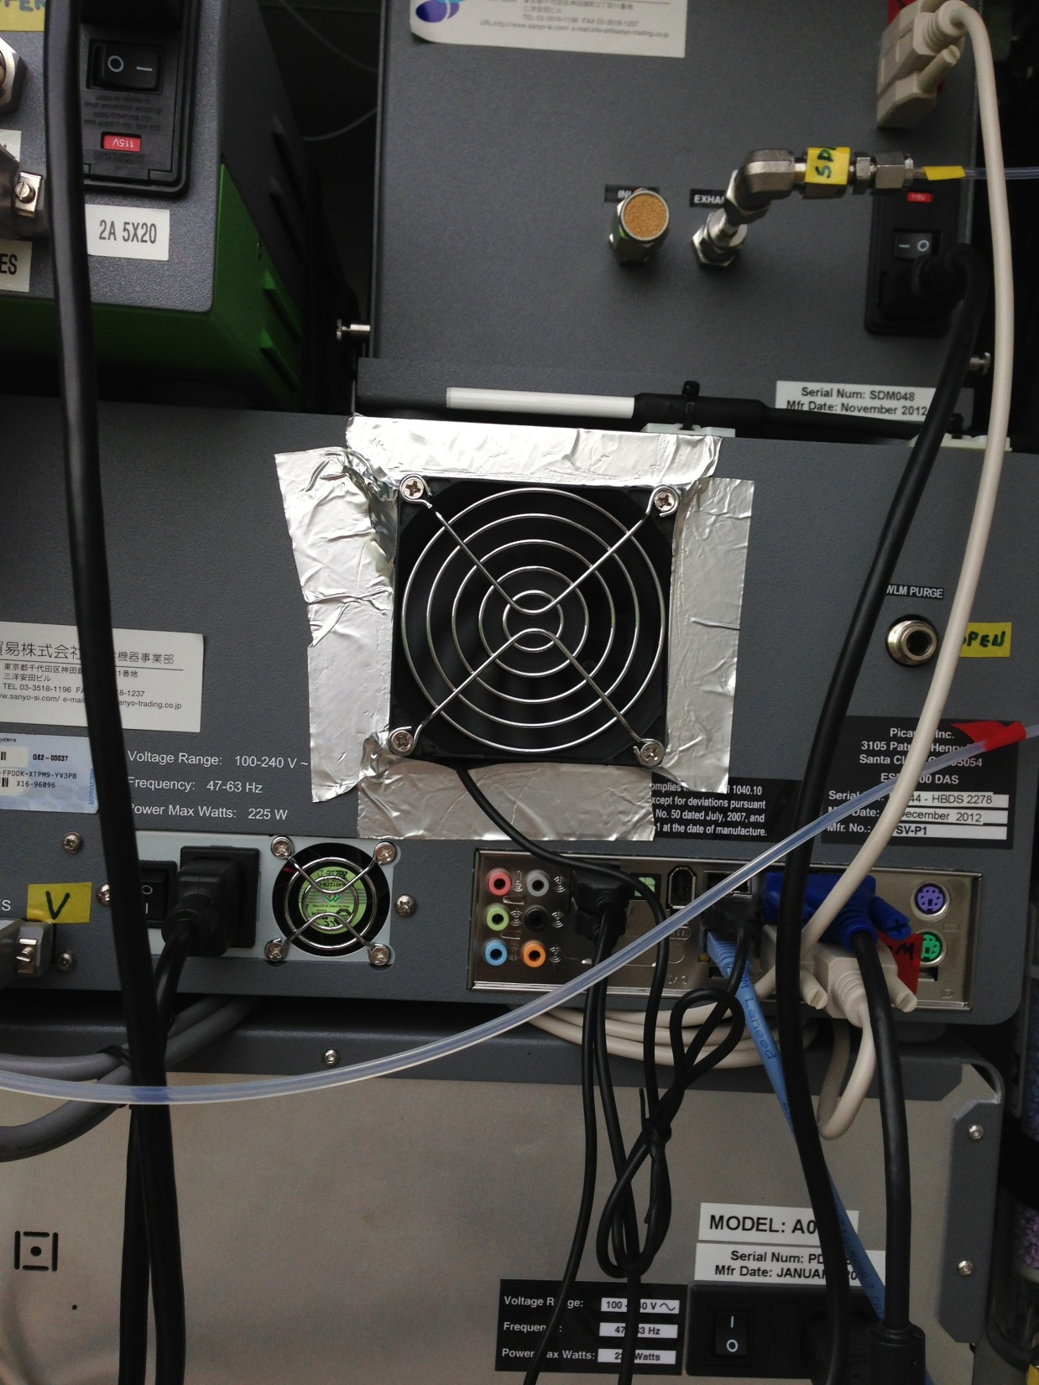

Slide 30
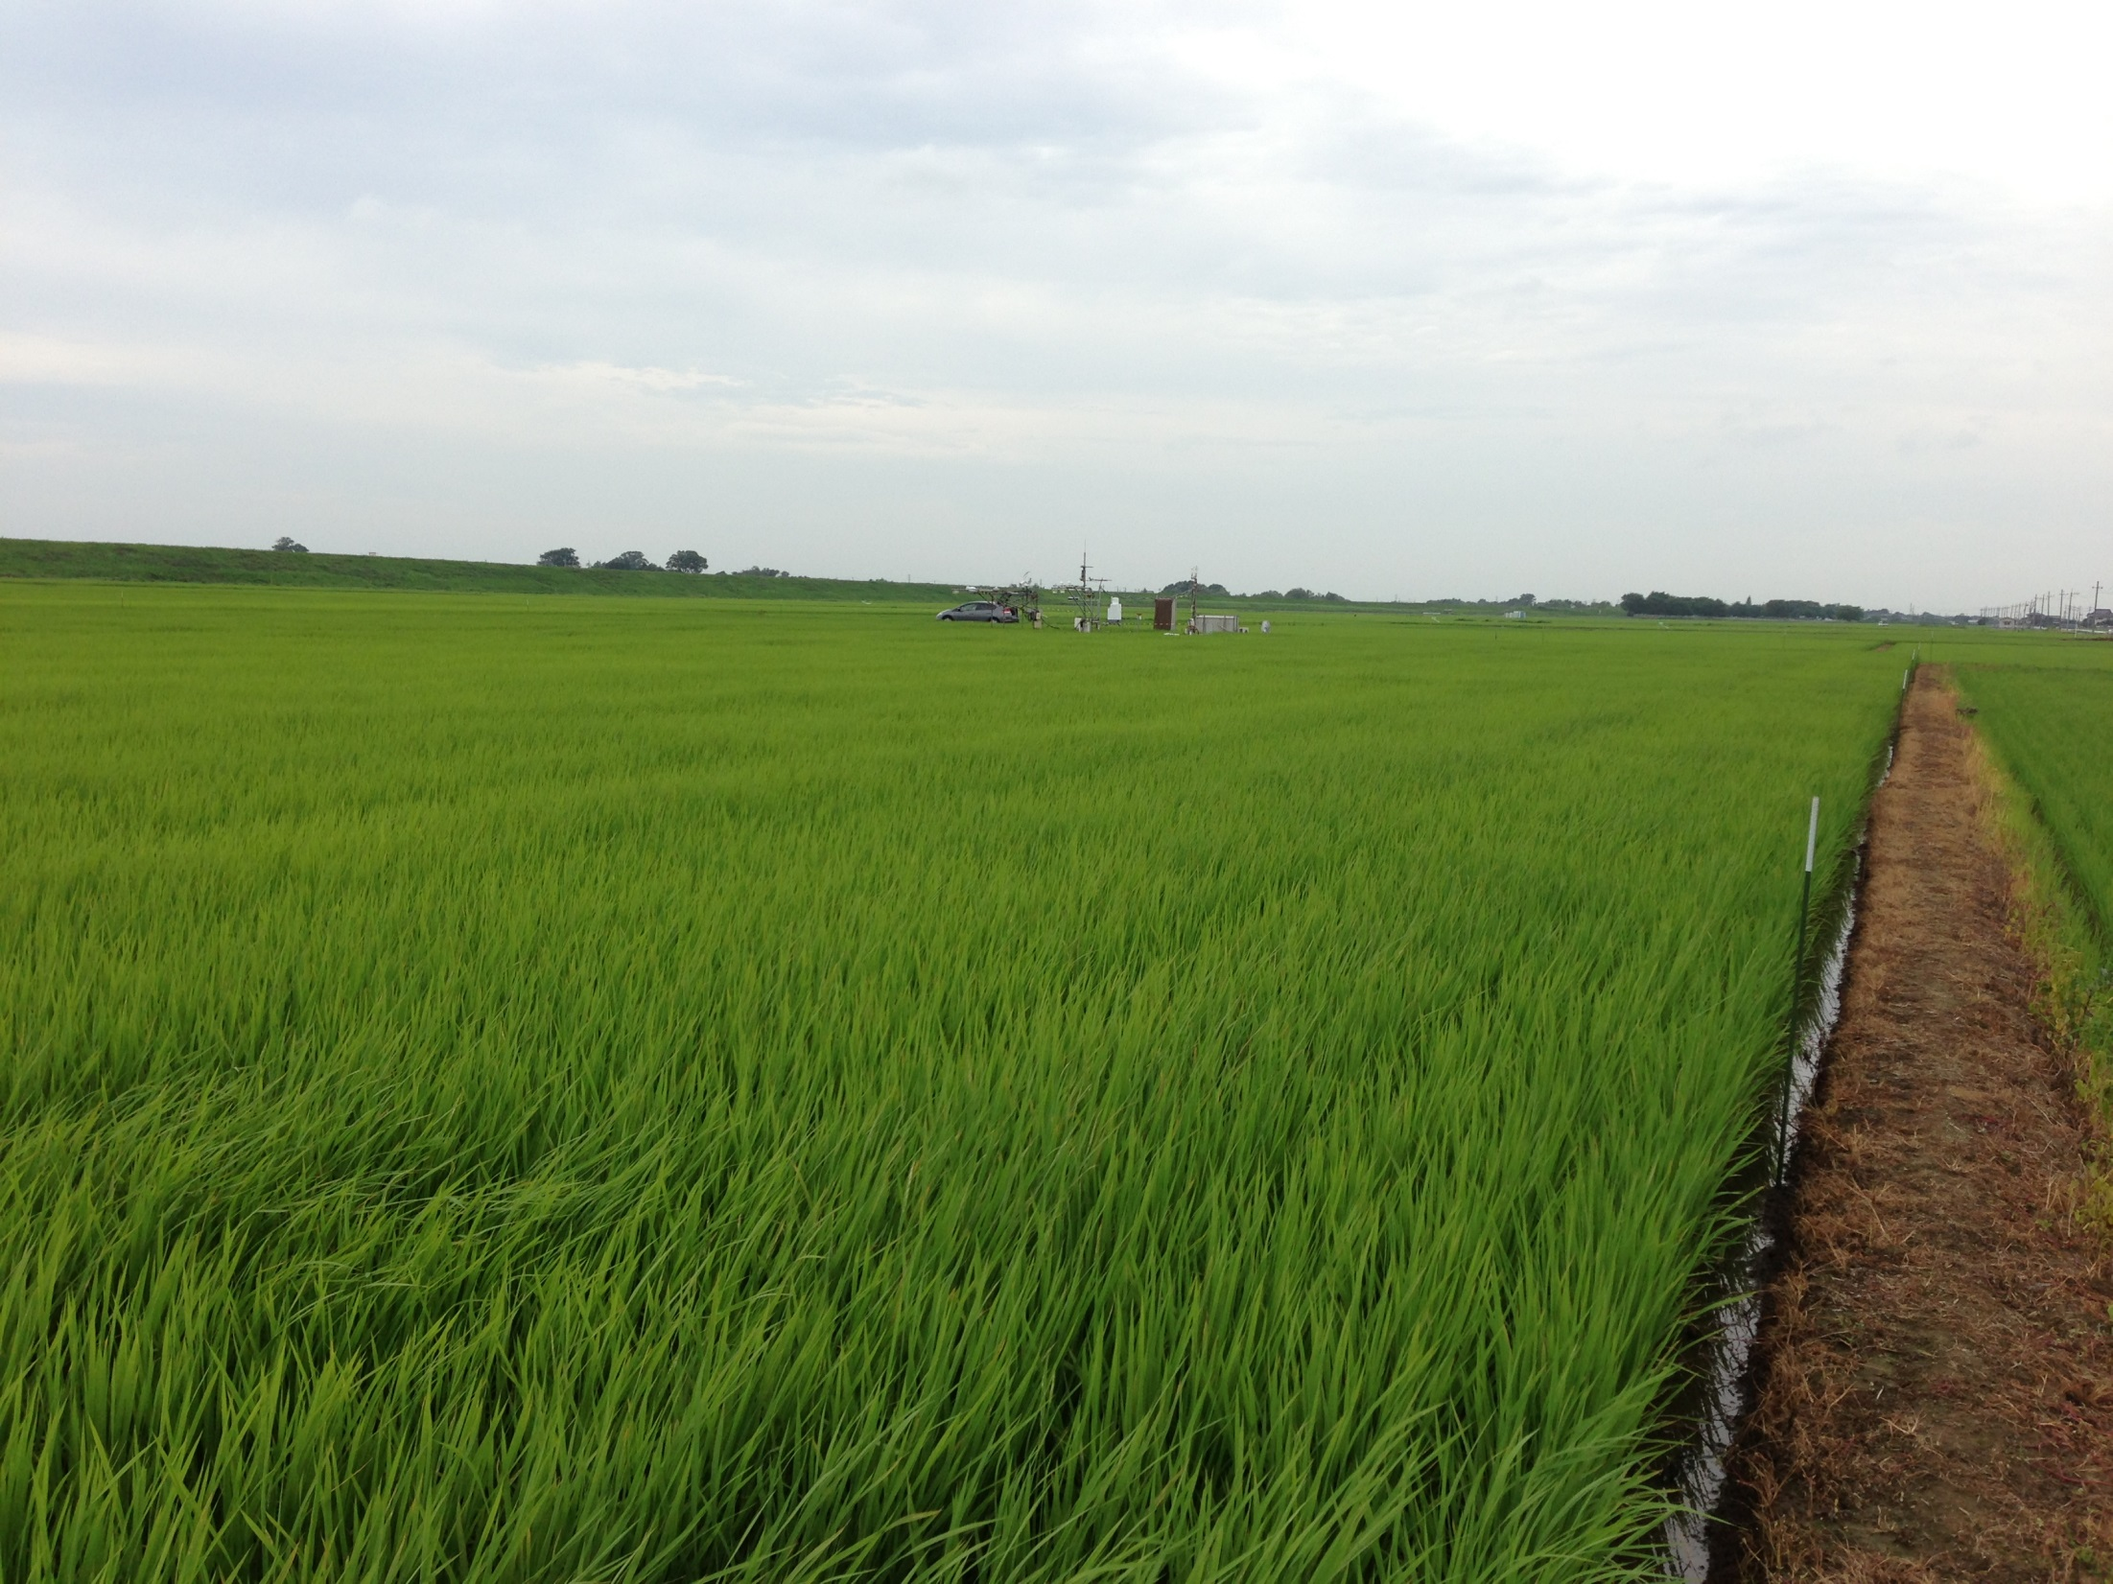

Slide 31
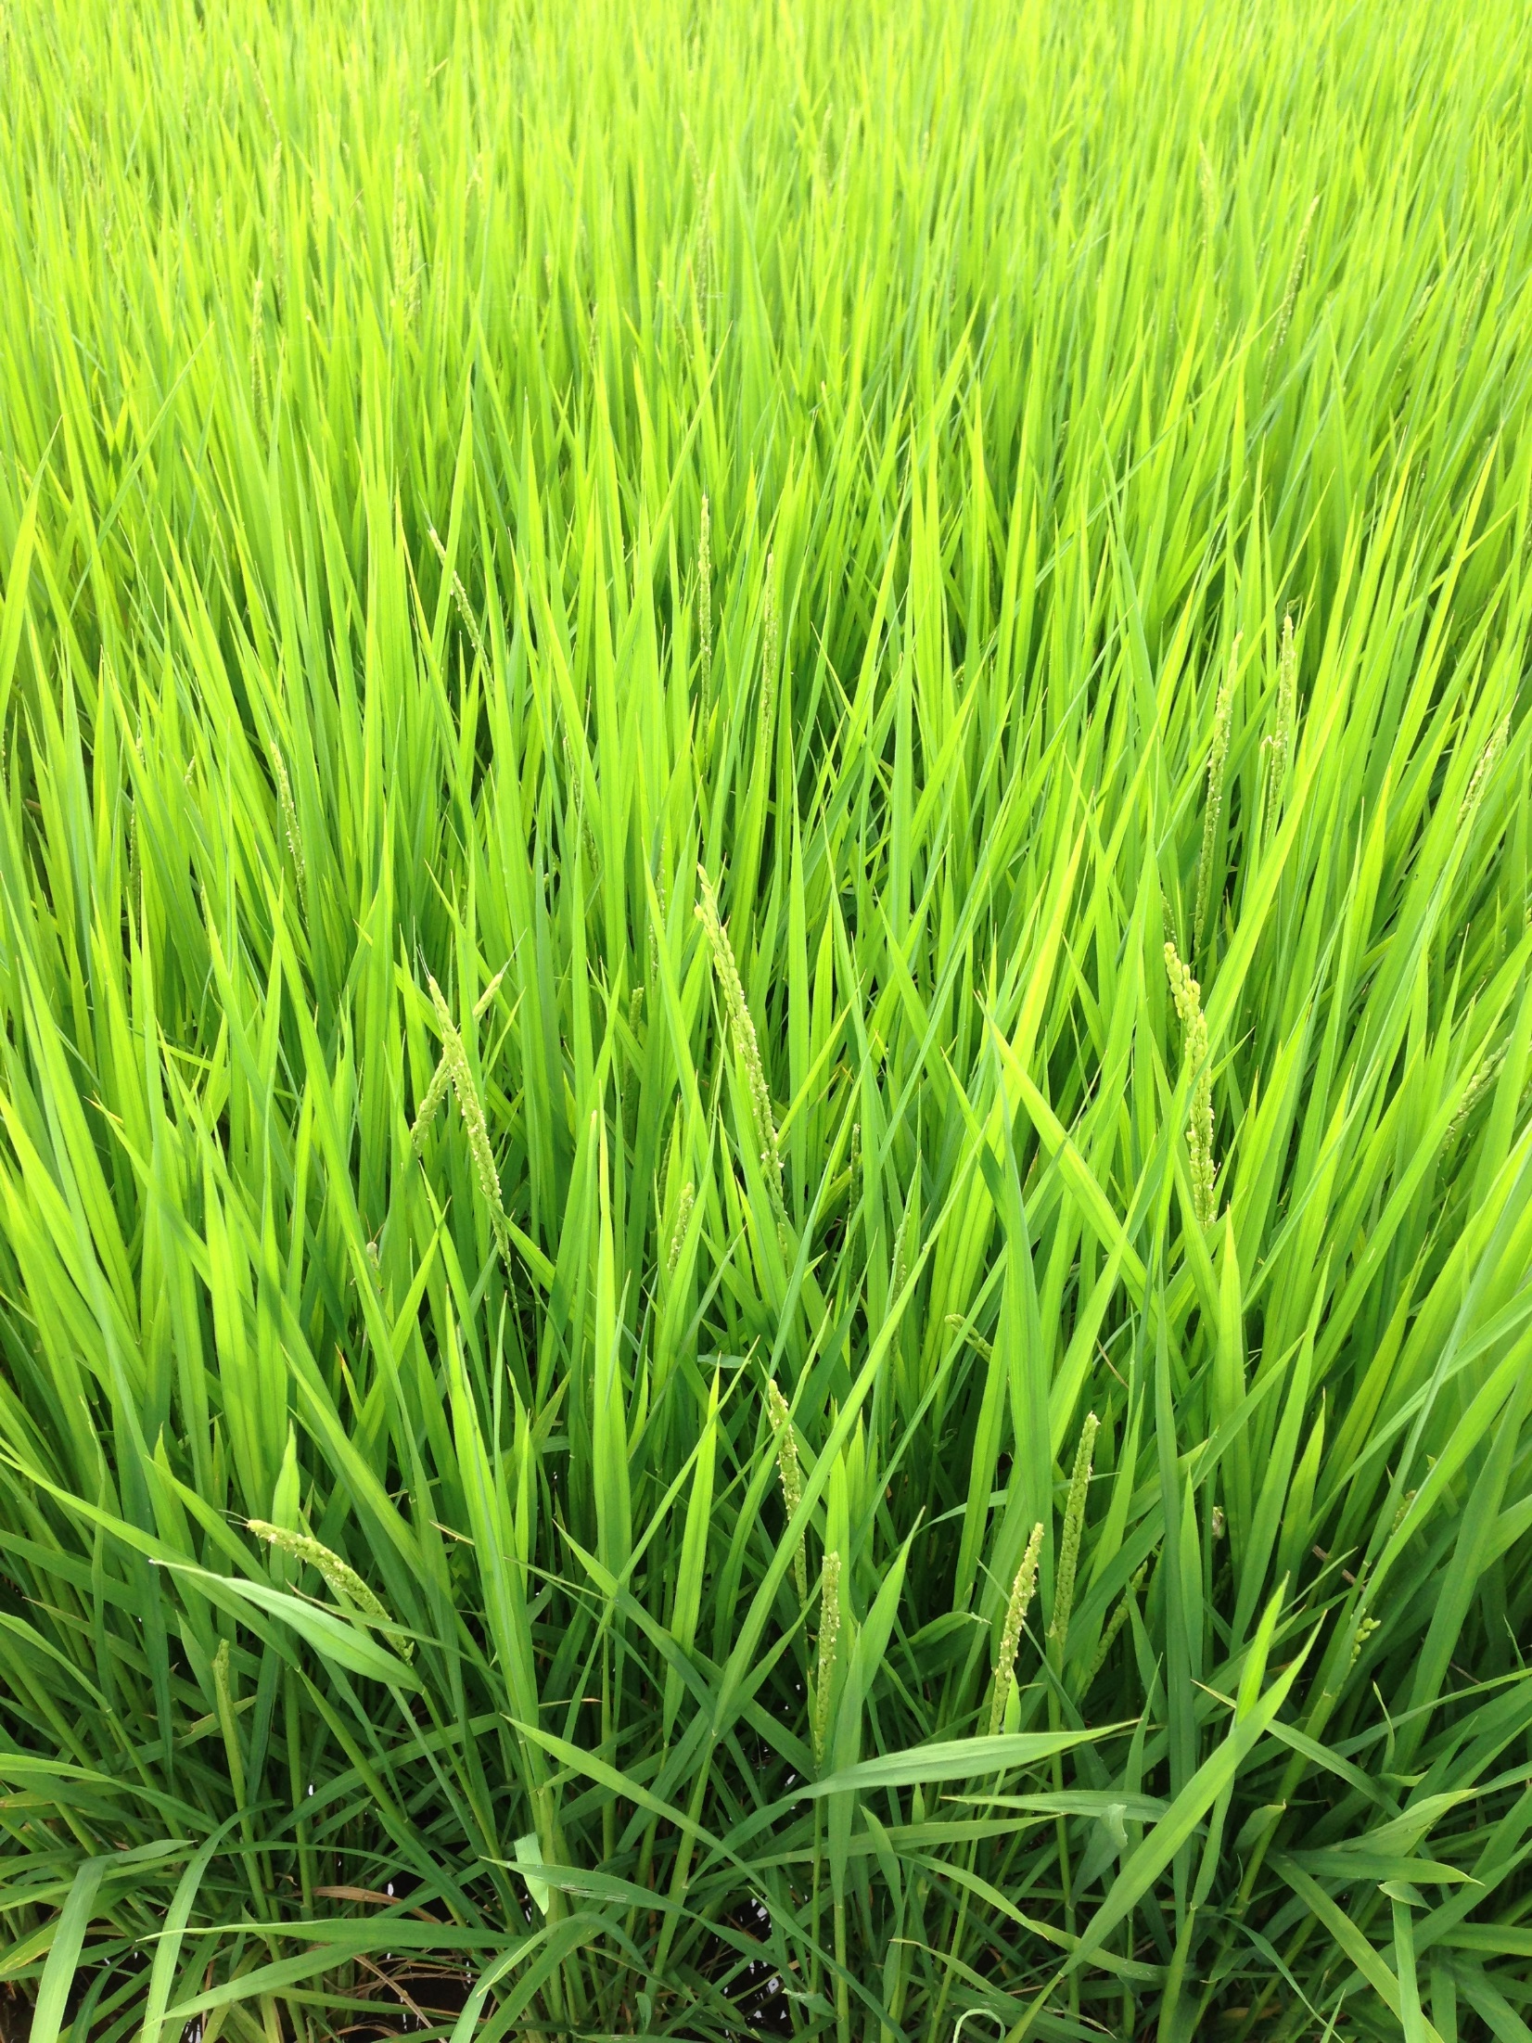

Slide 32
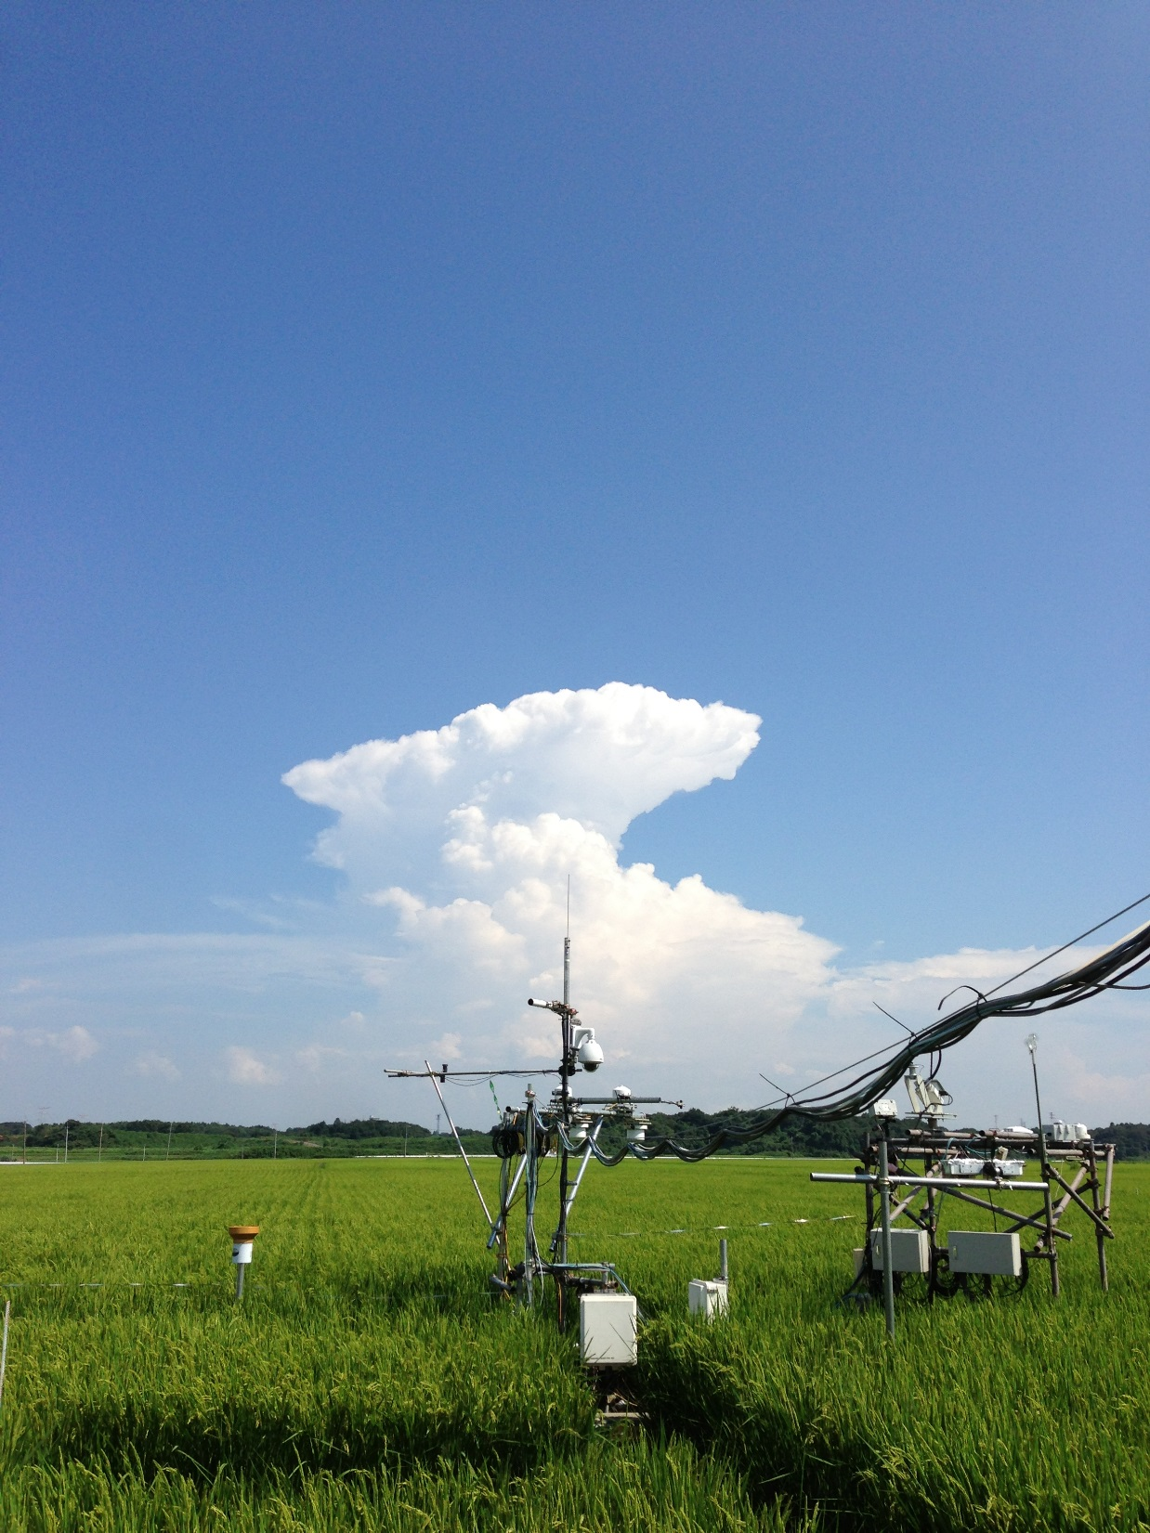

Slide 33
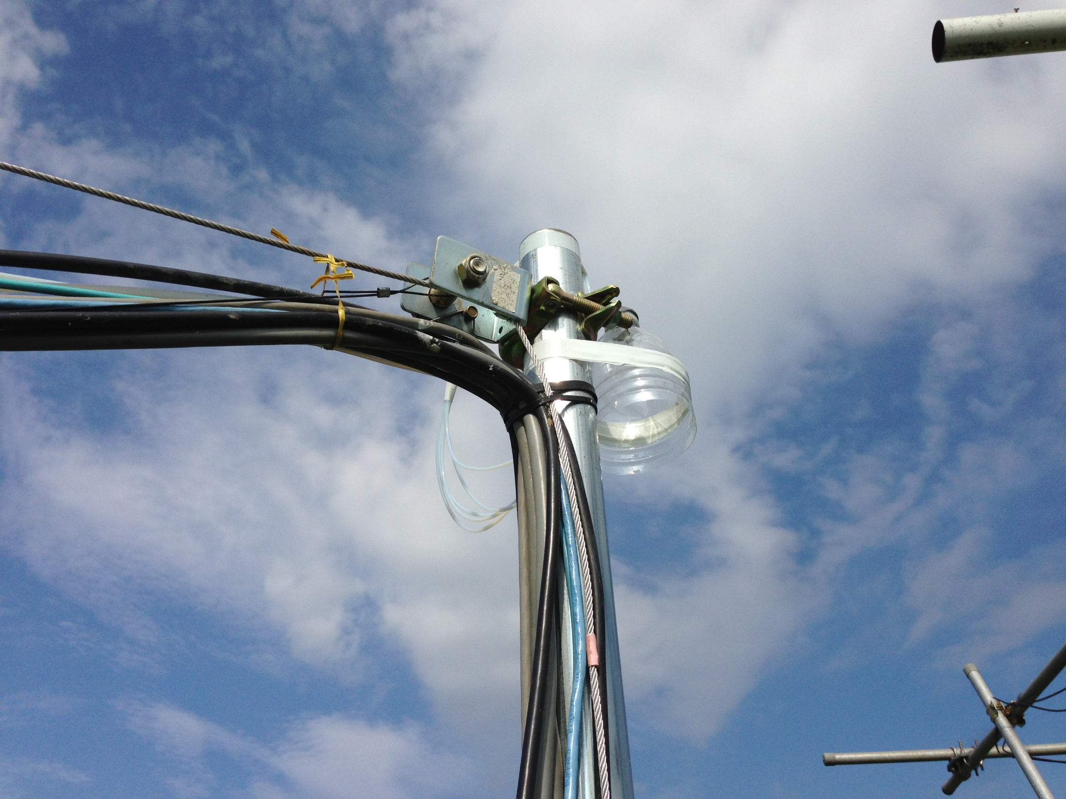

Slide 34
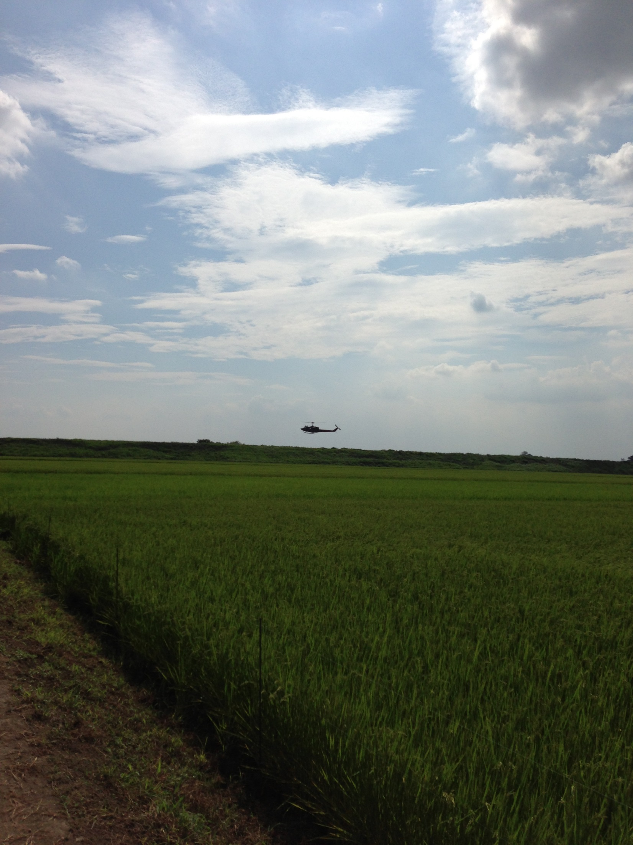

Slide 35
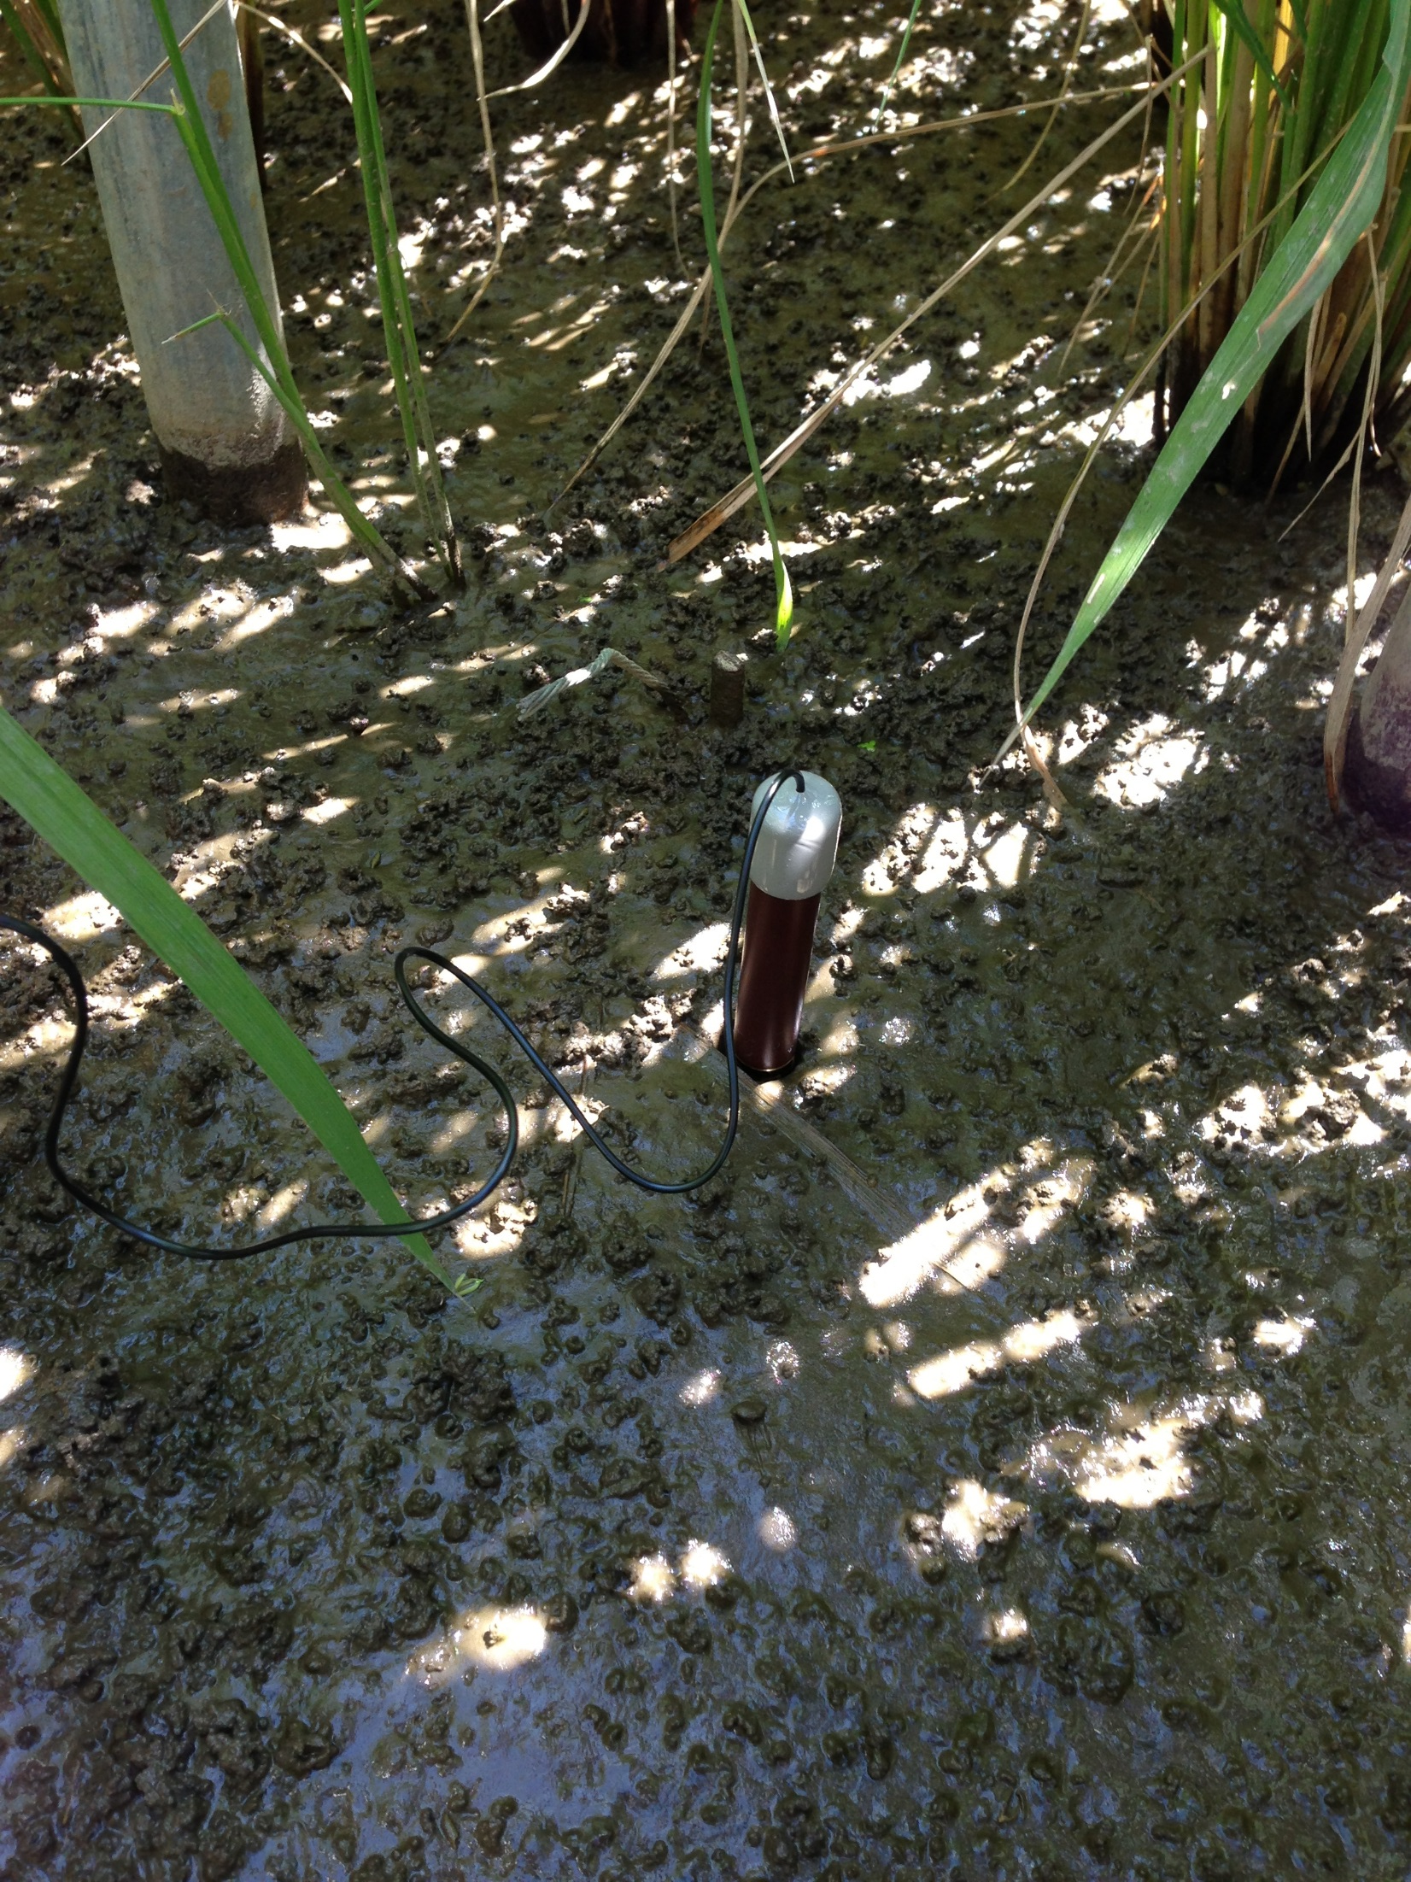

Slide 36
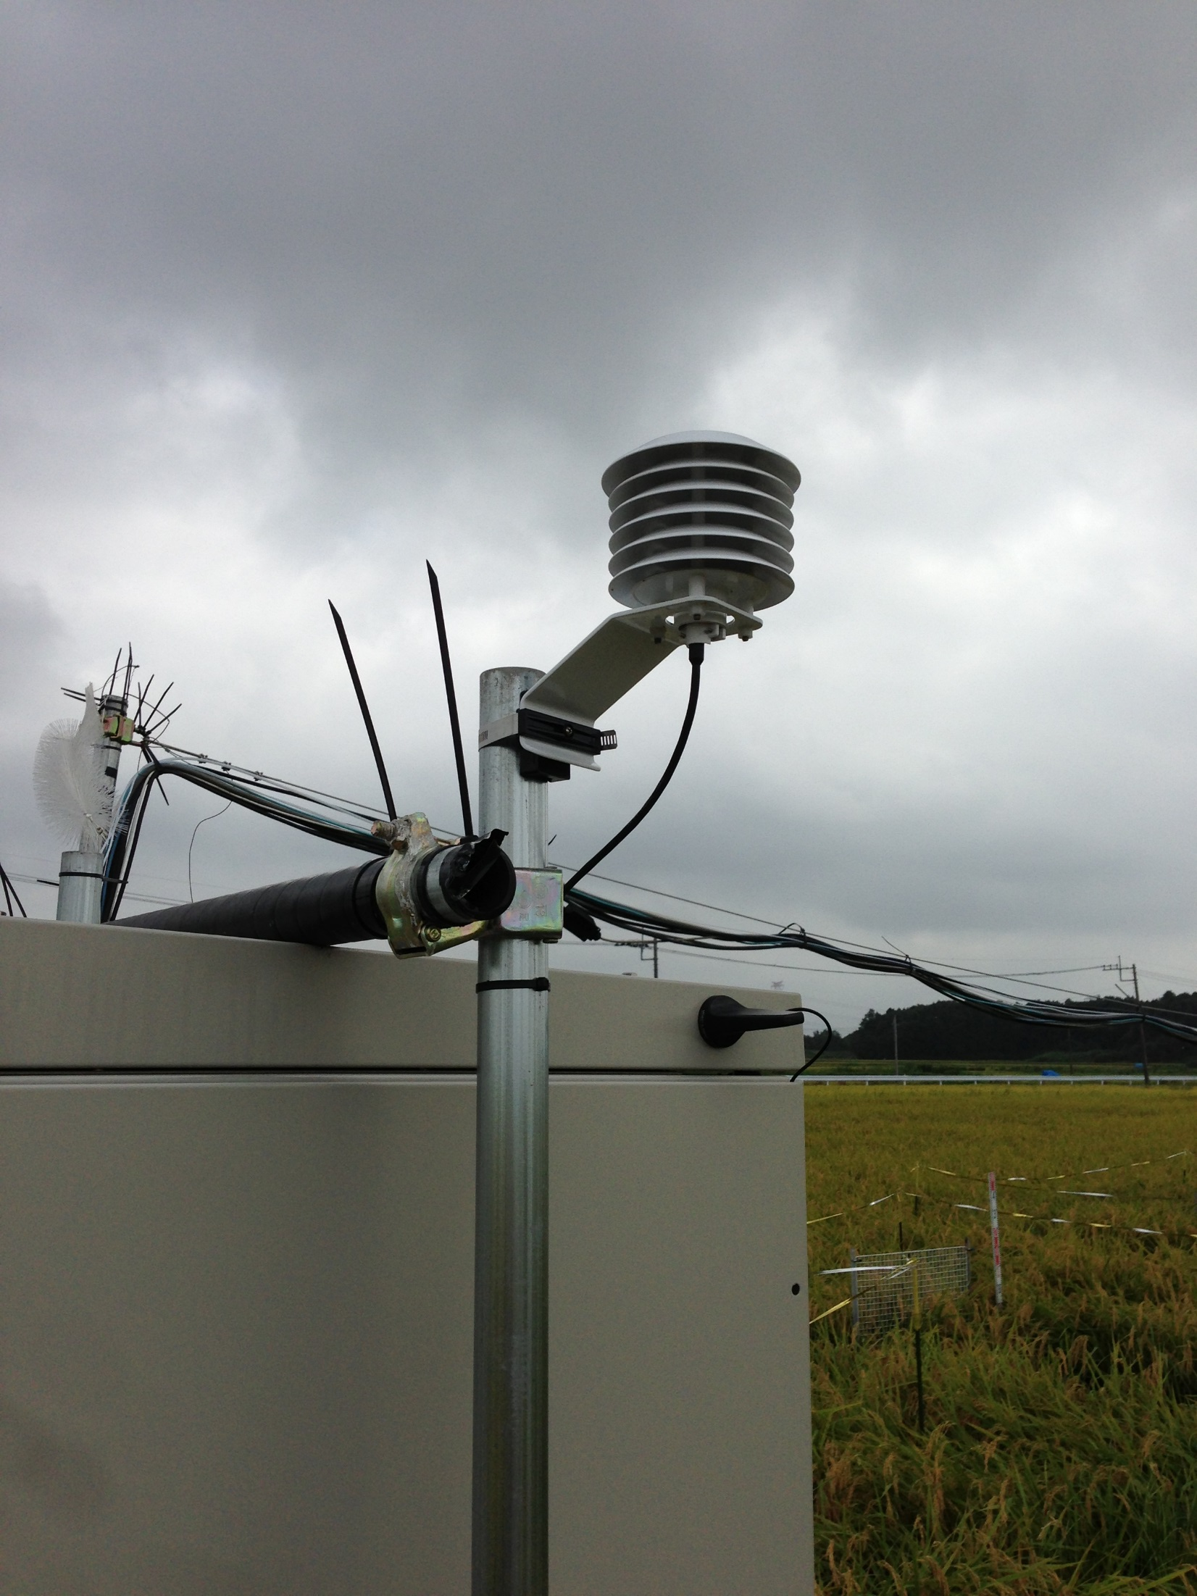

Slide 37
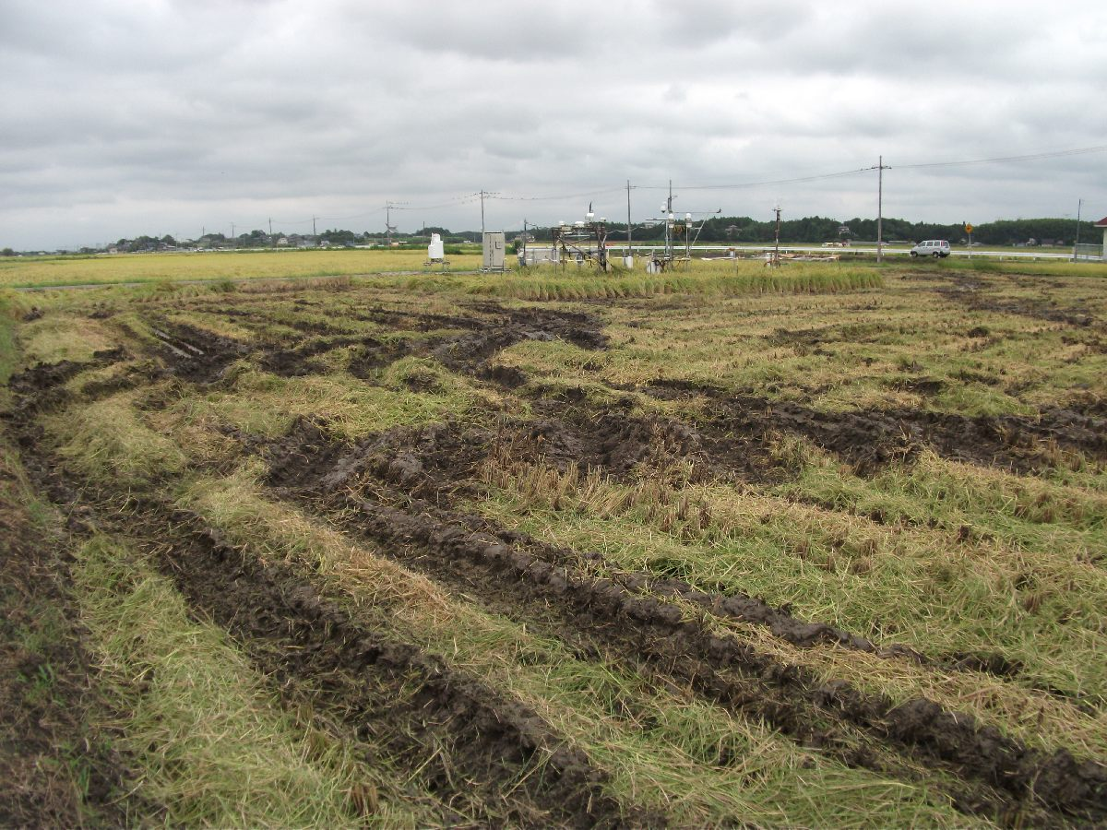
2013/09/06

Slide 38
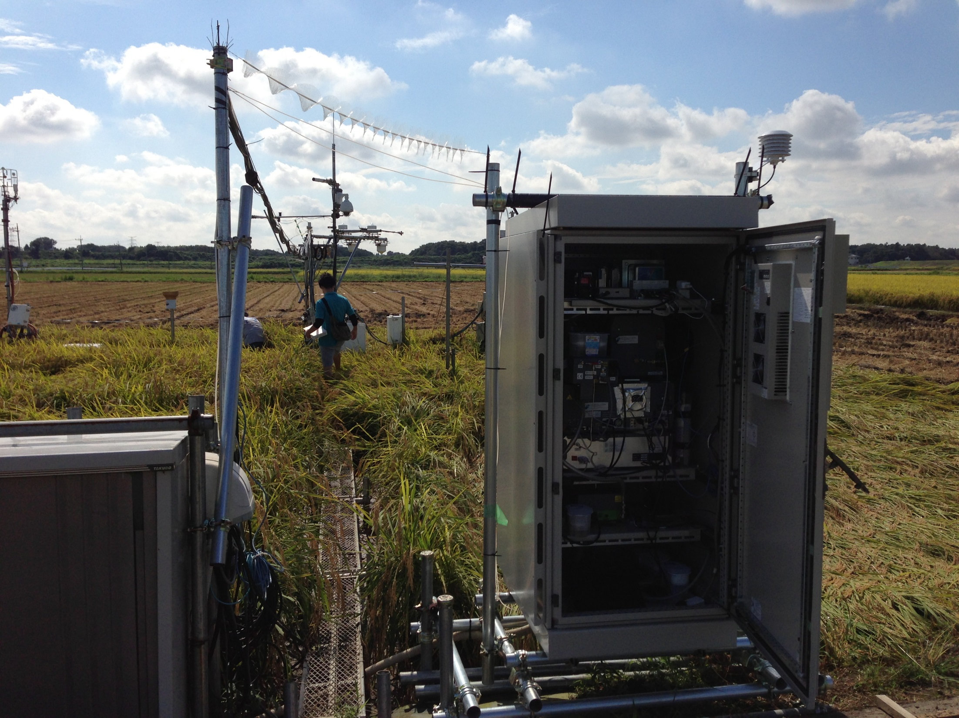

Slide 39
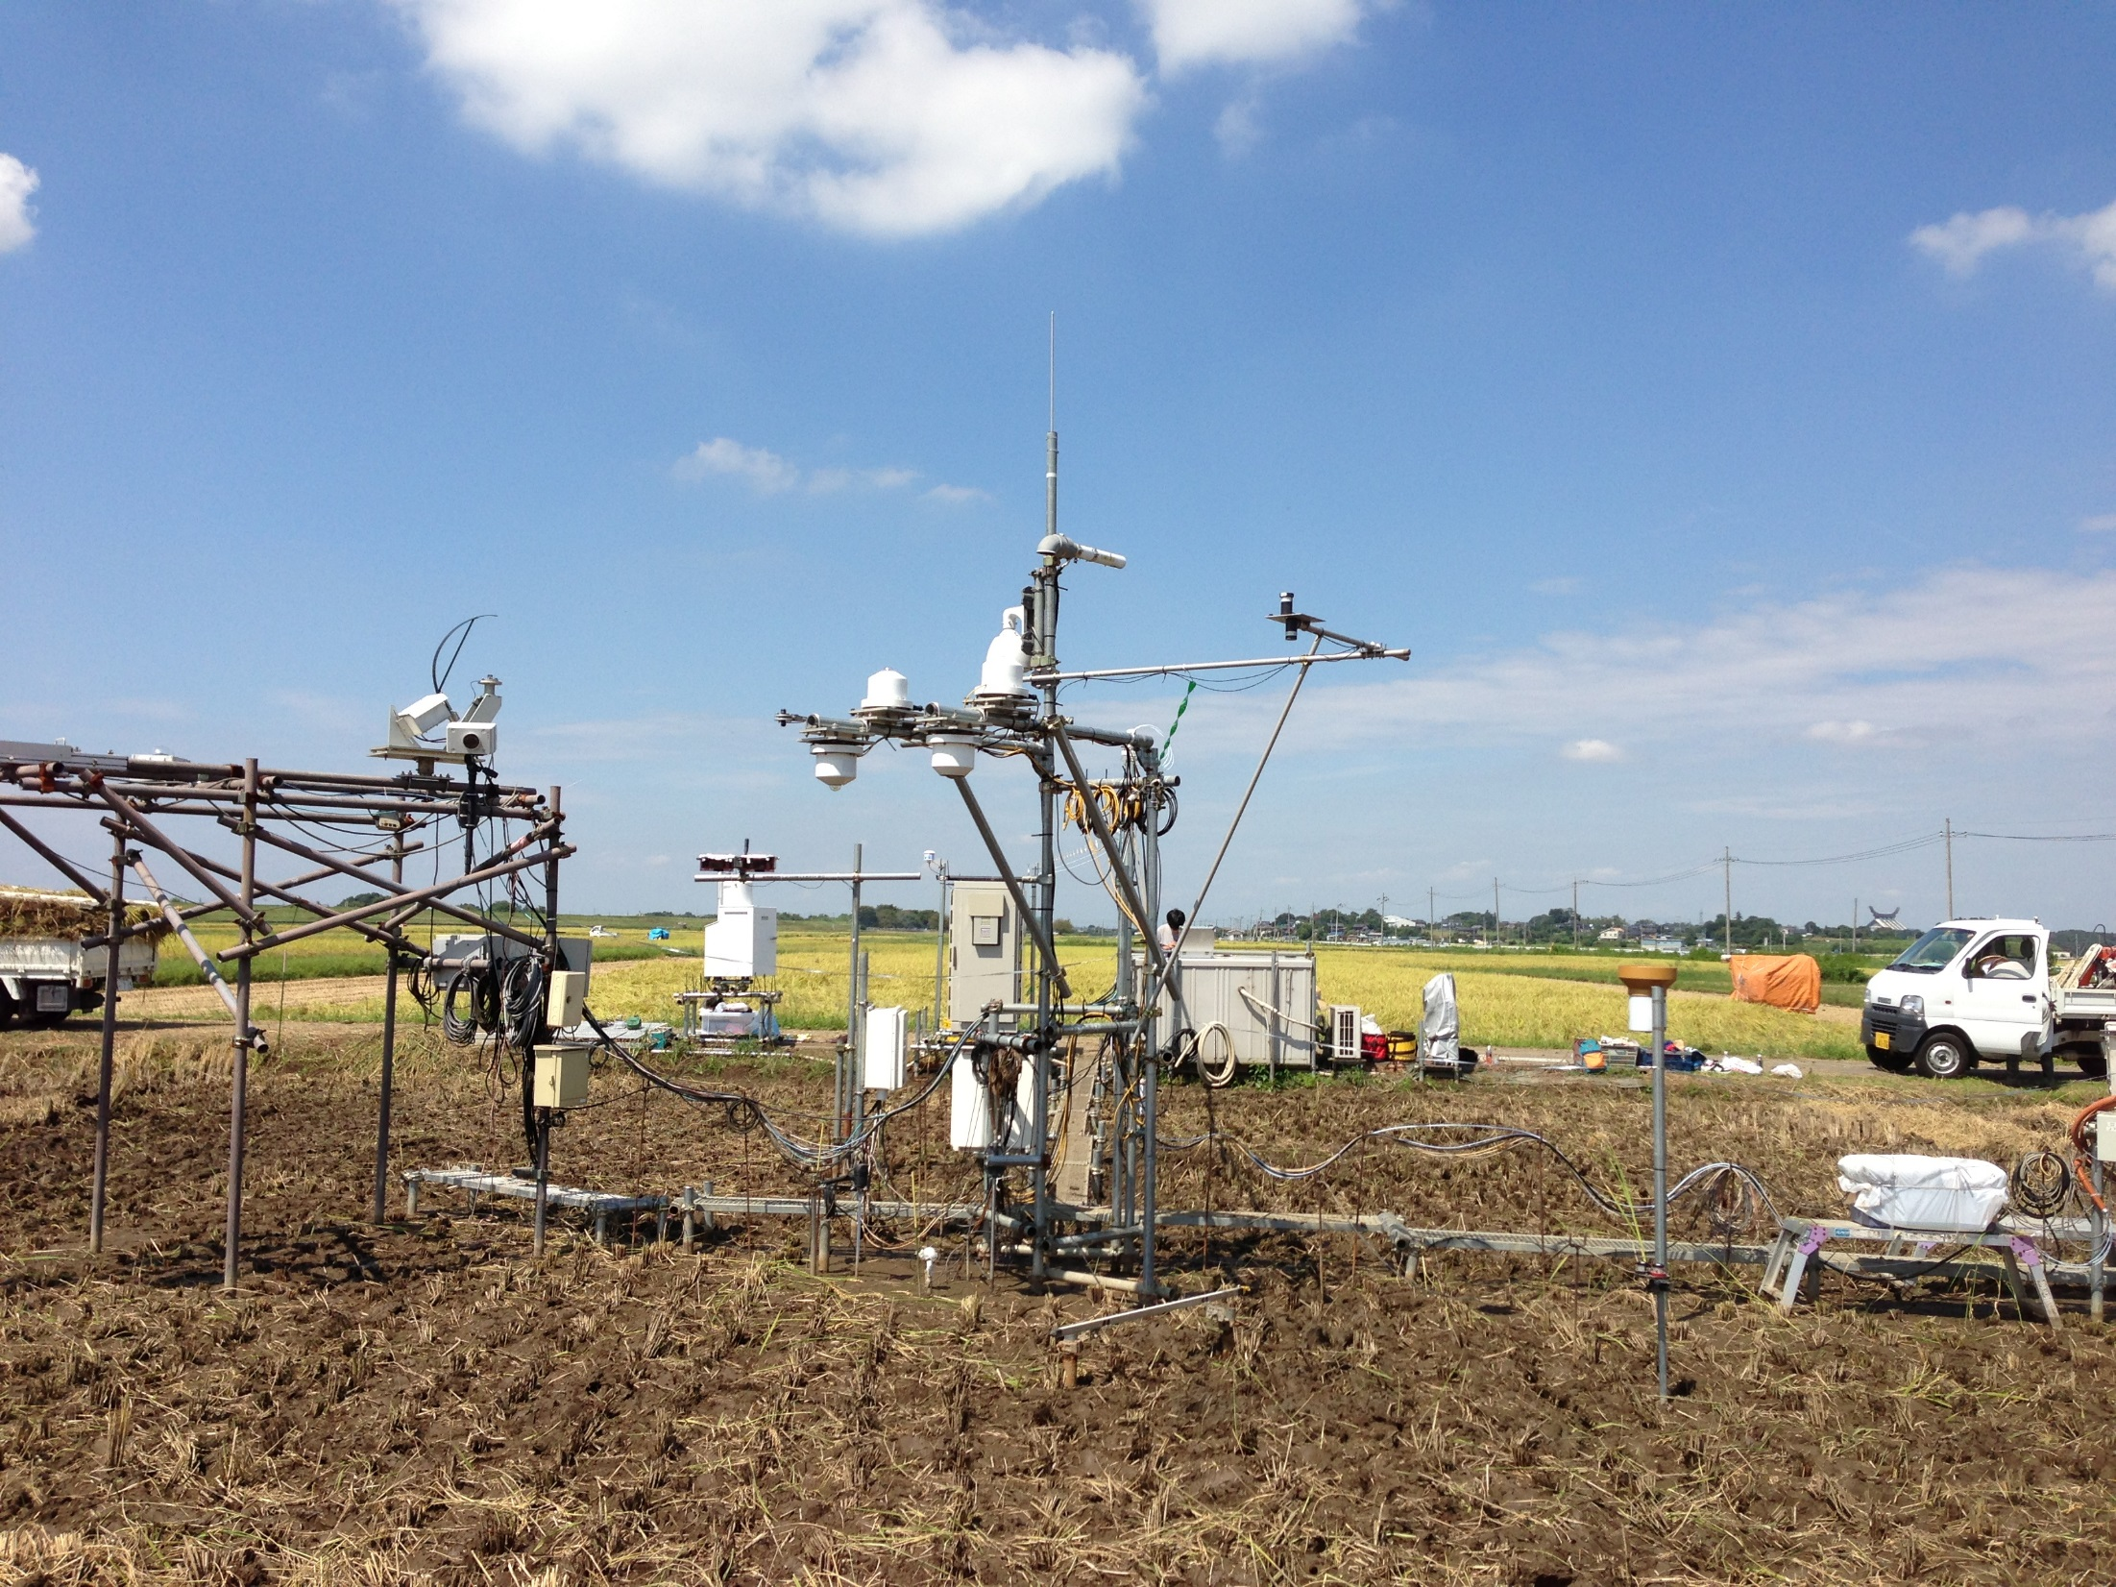

Slide 40
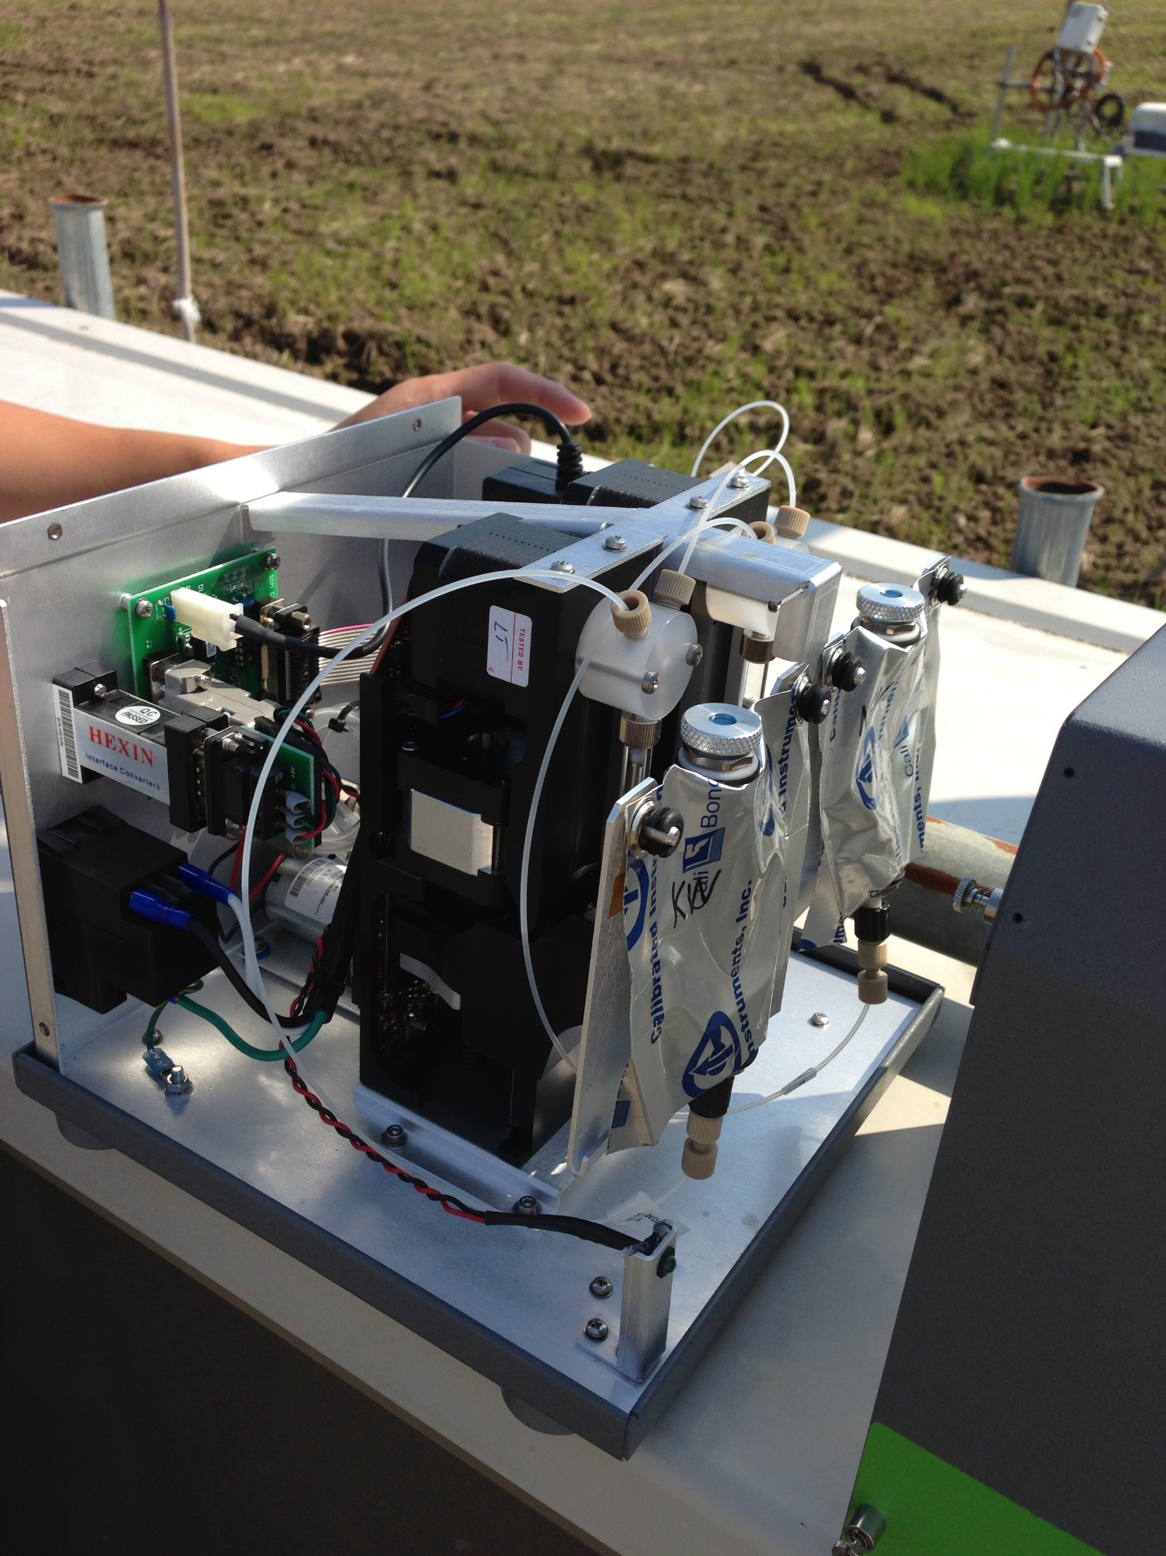

Slide 41
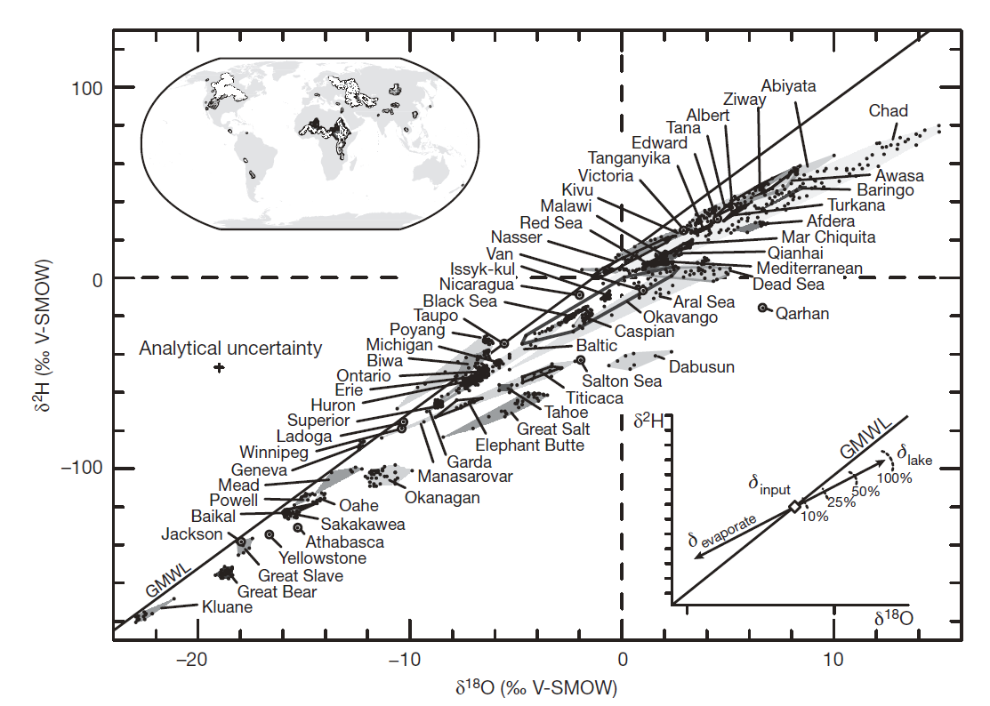
How did they do?
Lake isotope data were archived.

Slide 42
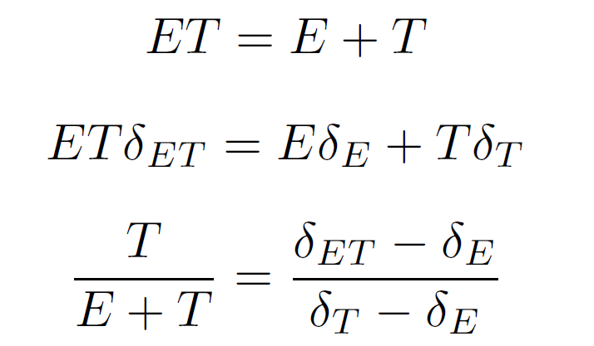
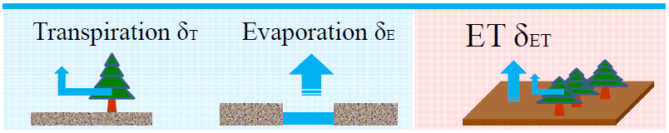

ET Partitioning
ET: 蒸発散、T:蒸散、E: 蒸発
δ_{ET}, δ_{E}, δ_{T}: 各同位体比
観測によって算定
δ=R_{sample}/R_{standard}-1
田面水と同じ
同位体比と仮定
田面水からCraig-Gordon モデルを用いて算定
レーザー分光器
で測定

Slide 43
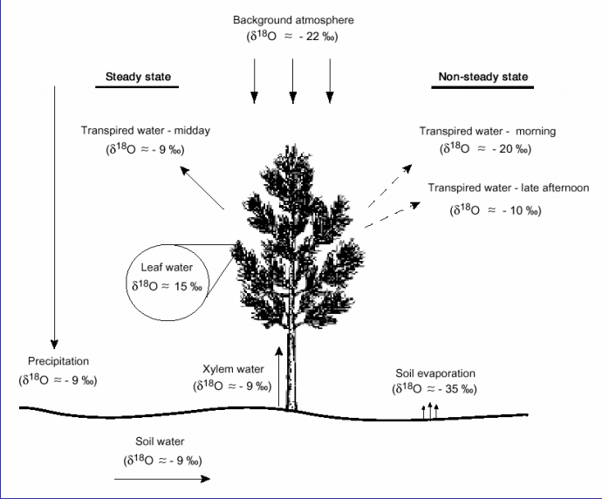
About Non-steady state
If we consider it in diurnal time scale
Steady state assumption:
Isotope ratios of plant transpiration equal those of isotope ratios in surface water
Non-steady state assumption:
Vegetation activity should be considered!
Oxygen-18 ratios of water in a forest canopy
Figure from Lai (2006)

Slide 44
Typical Climate Model Estimate
Yoshimura
(Aug, 2006)
-14.6‰
：Amount (10⁴km³)
：Flux (10⁴km³/year)
-13.0‰
10.5‰
9.5‰
$$\frac{T}{E+T}=\frac{d_{e+t}−d_{e} }{d_{t}−d_{e} }$$
d_{e+t}=11‰➔11‰、d_{e}=75‰➔20‰、d_{t}=8‰➔3‰
$$\frac{T}{E+T}≅50\%$$
Vapor over the land(0.28)
Vapor over sea (0.97)
Convergence(4.1)
-8.7‰
-7.3‰
13.0‰
Prp over land (11.8)
Evap from land(7.7)
-8.7‰
Prp. over sea (42.7)
-5.7‰*
-7.8‰
Discharge
(4.1)
Evap. from sea* (46.8)
-9.3‰
-5.5‰
11.1‰
Rivers(0.4)
9.2‰
Transp.(2.4)
Soil evp (2.5)
Canopy E (2.8)
-3.9‰
-9.2‰
-7.9‰
3.1‰
19.6‰
13.3‰
Sea
~0‰
* Adjusted because of inbalance (8.2mm/y=0.4*10⁴km³/y)

