Slide 1
Research Progress (02/24/2021)
Gaohong Yin
ML-Japan
Analysis of ML results for site C
Absolute value of the Relative Differences (ARD) time series
Statistical skill versus forecast time
ML-Global
Quality control for GSMaP

Slide 2
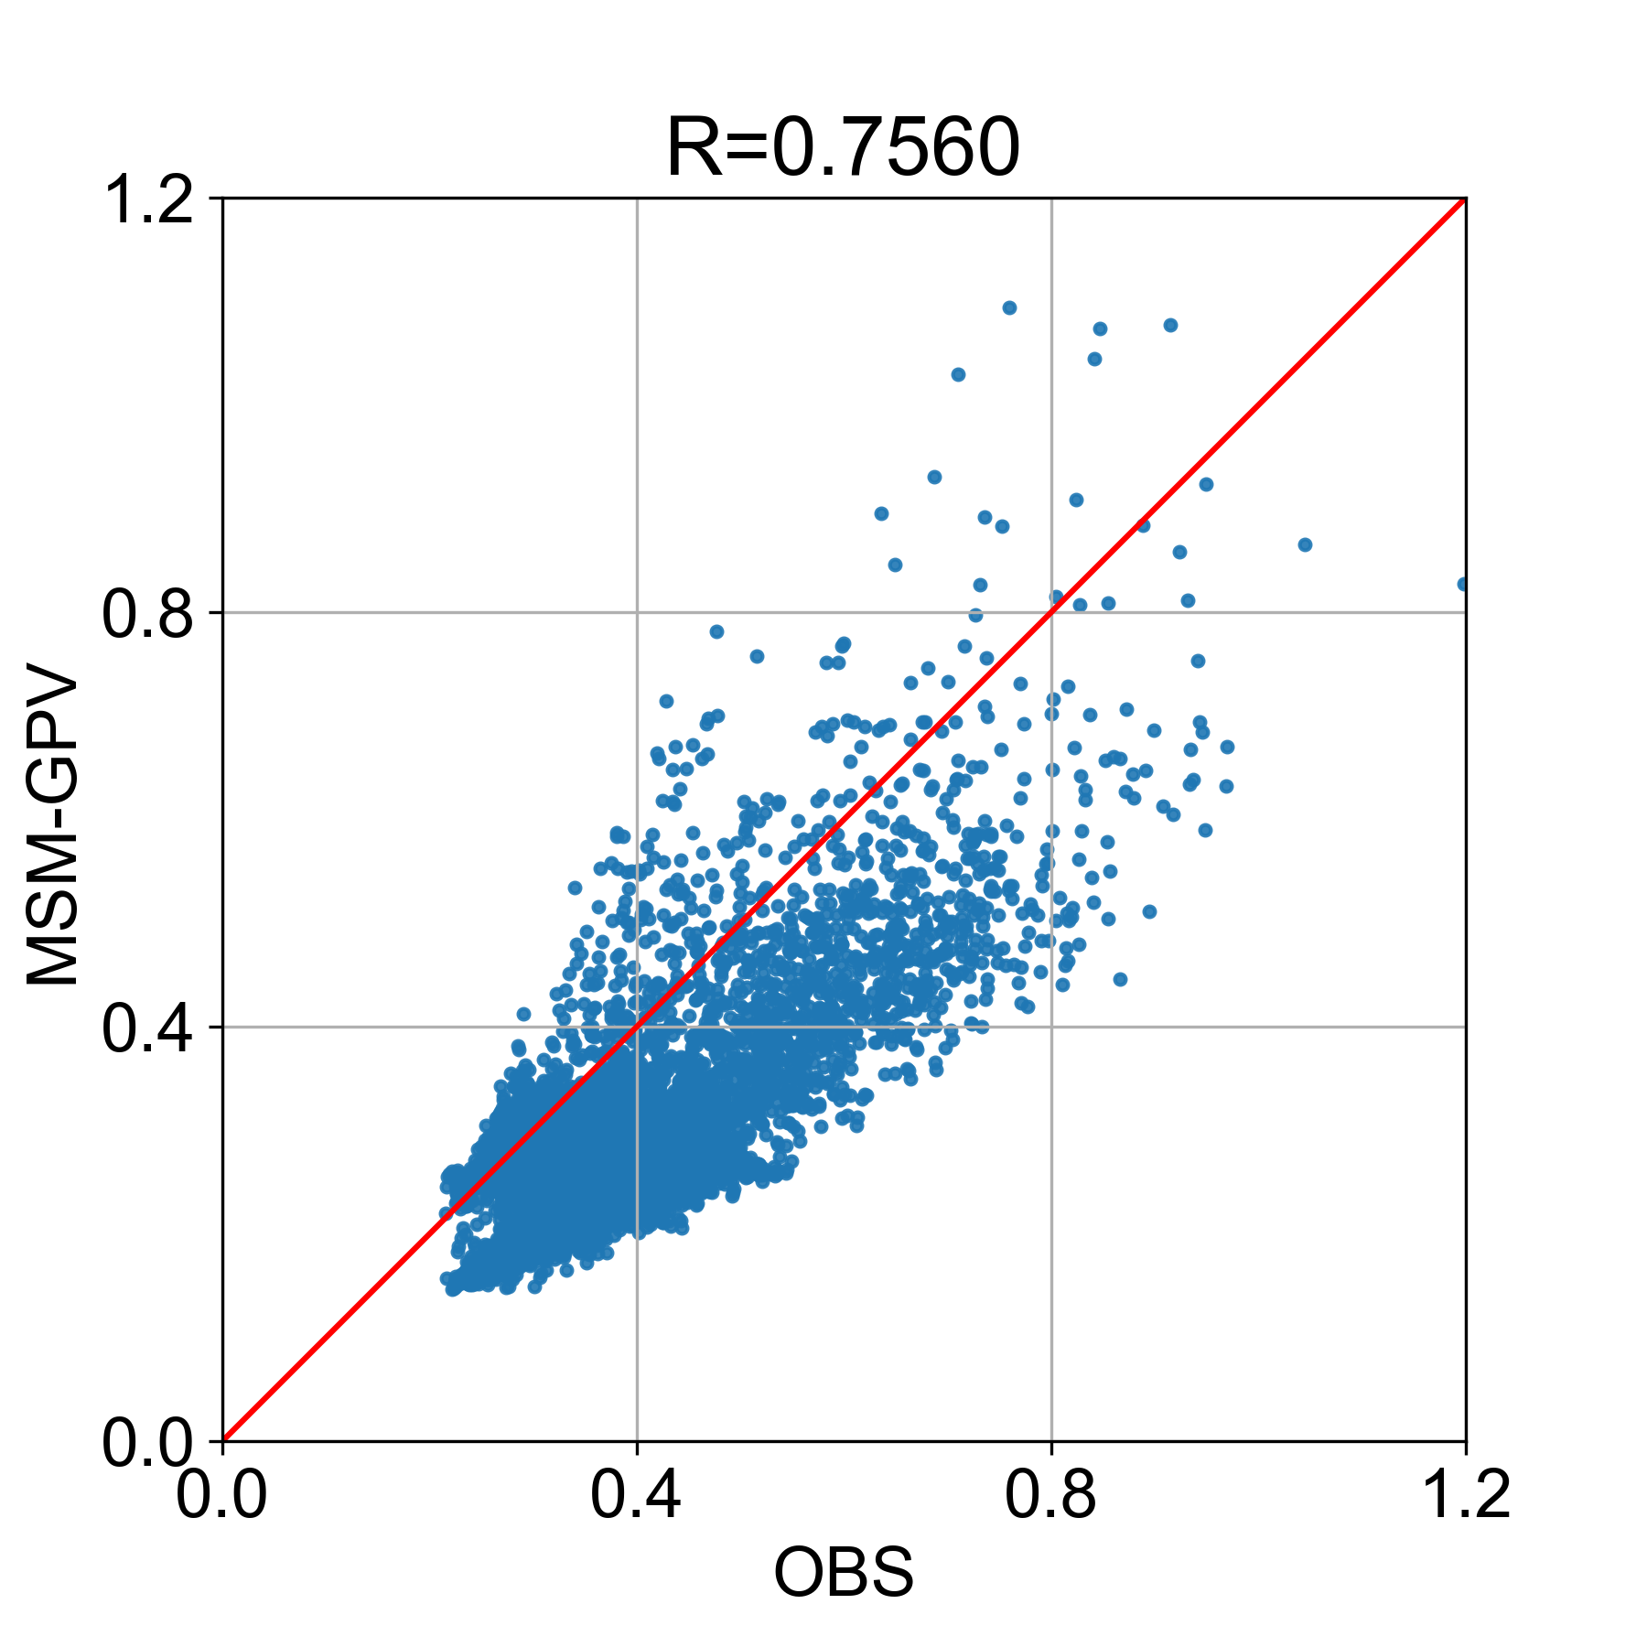
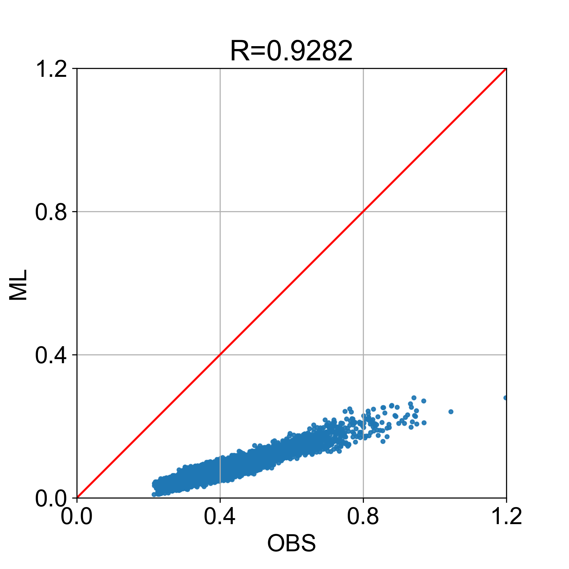
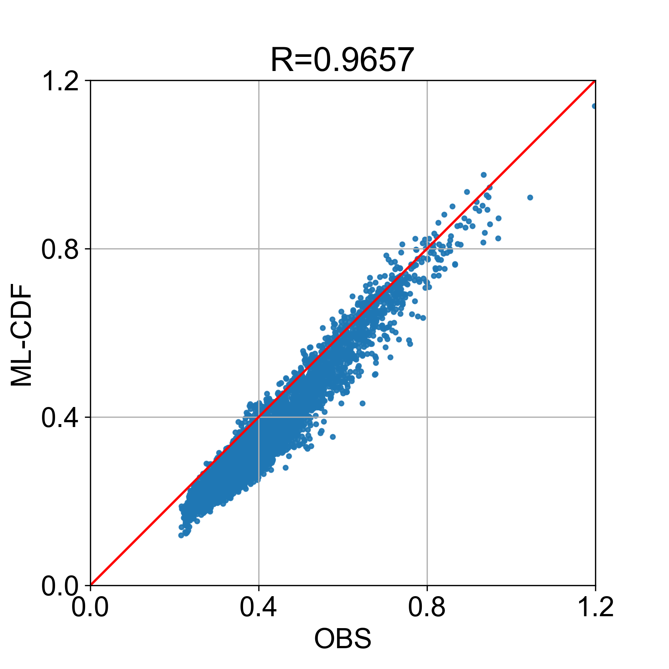
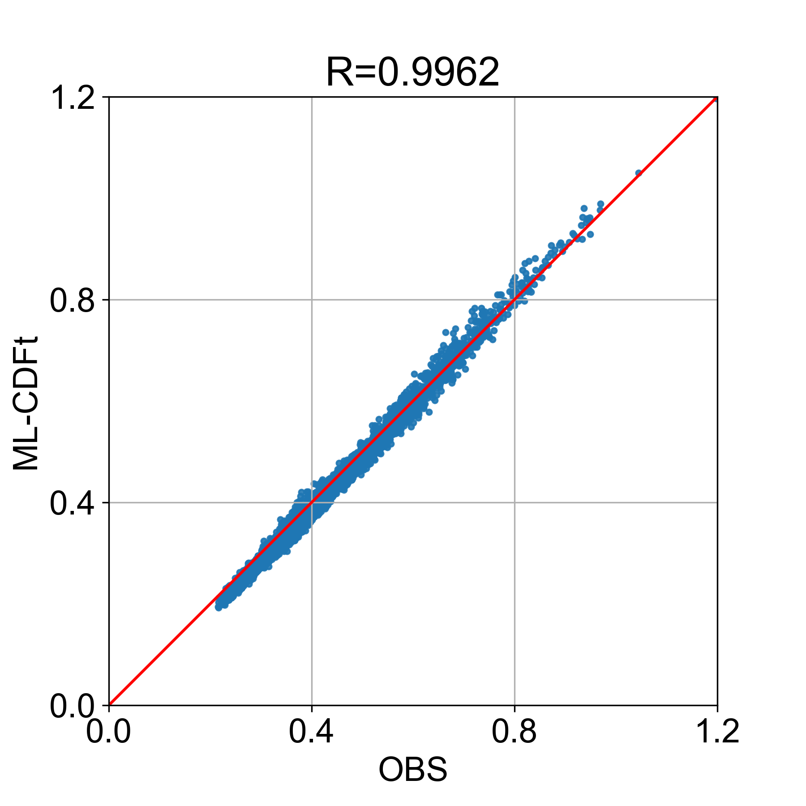
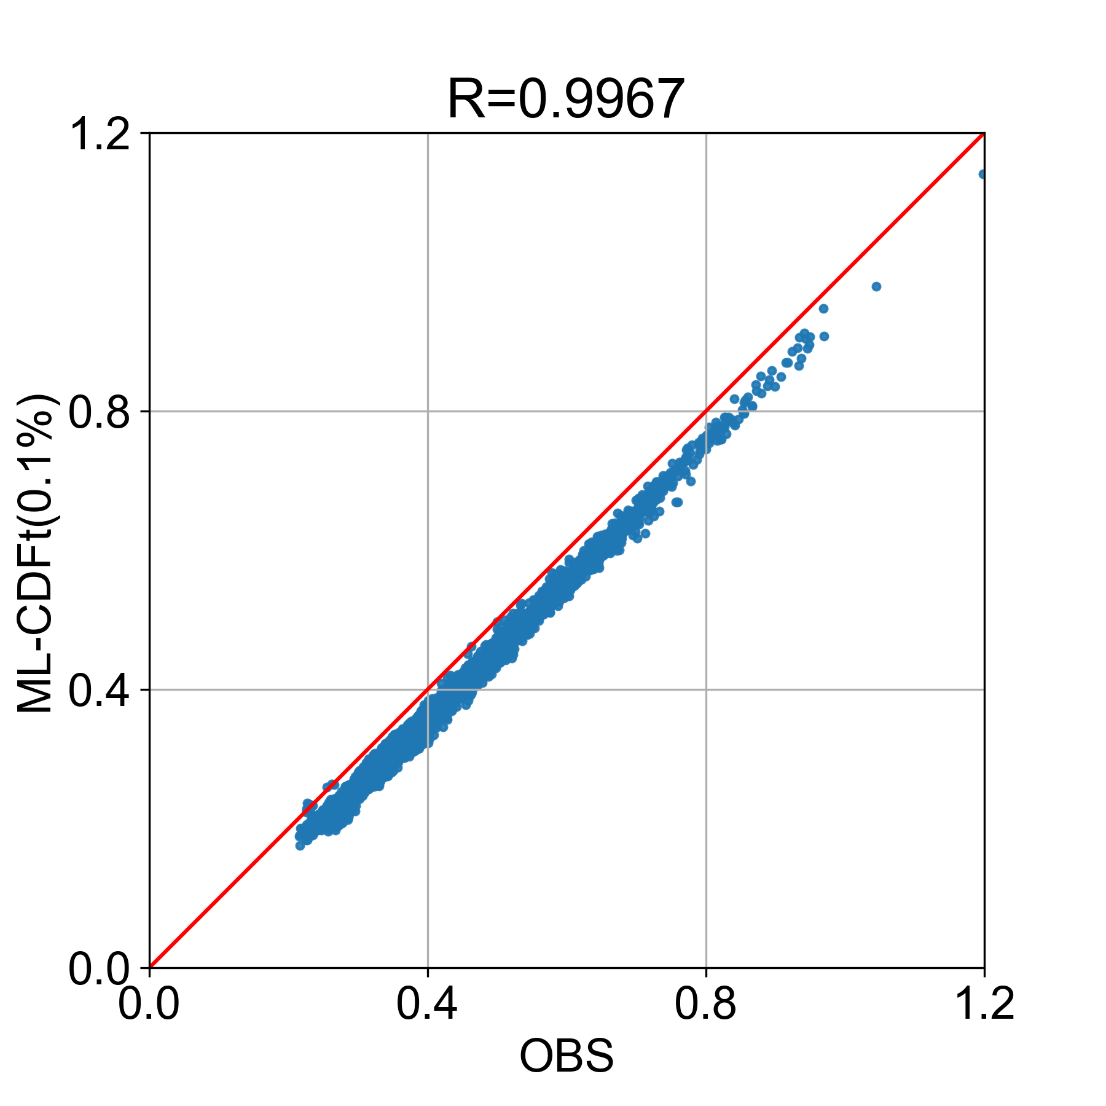
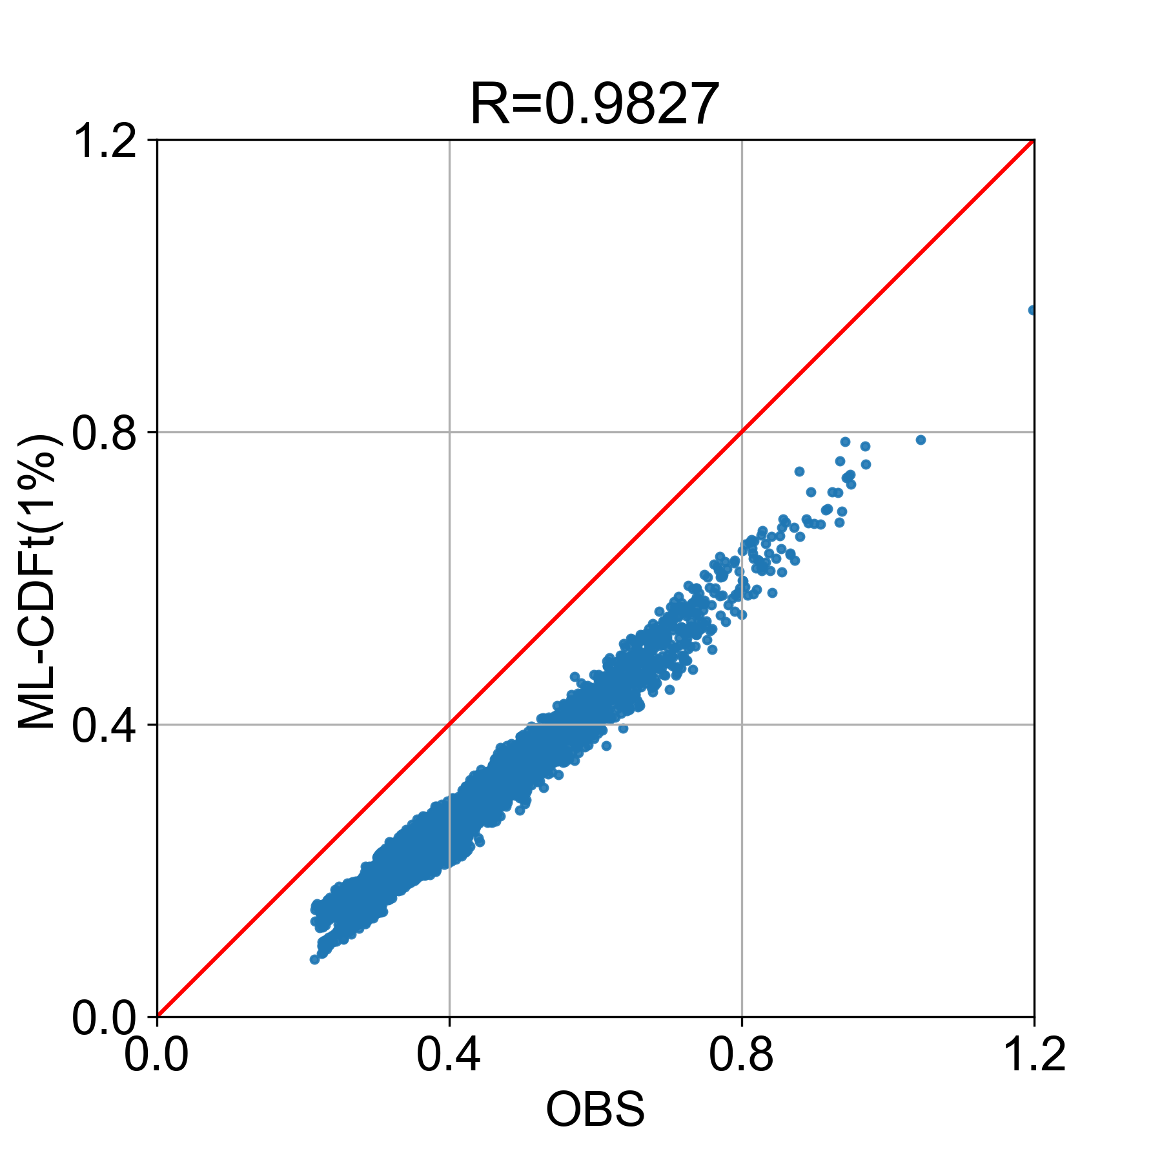
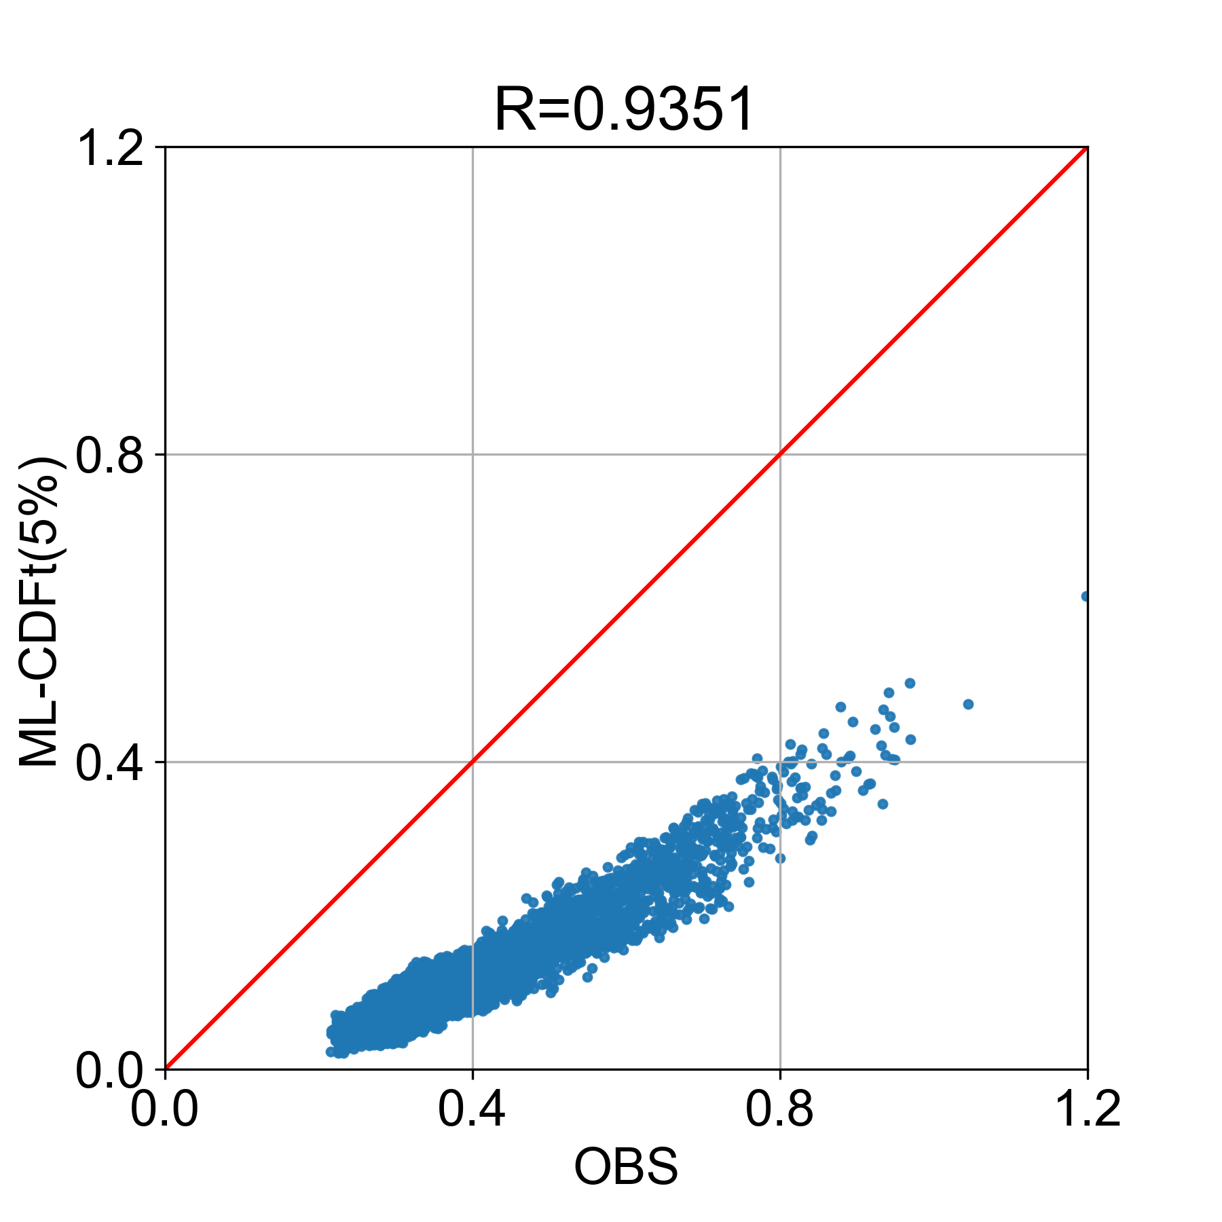
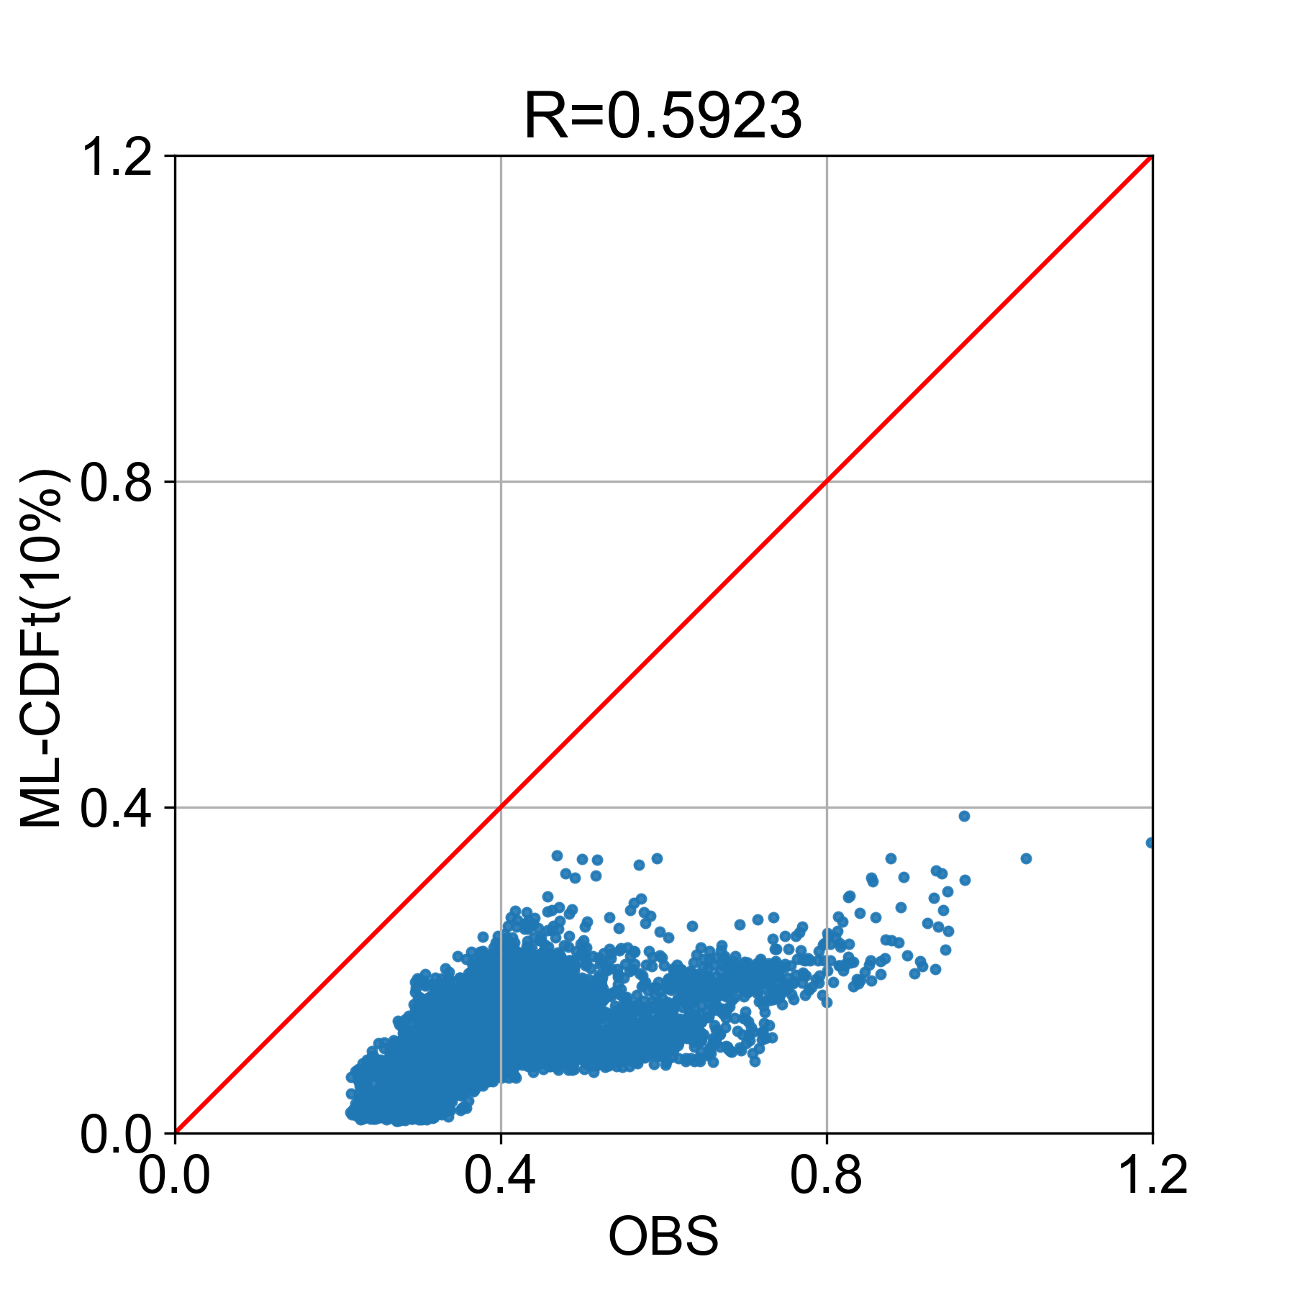
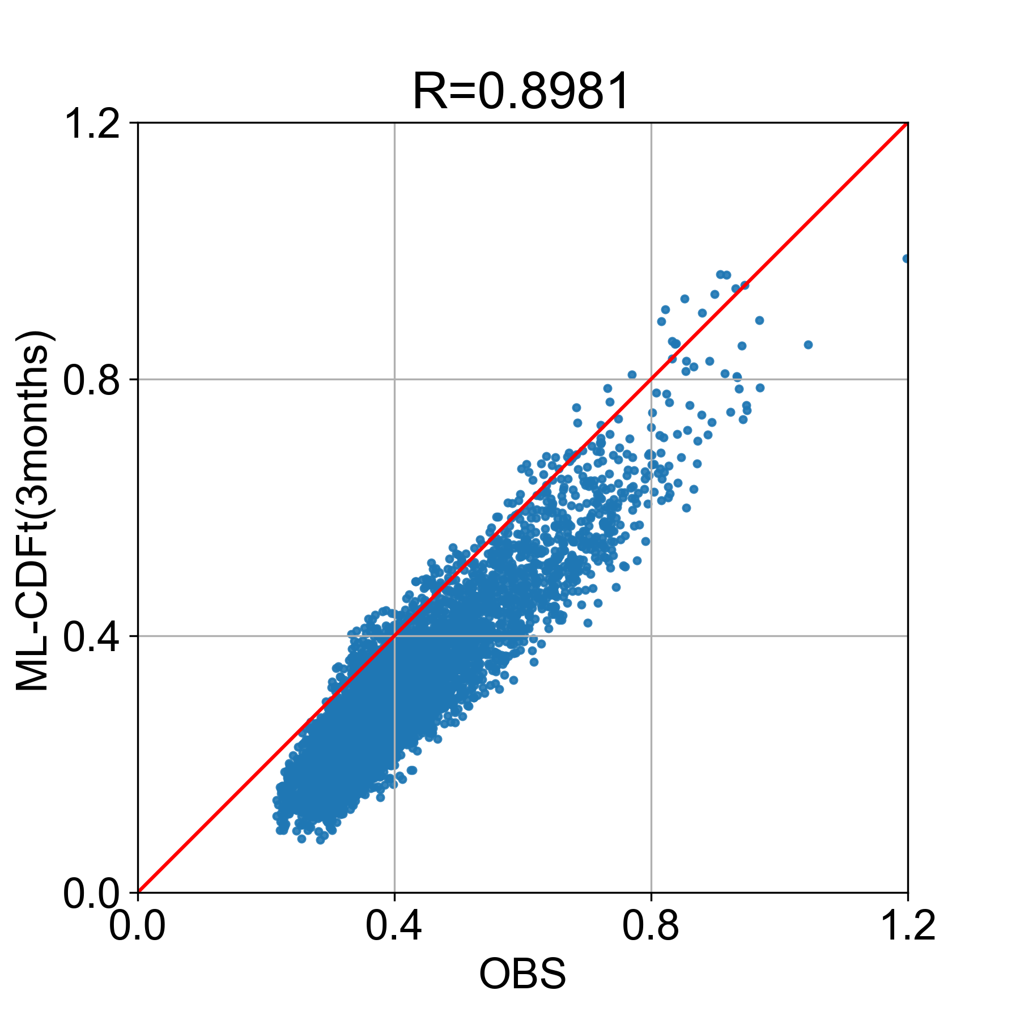
ML-Japan (Site C; July)
Scatter Plot and R (12-year monthly averaged precipitation)
MSM-GPV
ML
ML-CDF
ML-CDFt
Steps:
Calculate 12-year monthly mean precipitation
Calculate R

Slide 3
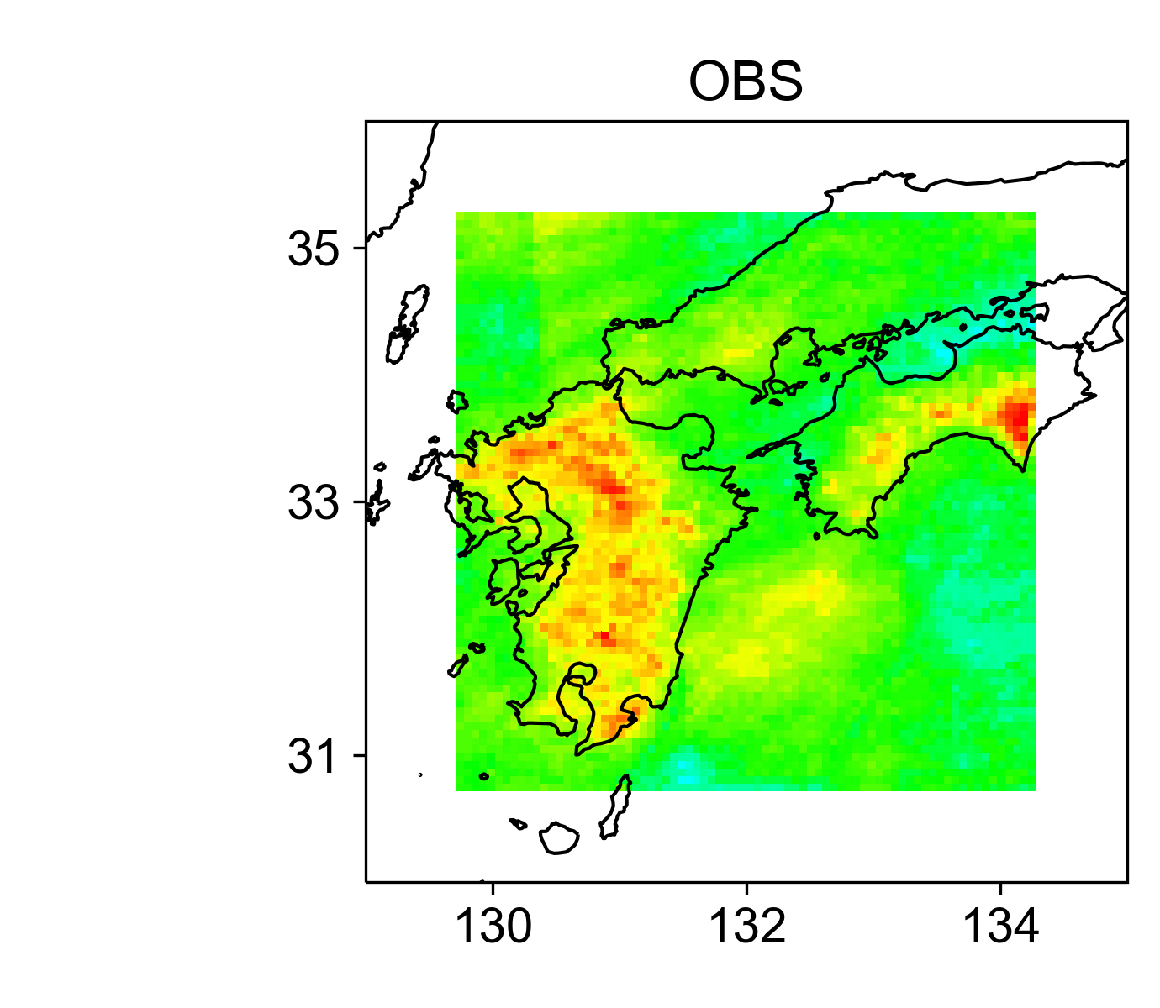
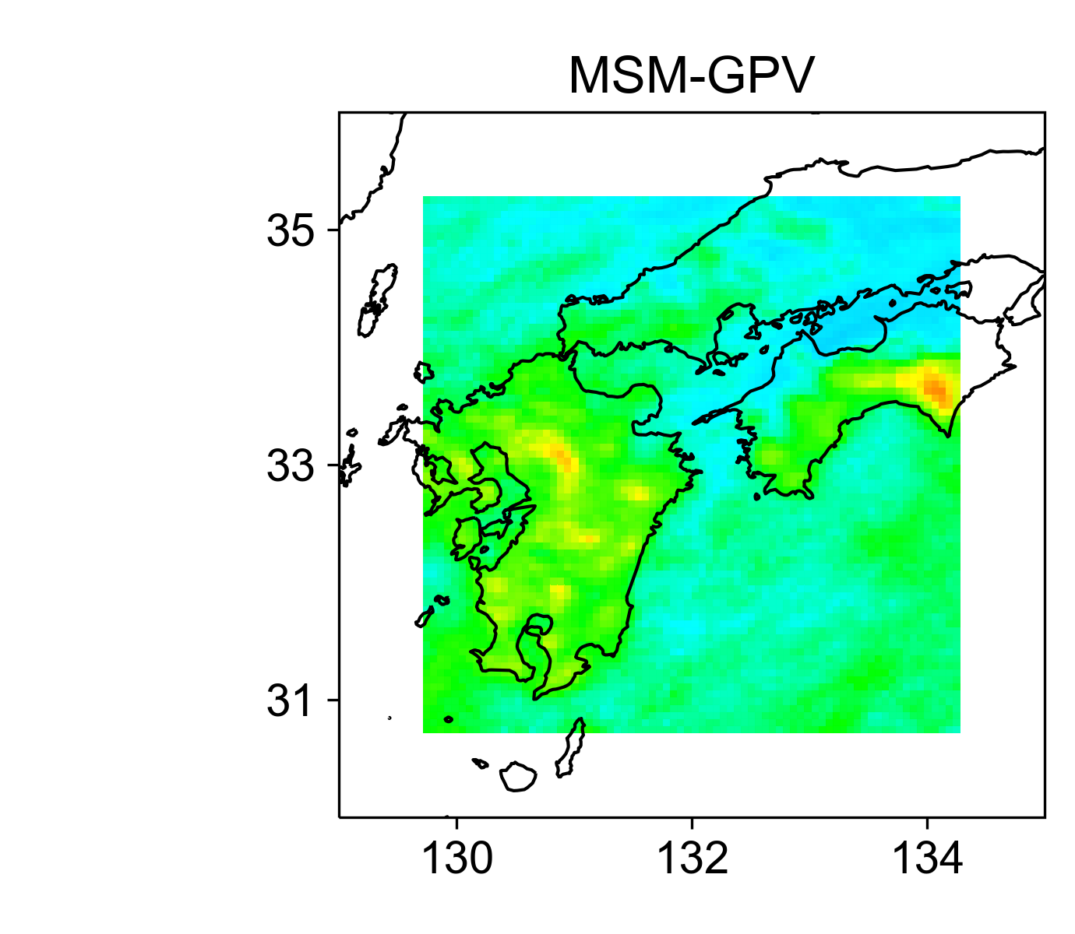
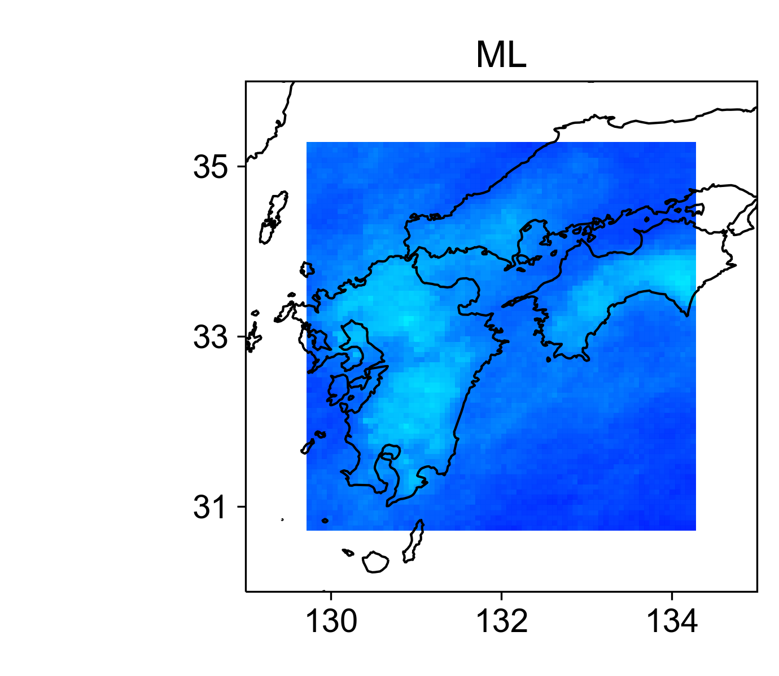
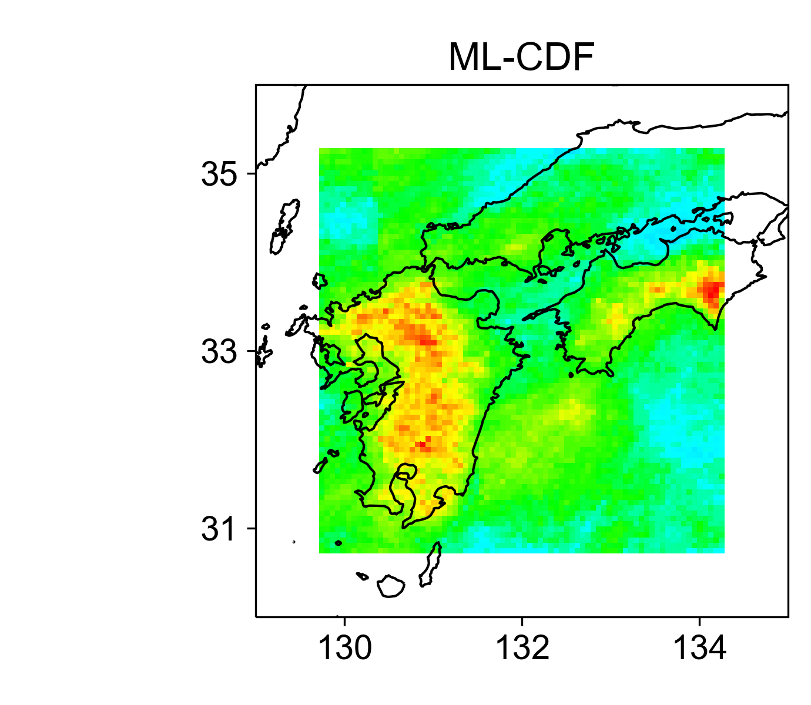
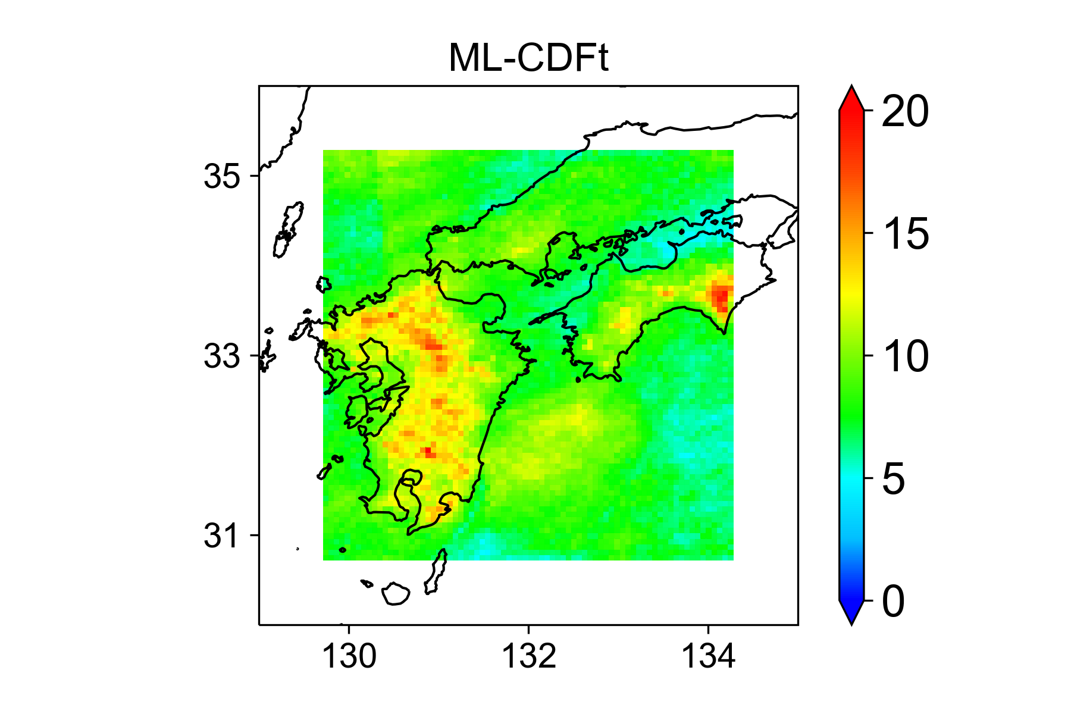
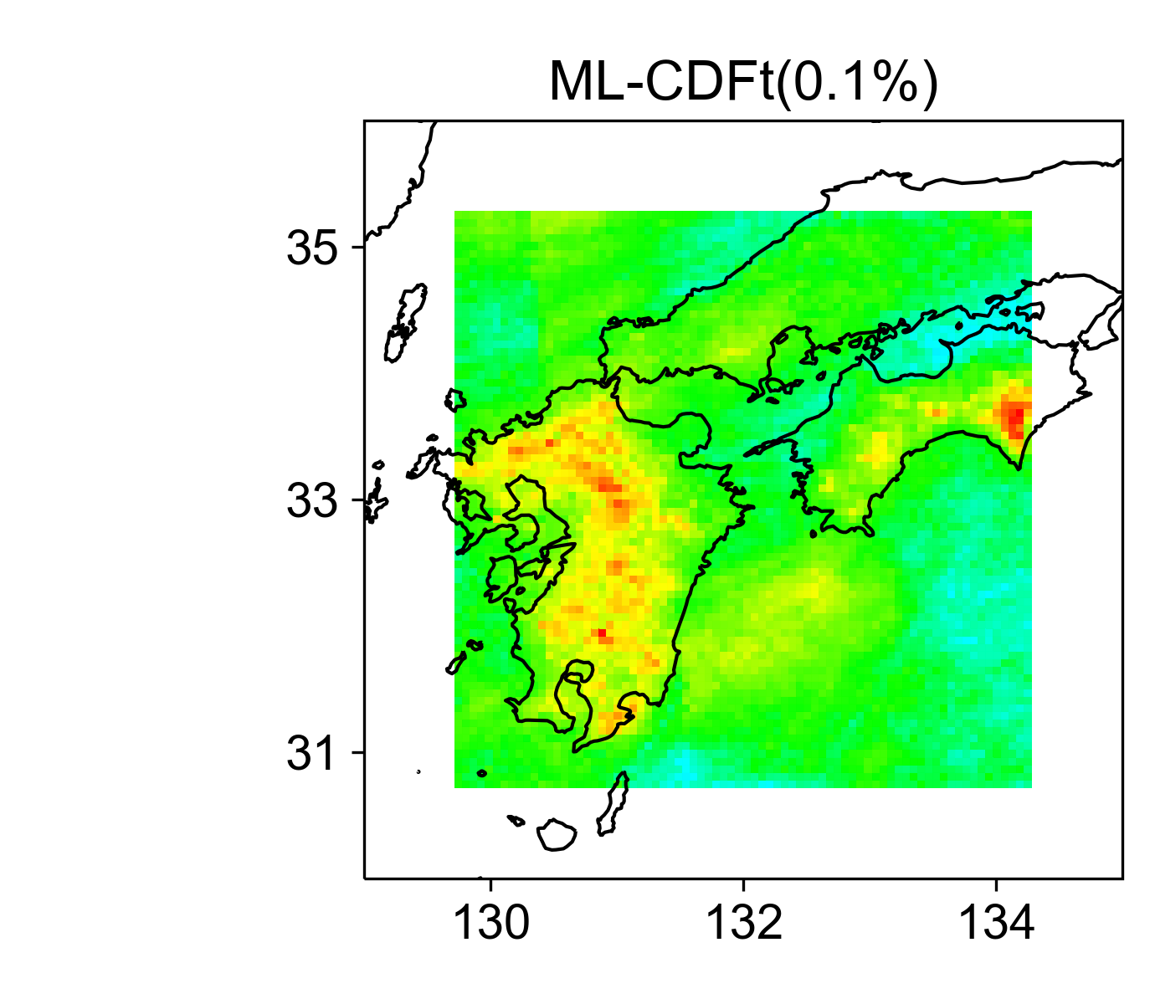
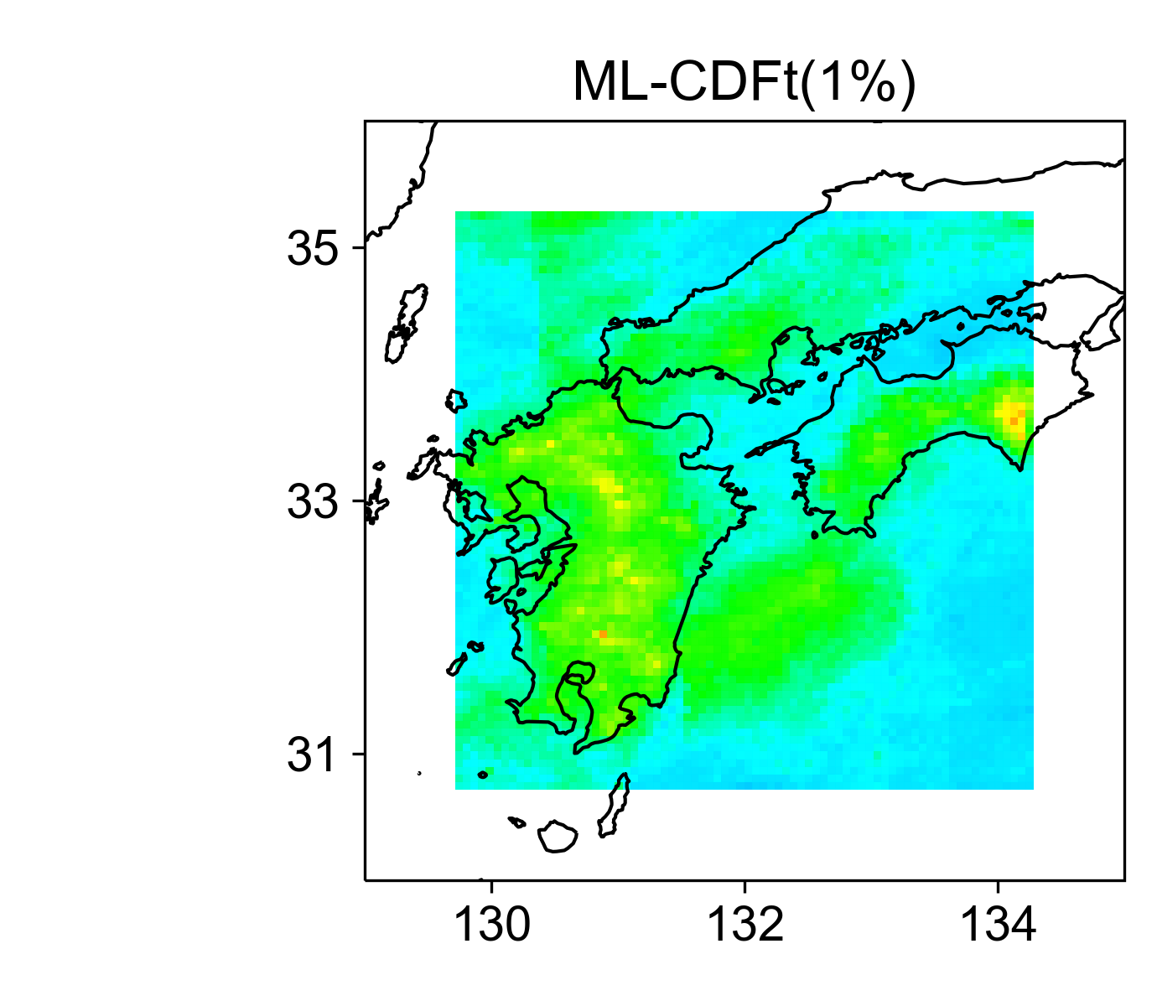
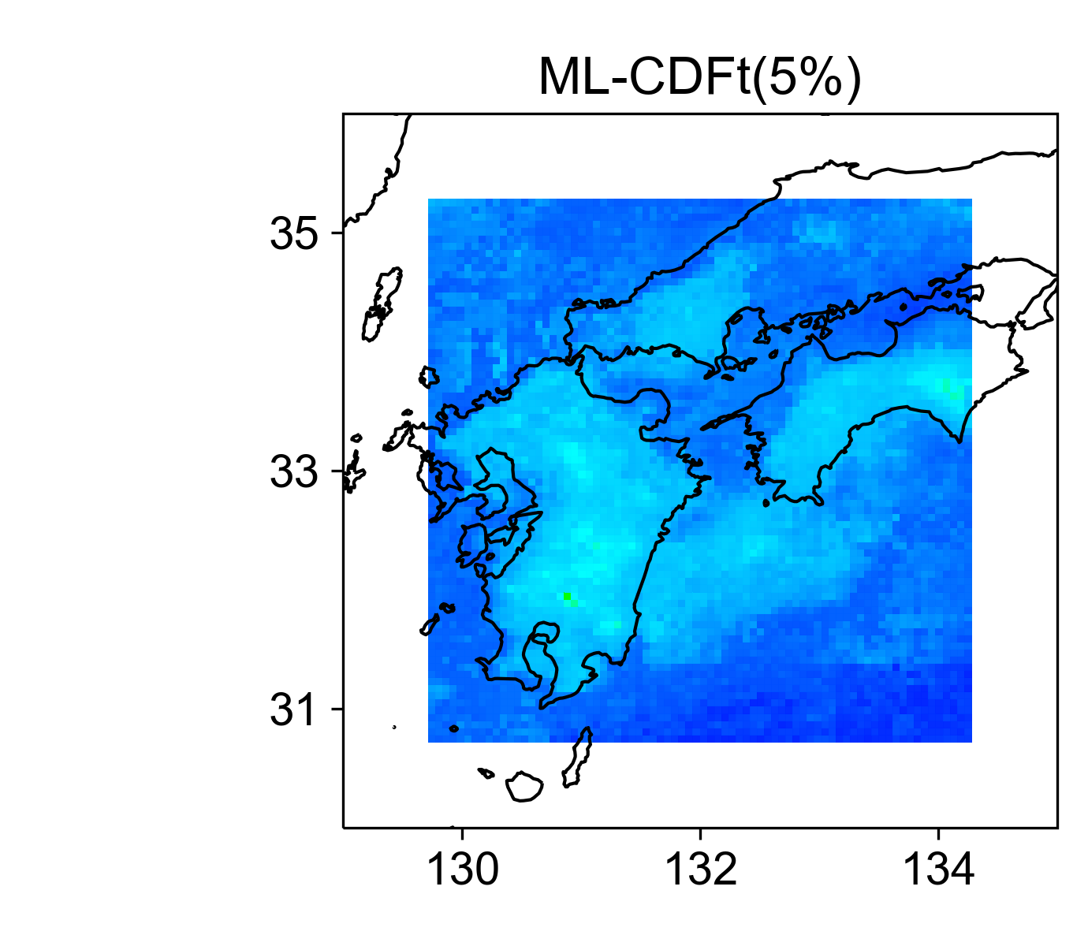
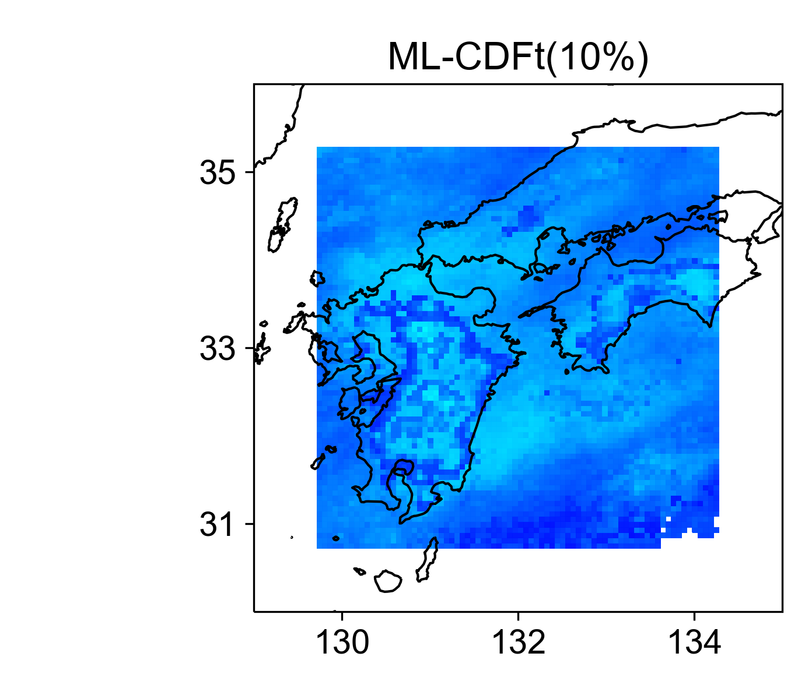
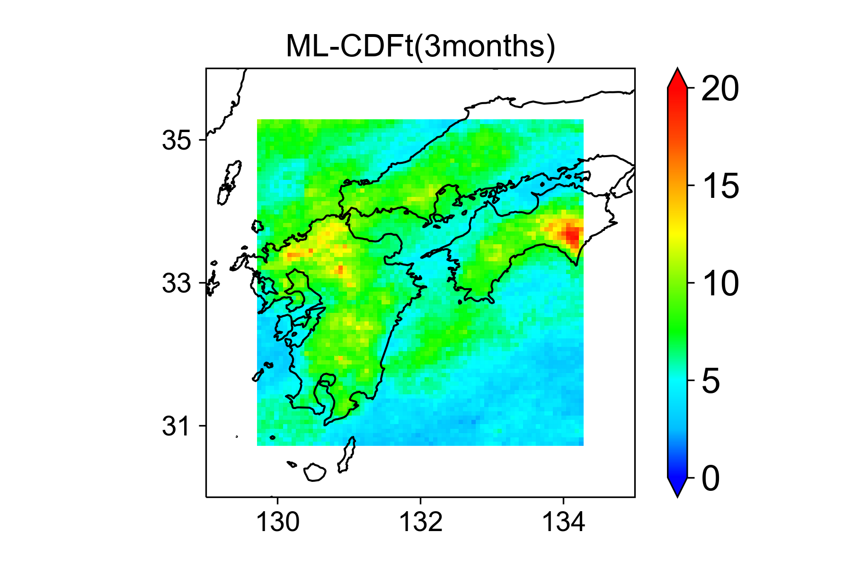
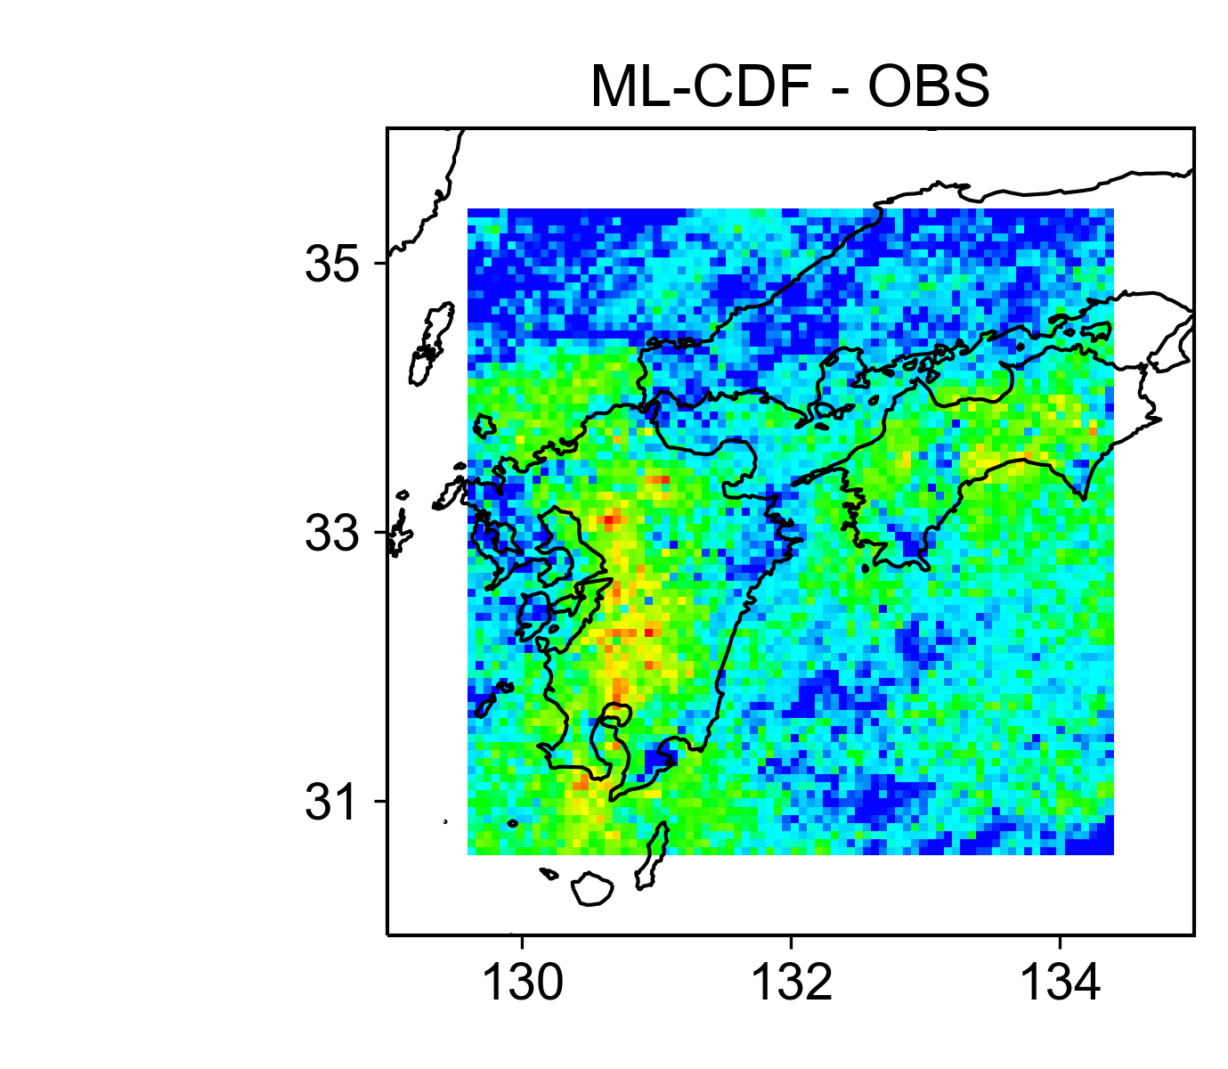
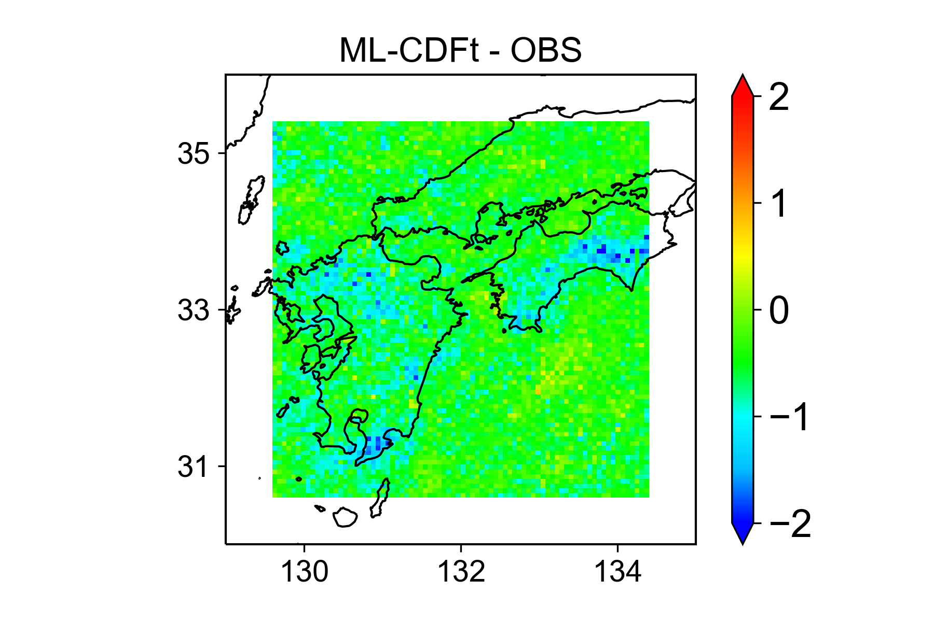
ML-Japan (Site C; July)
99% Precipitation (12-year hourly precipitation)
Difference Map

Slide 4
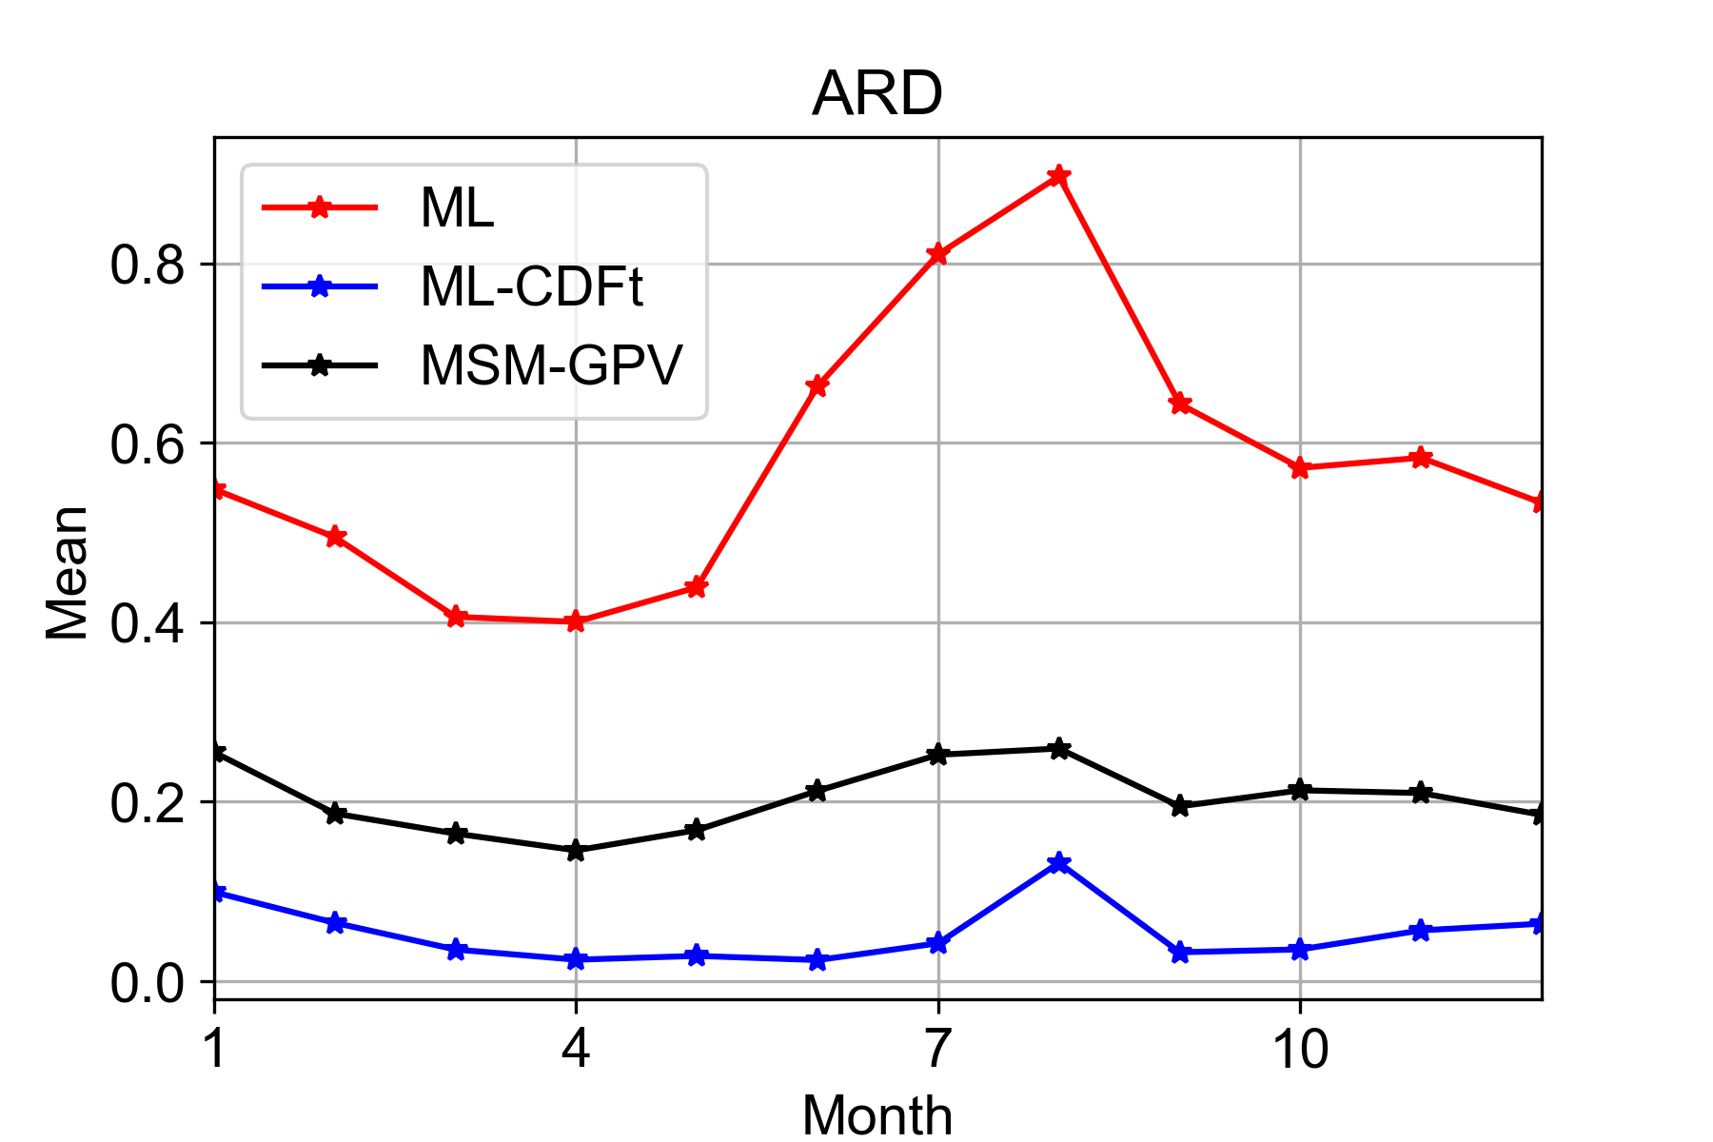
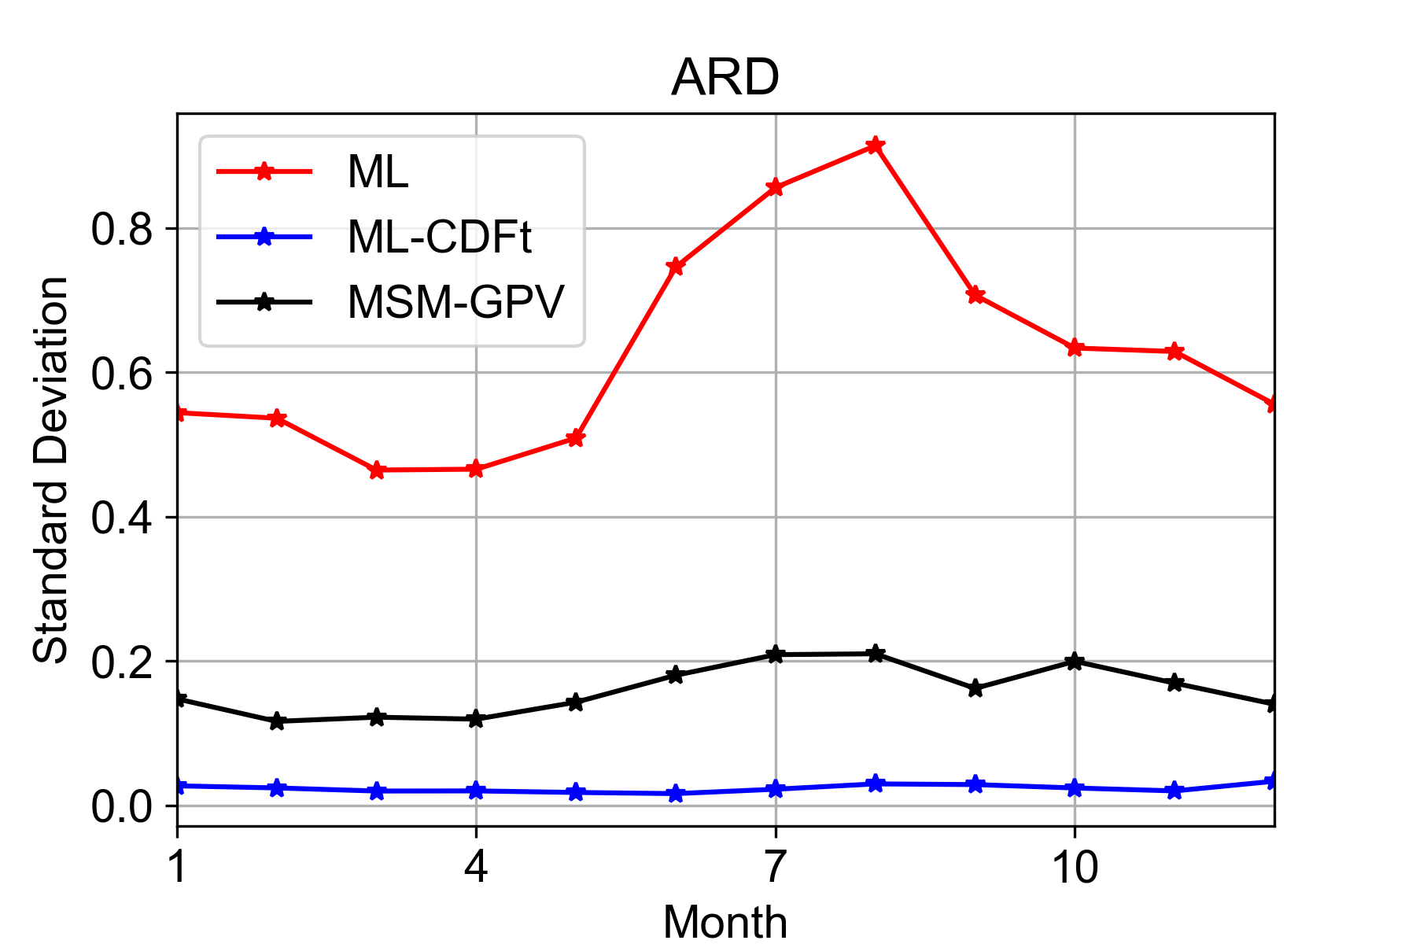
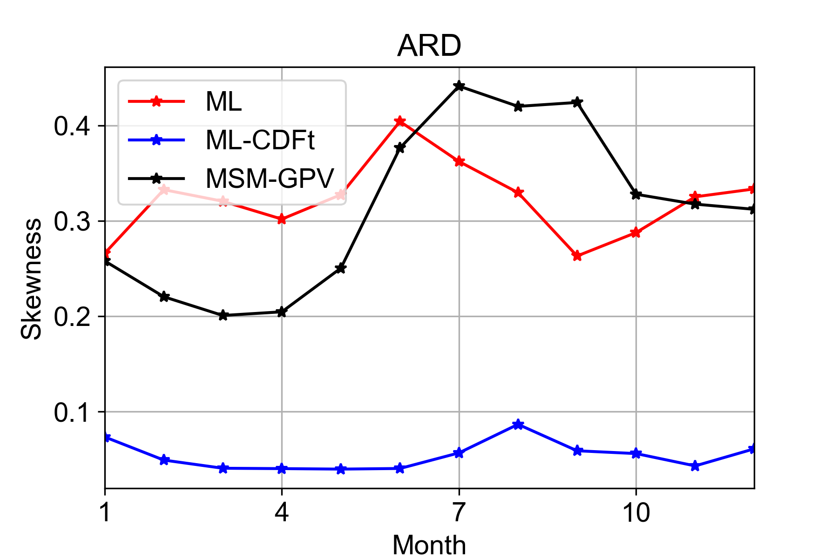
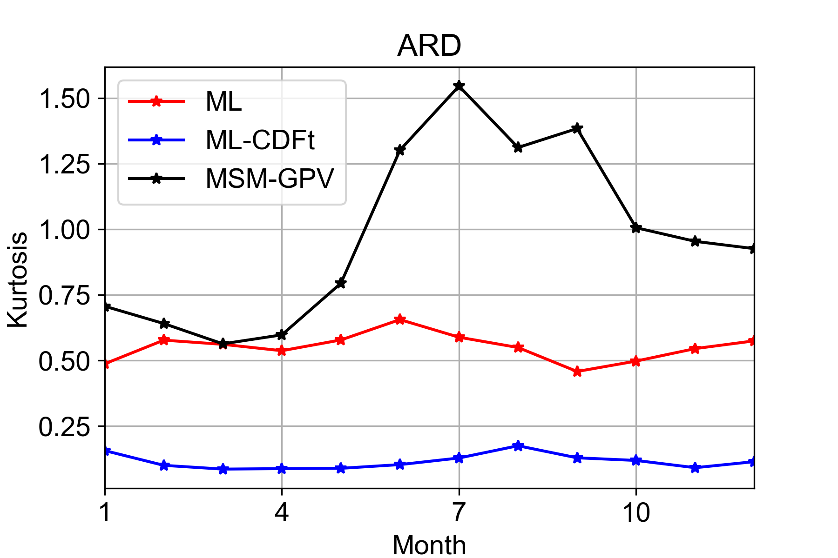
ML-Japan (Site C; Jan-Dec)
Absolute value of the Relative Differences (ARD)
$$ARD=\frac{\left|X^{′}−X\right|}{X}$$
(a)
(b)
X and X’ are statistics from observed and predicted precipitation, respectively
Area-averaged; Closer to 0 → higher consistency with obs
(c)
(d)
Lafon, T., Dadson, S., Buys, G., & Prudhomme, C. (2013). Bias correction of daily precipitation simulated by a regional climate model: a comparison of methods. International Journal of Climatology, 33(6), 1367-1381.

Slide 5
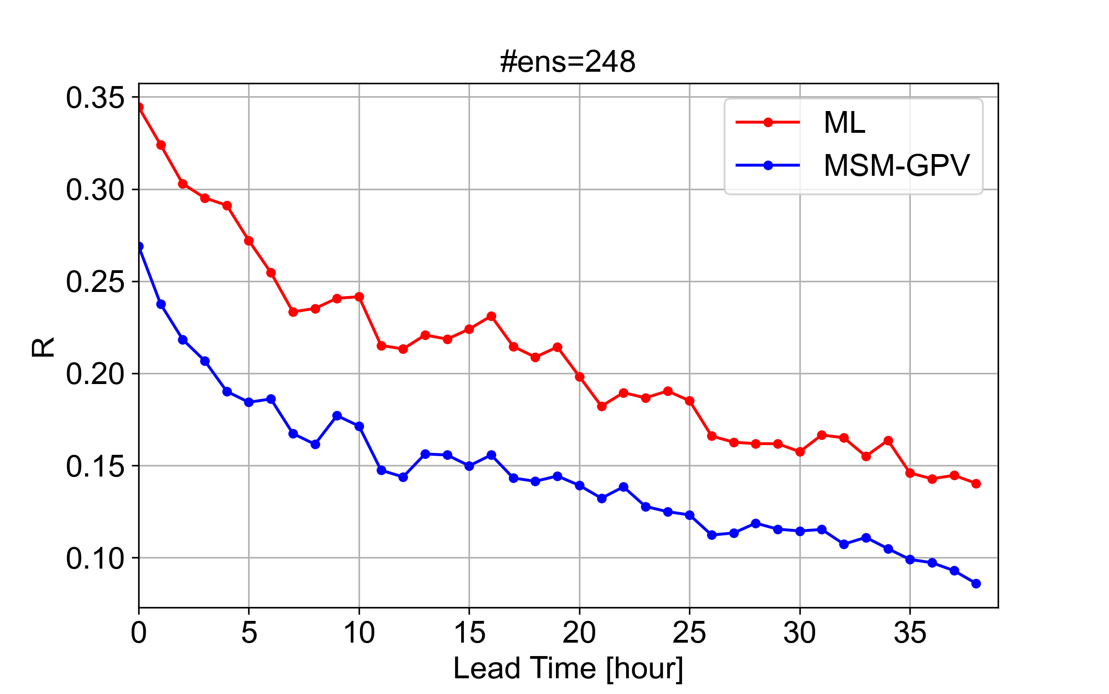
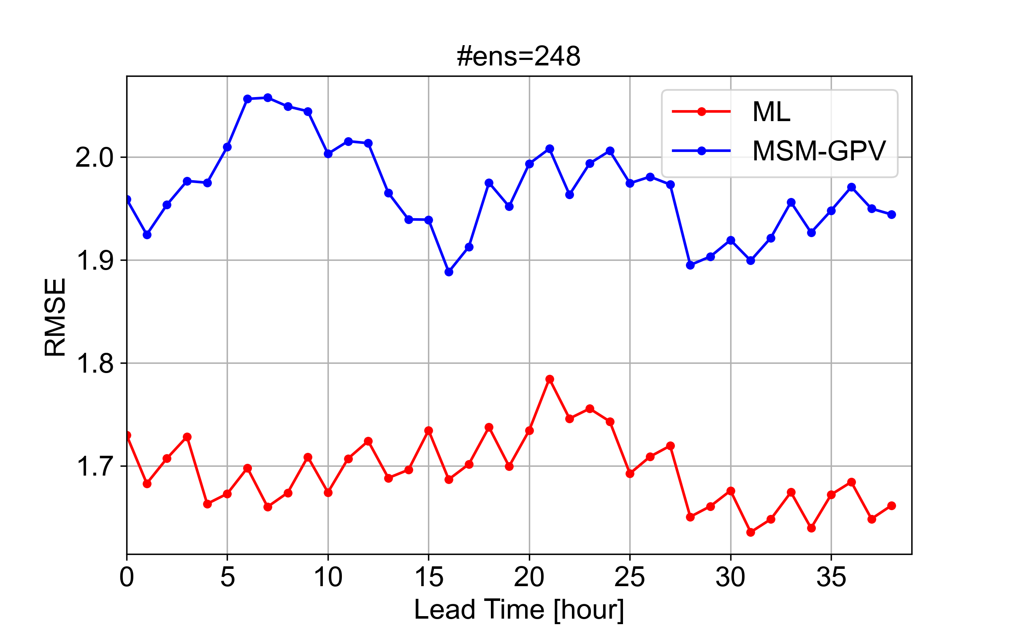
ML-Japan (Site C; July)
Training period: 2007-2018 July
Forecasting period: 2019 July (Used MSM-GPV 39 hr forecast data)
Testing site: Site C
No CDFt conducted in this results
8 forecast time series/day $×$ 31 day = 248 ensembles
*Lines in the figure represent ensemble mean time series
As forecast time increase, the correlation between ML (or MSM-GPV) and OBS decreases as expected.
There is no clear decreasing pattern found in RMSE, but RMSE_{ML} < RMSE_{MSM-GPV}

Slide 6
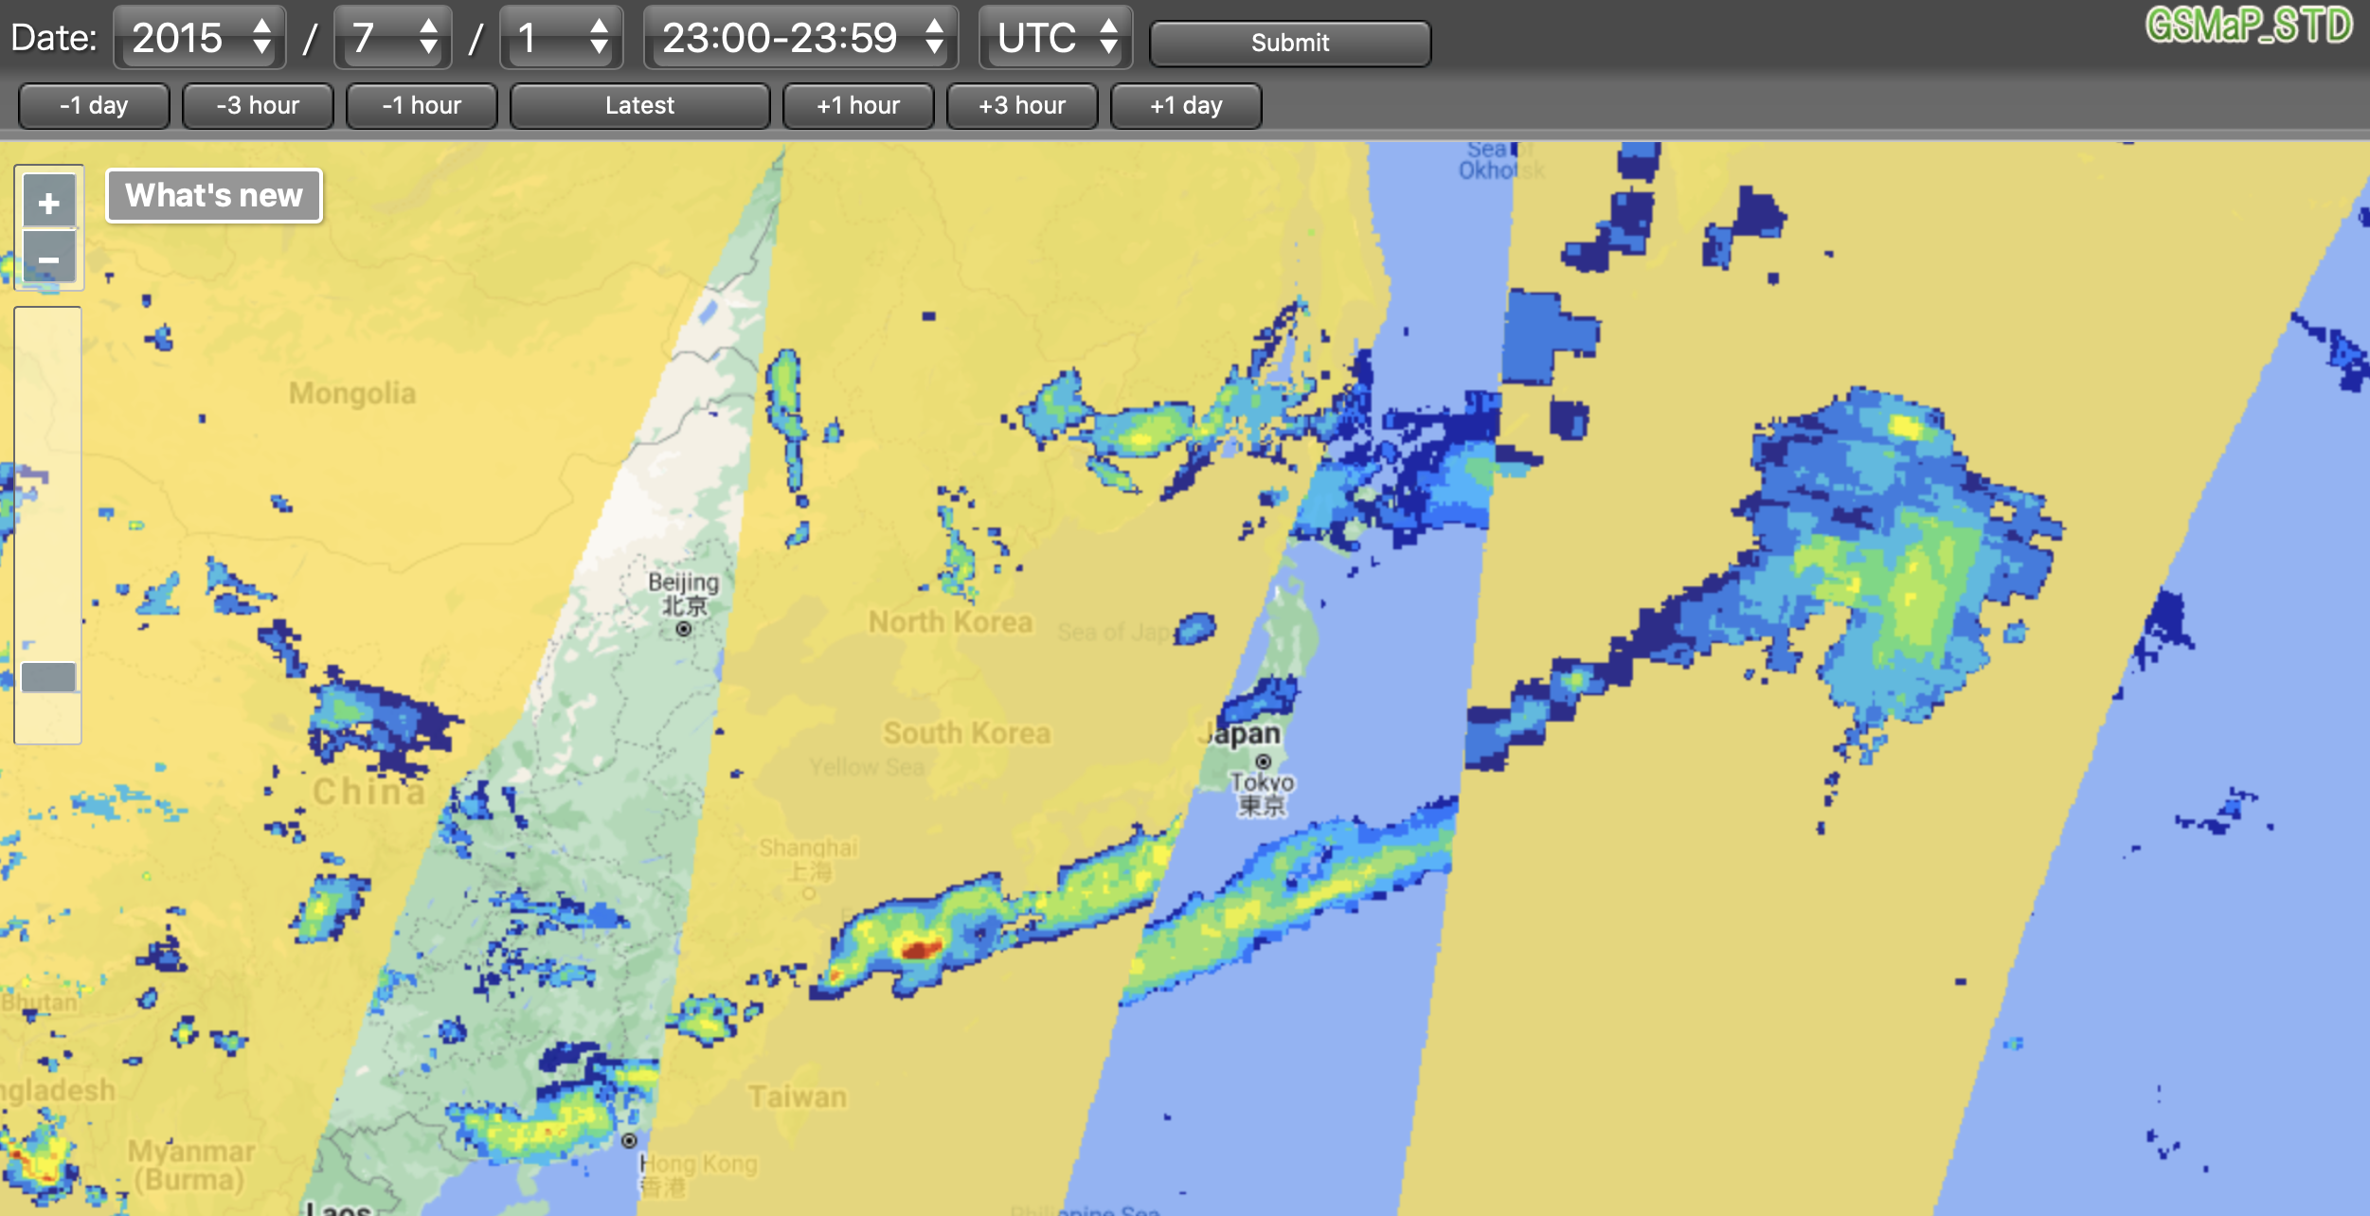
ML-Global
GSM-GPV (cumulative precipitation every 6 hours)
GSMaP (hourly precipitation; version 6; GSMaP_Gauge_NRT; 2008-2020)

Slide 7
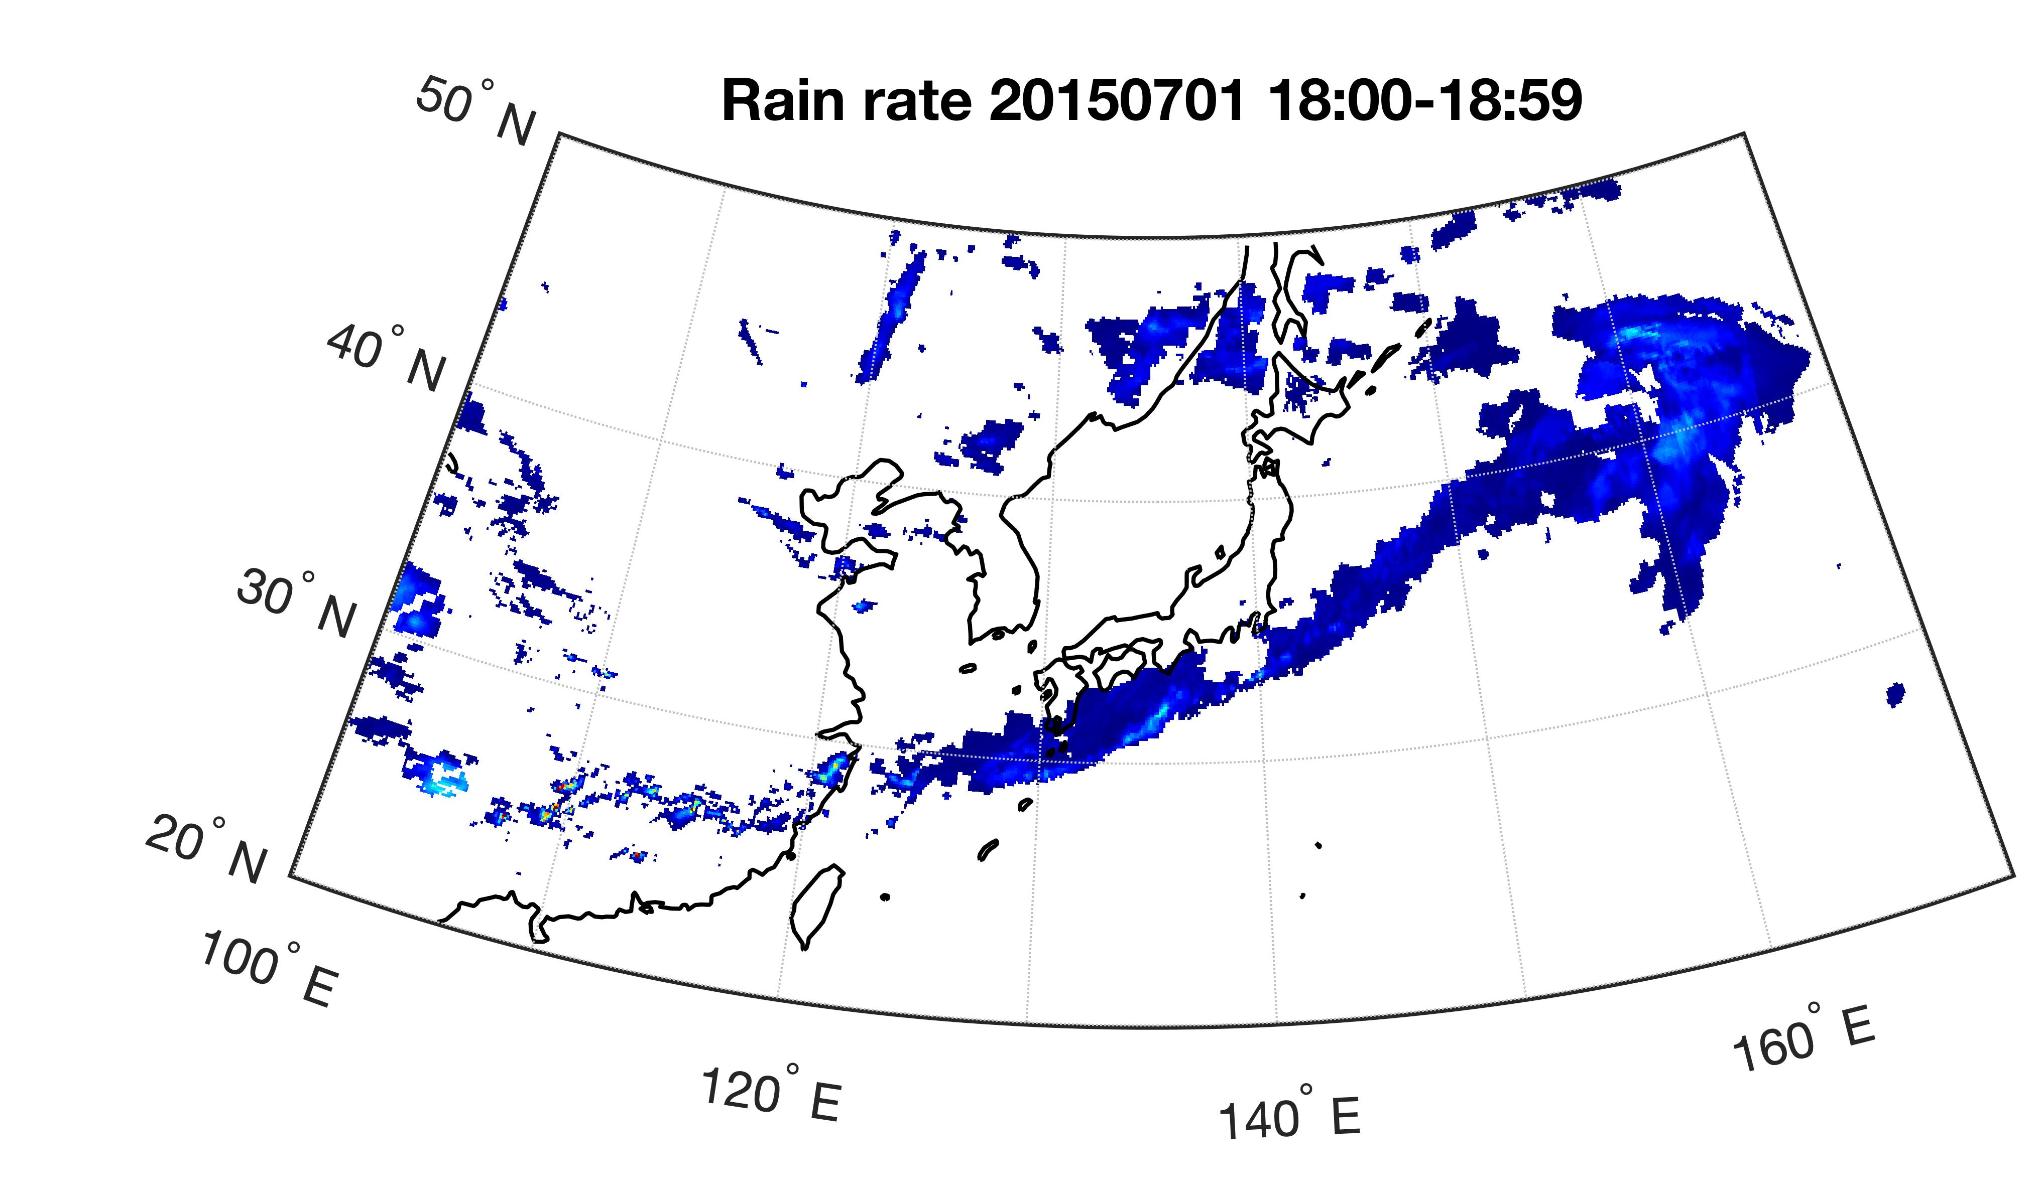
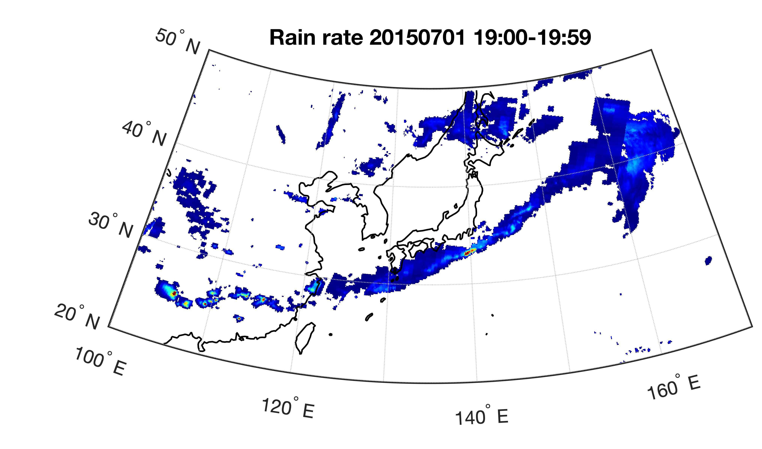
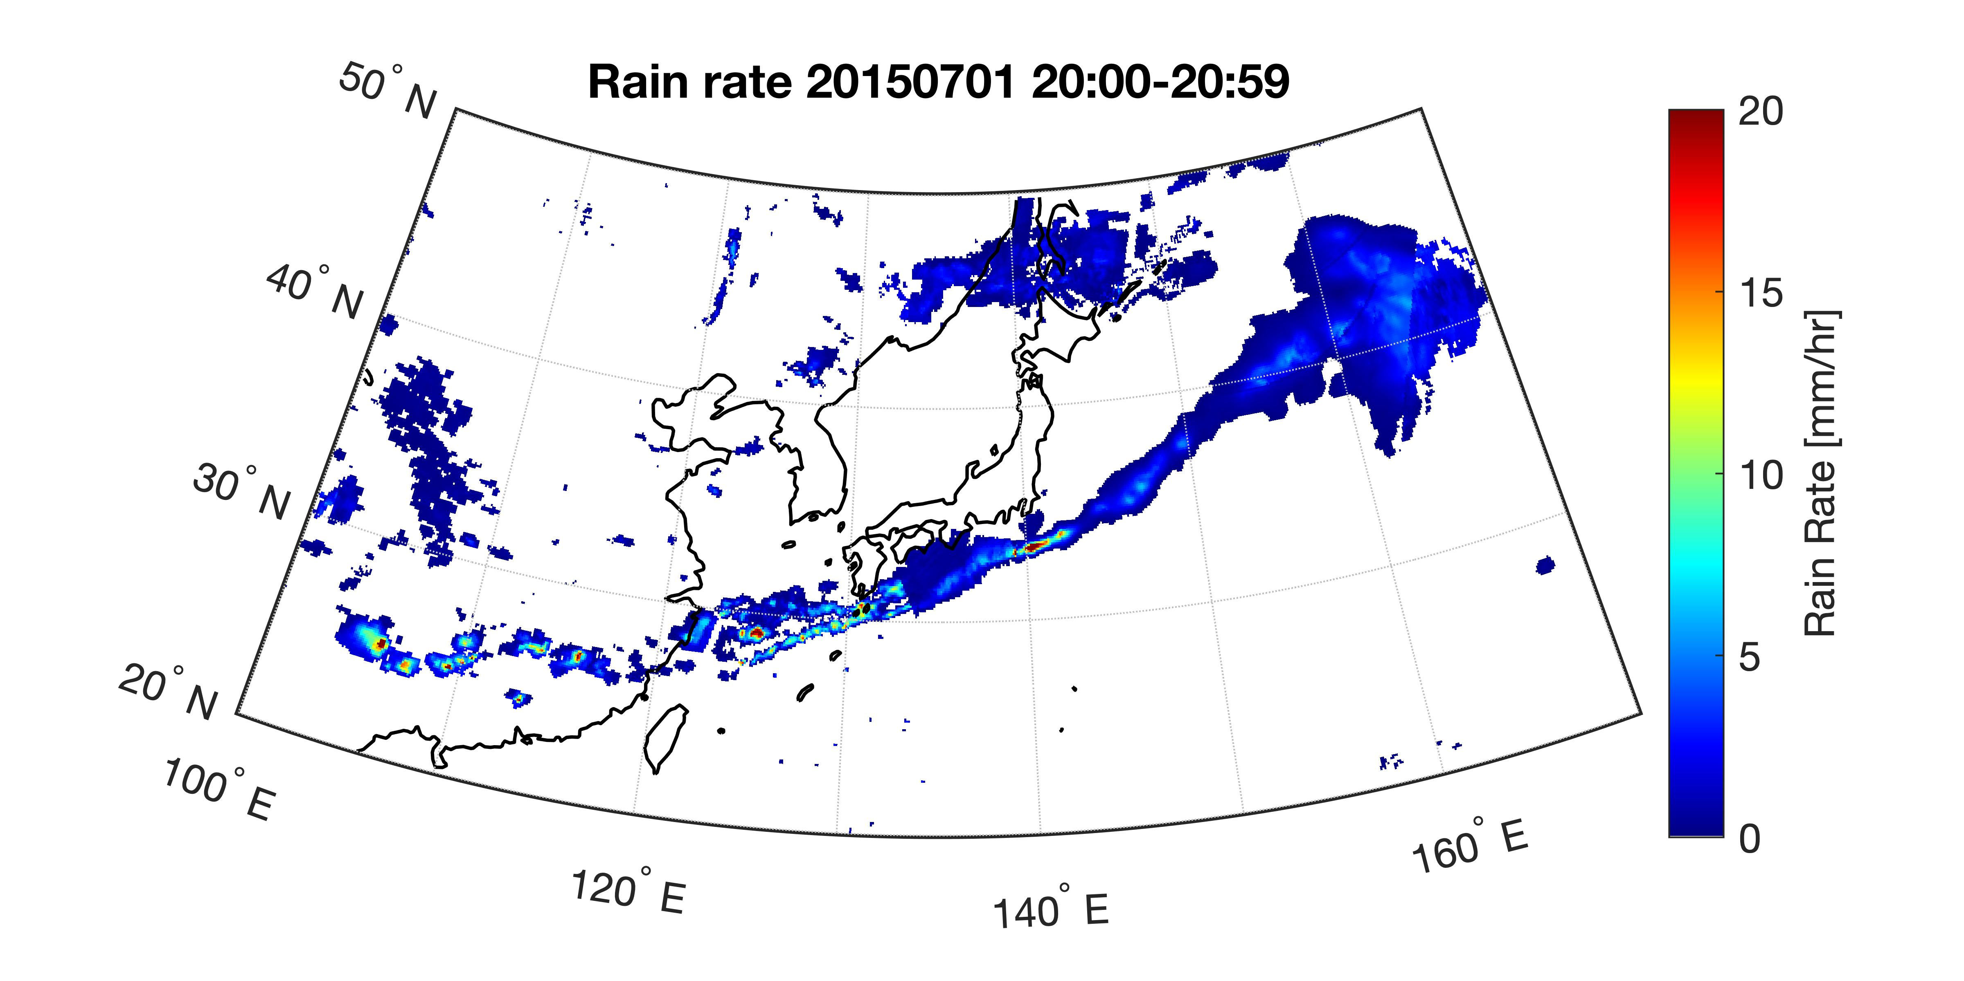
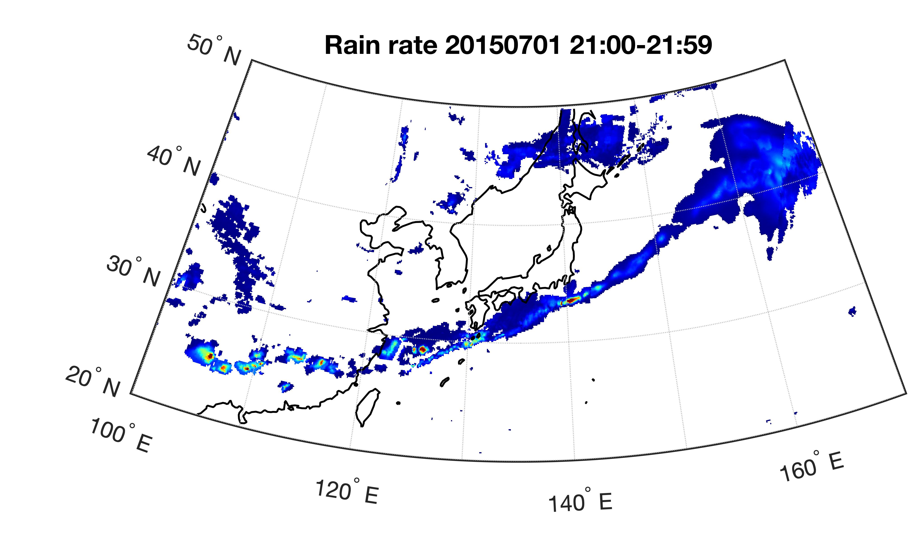
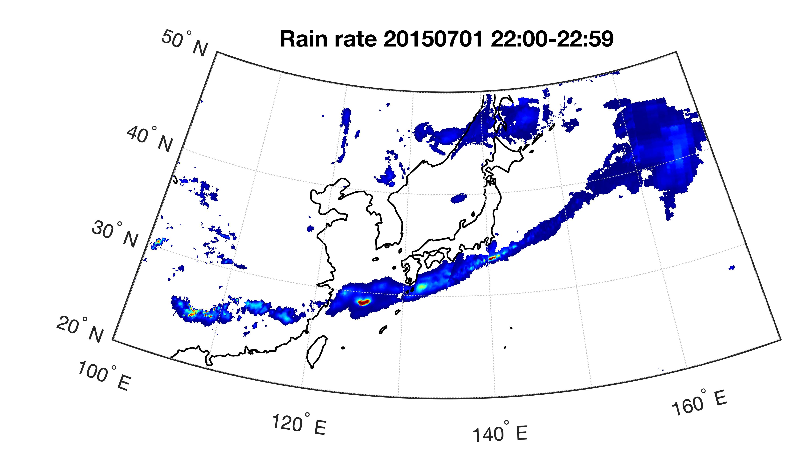
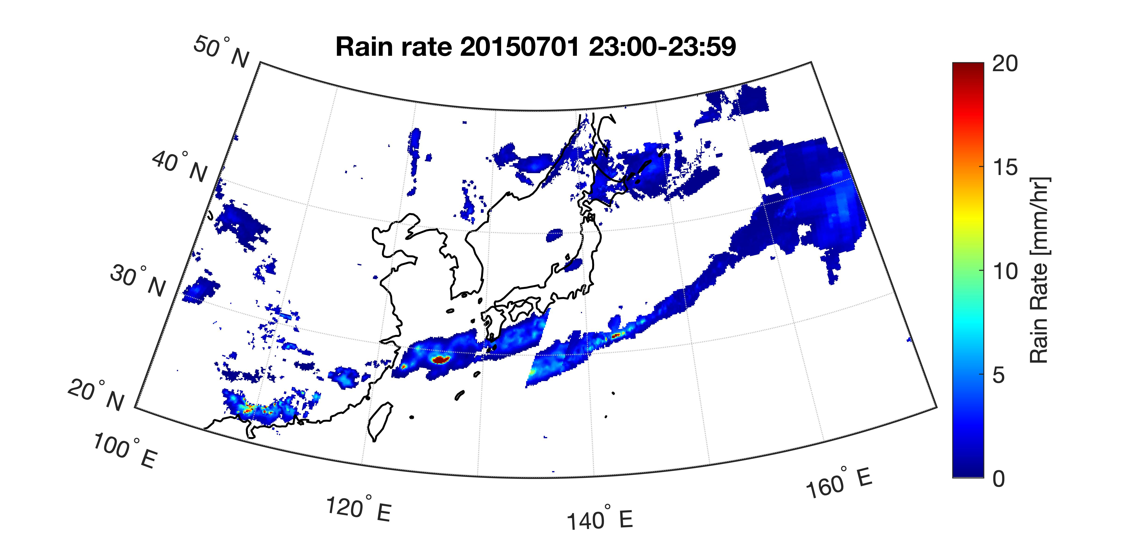
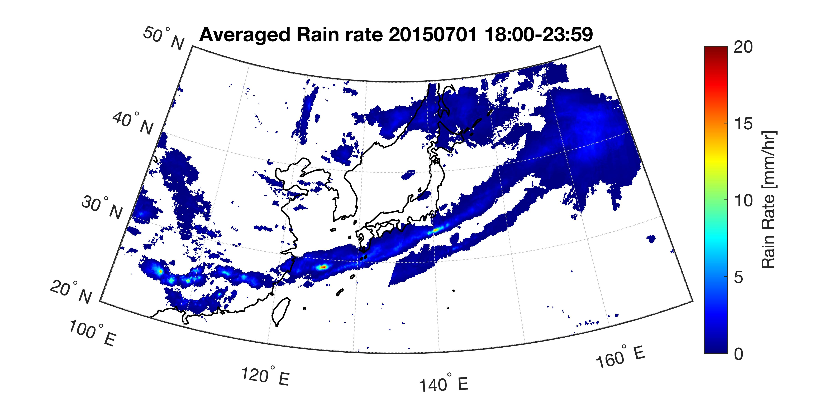
ML-Global

Slide 8
ML-Global
Every 6 hour MWR can cover 88% of the globe → Consider of not using IR-based results, and calculate 6-hour averaged rain rate?
Problem: If only one value --> using hourly value to represent averaged (over/under-estimation)
Using time information and find locations where X>0 and X<=1 → there is MWR at current hour

Slide 9
ML-Global
Every 6 hour MWR can cover 88% of the globe → Consider of not using IR-based results, and calculate 6-hour averaged rain rate?
Problem: If only one value --> using hourly value to represent averaged (over/under-estimation)

Slide 10
Research Plan
Test over a small region (100*100 grids over Japan area):
Downscale GSM-GPV from 0.5 degree resolution to 0.1 degree
Case 1: no pre-processing on GSMaP (baseline)
Case 2: Do not use IR-based values in GSMaP and calculate 6-hour average → Run ML
Case 3: Do not use IR-based values in GSMaP and calculate 6-hour average
use 3 months data to conduct ML
* hyperparameter selection need to be done first
* Radar-AMeDAS data can be used for results assessment
Notes:
CDFt did provide better performance although relatively poorer statistical skill relative to ML (advantages versus disadvantages) → increasing data set size will help

