Slide 1
Description of examined cases
version | case | description
v1 | 1hr | Current version (using one 39 hr fcst time series and time t)
v2 | 3hr | Using (1) one 39 hr fcst time series; (2) time t, t+1, t+2
v3 | 3hr_area01_all_level | Using (1) one 39 hr fcst time series; (2) time t, t+1, t+2; (3) if uparea<1km2 → all alert level minus 1
v4 | 3hr_area01_level5 | Using (1) one 39 hr fcst time series; (2) time t, t+1, t+2; (3) if uparea<1km2 → if alert level=5, change to level 4
v5 | 2series | Using (1) two 39 hr fcst time series (current and previous) (2) time t of the first 39 hr fcst + time t, t+1 of the second 39 hr fcst
v6 | 2series_3hr | Using (1) two 39 hr fcst time series (current and previous) (2) time t, t+1, t+2 of both two 39 hr fcst
v2: consider 3 hours for each grid
v3/v4: consider both 3 hours and uparea for each grid
v5/v6: consider both multiple hours and results from two 39-hr forecasts for each grid

Slide 2
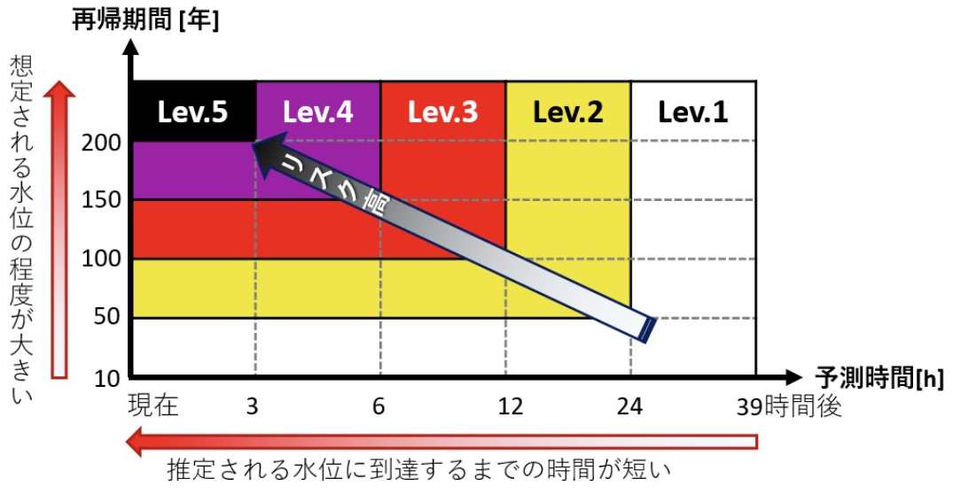
Description of examined cases
39 hr
v1 (Current)
07-12 00:00
07-12 01:00
07-12 02:00
07-12 03:00
39 hr
v2
If all three hours give the same level → use the level
(e.g., 5,5,5 → 5)
If two hours give the same level → use the min level
(e.g., 5,2,2 → 2;
5,5,2 → 2)
If all three hours give different levels → use median
(e.g., 1,2,5 → 2)
07-12 00:00
07-12 01:00
v3
Calculation is all the same as v2, but after calculation, for each grid, if the uparea<1km², alert level minus 1
v4
Calculation is all the same as v2, but after calculation, for grids with alert =5, if the uparea<1km², alert level minus 1

Slide 3
Description of examined cases
39 hr
To get alert level at 7-12 00:00, use
The later 36 hrs from 07-11 21:00 fcst (blue color)
The 39 hrs from 07-12 00:00 fcst
The later 38 hrs from 07-12 00:00 fcst
→ will give 3 alert level values for 7-12 00:00
Then the same as V2:
If all three hours give the same level → use the level
If two hours give the same level → use the min level
If all three hours give different levels → use median
v5
07-11 21:00
39 hr
07-12 00:00
07-12 01:00
v6
39 hr
07-11 21:00
To get alert level at 7-12 00:00, use
The later 36, 35, 34 hrs from 07-11 21:00 fcst (blue color)
The 39 hrs, later 38, 37 hrs from 07-12 00:00 fcst
→ will give 6 alert level values for 7-12 00:00
Then find max level from the 6 values:
If number of max value = 6 → use the max level
If number of max value = 5 or 4 → use level (max-1)
If number of max value <=3 → use median of the 6 values
39 hr
07-12 00:00
07-12 01:00
07-12 02:00

Slide 4
V1 (current)
V2 (3hr)
V3 (3hr_area01
_all)
V4 (3hr_area01
_level5)
V5 (2series)
V6 (2series
_3hr)
Green circle: dam break locaiton without time info. Green triangle: dam break locaiton at current time

Slide 5
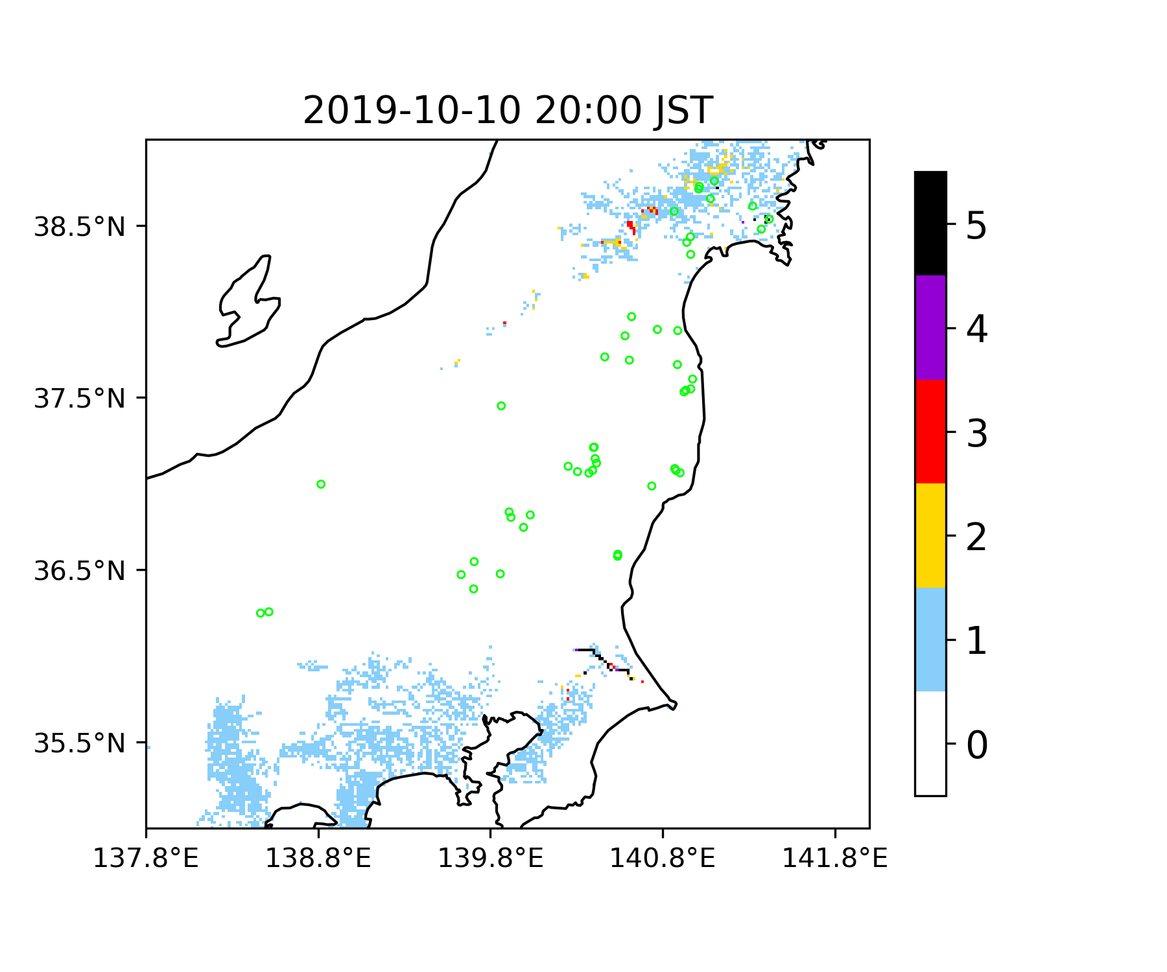
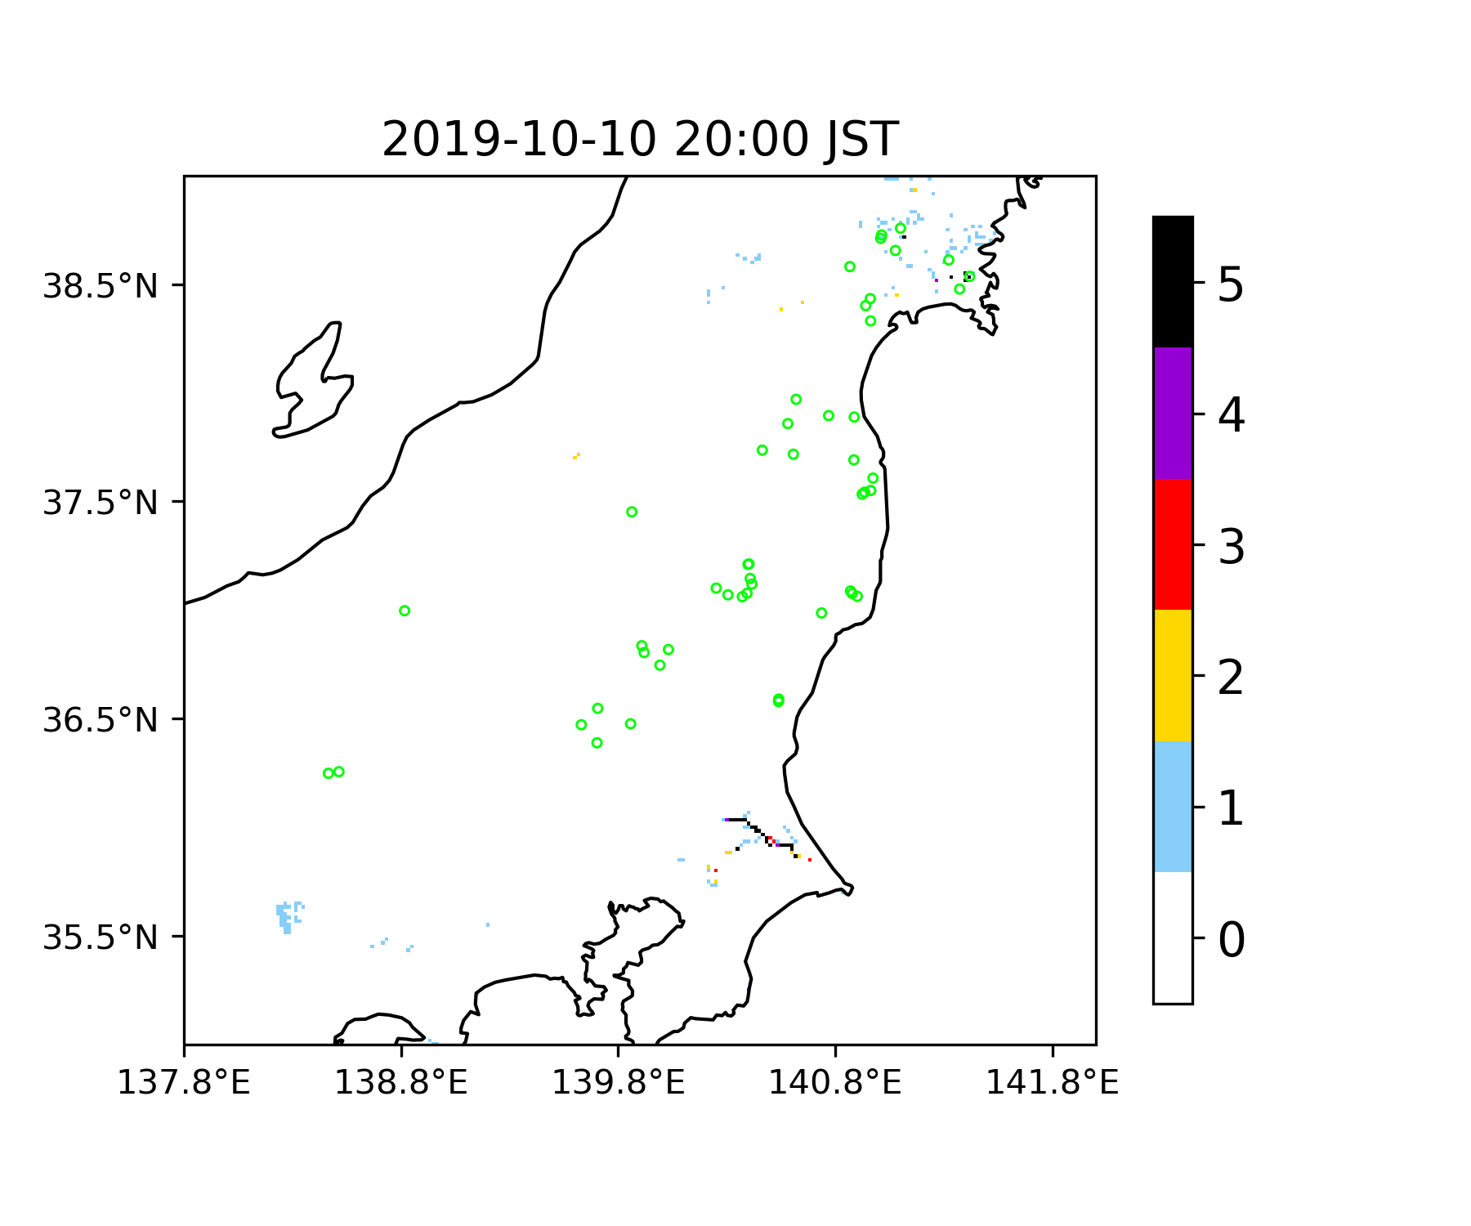
V1 (current)
V2 (3hr)
V3 (3hr_area01
_all)
V4 (3hr_area01
_level5)
V5 (2series)
V6 (2series
_3hr)

Slide 6
Contigency table statistics calculated from examined cases
 |  | level | TPR | FPR | PPV
V1 | Current (1hr) | 1 | 1.0000 | 0.5253 | 0.0013
 |  | 2 | 0.9608 | 0.3807 | 0.0017
 |  | 3 | 0.9314 | 0.3086 | 0.0021
 |  | 4 | 0.8627 | 0.2558 | 0.0023
 |  | 5 | 0.8039 | 0.2229 | 0.0025
V2 | 3hr | 1 | 1.0000 | 0.5237 | 0.0013
 |  | 2 | 0.9608 | 0.3773 | 0.0018
 |  | 3 | 0.9314 | 0.3036 | 0.0021
 |  | 4 | 0.8627 | 0.2479 | 0.0024
 |  | 5 | 0.8039 | 0.2113 | 0.0026
V3 | 3hr_area01_all_level | 1 | 0.9804 | 0.5154 | 0.0013
 |  | 2 | 0.9608 | 0.3727 | 0.0018
 |  | 3 | 0.9314 | 0.2982 | 0.0022
 |  | 4 | 0.8627 | 0.2447 | 0.0024
 |  | 5 | 0.7843 | 0.1994 | 0.0027
V4 | 3hr_area01_level5 | 1 | 1.0000 | 0.5237 | 0.0013
 |  | 2 | 0.9608 | 0.3773 | 0.0018
 |  | 3 | 0.9314 | 0.3036 | 0.0021
 |  | 4 | 0.8627 | 0.2479 | 0.0024
 |  | 5 | 0.7843 | 0.1994 | 0.0027
V5 | 2series_3hr | 1 | 1.0000 | 0.4811 | 0.0014
 |  | 2 | 0.9608 | 0.3448 | 0.0019
 |  | 3 | 0.9314 | 0.2819 | 0.0023
 |  | 4 | 0.8431 | 0.2364 | 0.0025
 |  | 5 | 0.8039 | 0.1977 | 0.0028
V6 | 2series_6hr | 1 | 1.0000 | 0.4857 | 0.0014
 |  | 2 | 0.9608 | 0.3447 | 0.0019
 |  | 3 | 0.9216 | 0.2803 | 0.0023
 |  | 4 | 0.8431 | 0.2344 | 0.0025
 |  | 5 | 0.8039 | 0.1885 | 0.0029
Data used:
Forecast alert levels calculated from each case from 2019/10/10 9:00 JST to 2019/10/14 8:00 JST
Observation based on dam break (Ma-san): 125 locations
For each grid:
TP: dam break observed & any time during the period (10/10 9:00 -10/14 8:00) provides alert level >= specified level (1-5)
True Positive Rate
$$TPR= \frac{TP}{TP+FN}$$
False Positive Rate
$$FPR= \frac{FP}{FP+TN}$$
Positive Prediction Value
$$PPV= \frac{TP}{TP+FP}$$
Summary:
All cases reduced FPR for all levels, espeically v6
Adding uparea as threshold (v3, v4) causes the decrease of TPR when using level 5 to decide flood or not
Using two 39 hr forecasts to decide alert level decrease TPR when using level 4 to decide flood or not, but not for level 5

Slide 7
Alert lead time calculated from examined cases
Among 125 locations, 77 locations provide dam break time
Among the 77 locations, for each location, find the earliest time (2019/10/10 9:00 JST – 2019/10/14 8:00 JST) when forecast provide alert >= specific level
Compute the time difference between observed dam break time and the earliest alert time (DBT – the earliest alert time)
Table 1. Dam break event captured by finding alert >= speicific level (1 to 5)
Level | v1 | v2 | v3 | v4 | v5 | v6
5 | 65 | 65 | 64 | 64 | 65 | 65
4 | 68 | 68 | 68 | 68 | 67 | 67
3 | 74 | 74 | 74 | 74 | 74 | 74
2 | 76 | 76 | 76 | 76 | 76 | 76
1 | 77 | 77 | 76 | 77 | 77 | 77
Summary:
From table 1: The same as findings in the previous page, adding uparea as threshold cause reduced hit when using level 5 to decide flood or not; using two 39 hr forecasts to calculate alert caused reduced hit when using level 4 to decide flood or not.
From table 2: Using two 39 hr forecasts to calculate alert level cause reduced time difference between DBT and the earliest alert
V2 (one 39 hr forecast, 3 hours) does not change current hit condition and time difference.
Table 2. Averaged time difference between DBT and the earliest alert >= specific level time at captured locations; in the unit of [hr]
Level | v1 | v2 | v3 | v4 | v5 | v6
5 | 10.35 | 10.35 | 10.15 | 10.15 | 9.90 | 9.70
4 | 13.23 | 13.23 | 13.20 | 13.23 | 12.81 | 12.96
3 | 20.33 | 20.33 | 20.24 | 20.33 | 19.79 | 19.79
2 | 33.89 | 33.89 | 33.72 | 33.89 | 32.70 | 32.68
1 | 47.13 | 47.13 | 47.15 | 47.13 | 43.93 | 43.92

Slide 8
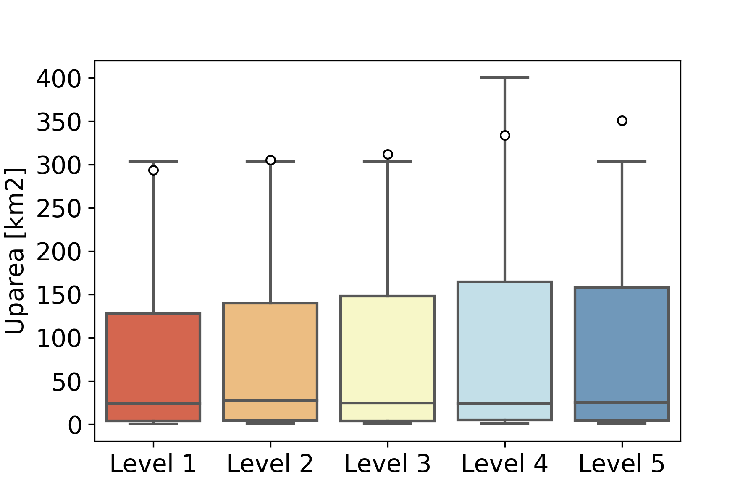
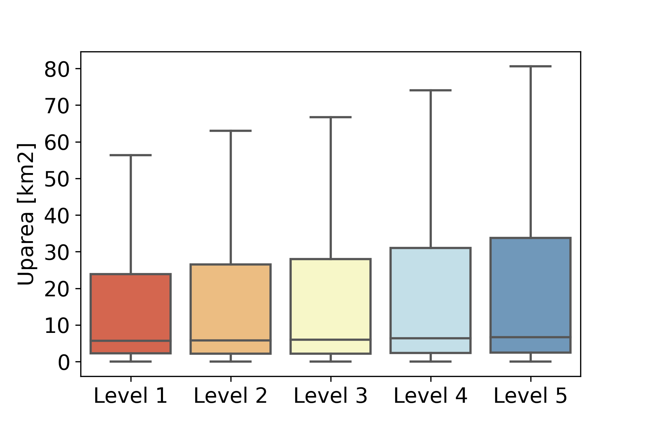
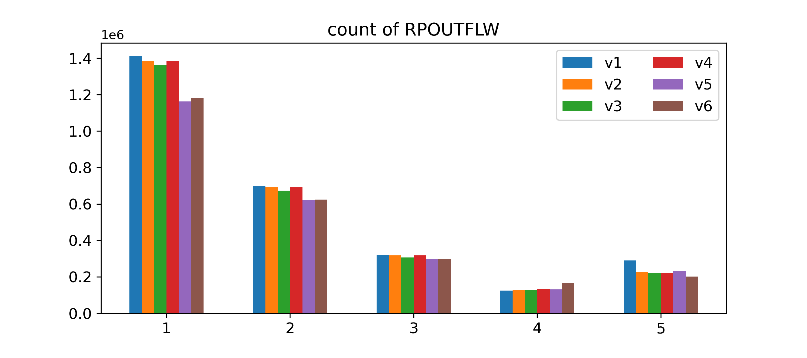
Additional Figures
Boxplot of upareas of grids providing true postivie (TP) prediction
Boxplot of upareas of grids providing false postivie (FP) prediction
Used the boxplot to decide threshold of uparea
TP grids also have many grids with small uparea
use uparea as threshold may caused reduced hit rate
Count of alerts for levels 1-5 from each case between 2019/10/10 9:00 and 2019/10/14 8:00 JST
Count
Level

Slide 9
Conclusions:
V2:
Use three hours from the same 39 hr forecast can reduce false alerts, maintain the hit rate and earliest alert time, but the false alarm that can be reduced (especially for level 5) is limited.
V3/V4:
Adding uparea as threshold reduced false alarm, but also reduced hit rate → suggest not to use uparea as threshold
(also tried other threshold values except 1km2, but smaller threshold values had limited effects in reducing false alert, and larger threshold caused larger reduced hit rate)
V5/V6:
Using two 39 hr forecasts can best reduce false alerts and maintain the hit rate at level 5, but it may reduce hit rate when using level 4 to decide flood or not; it also delayed the earliest alert for flood.
→ Maybe modification on V5/V6 (if conditions used in page 3) can help solve the delayed earliest alert issue?

